Slide 1

The Countryside Code

Slide 2
The Countryside code
Respect Everyone
Protect the Environment
Enjoy the outdoors

Slide 3
Respect Everyone
The Countryside code
Be considerate of those living, working and enjoying the countryside
Leave gates and property as you find them

Slide 4
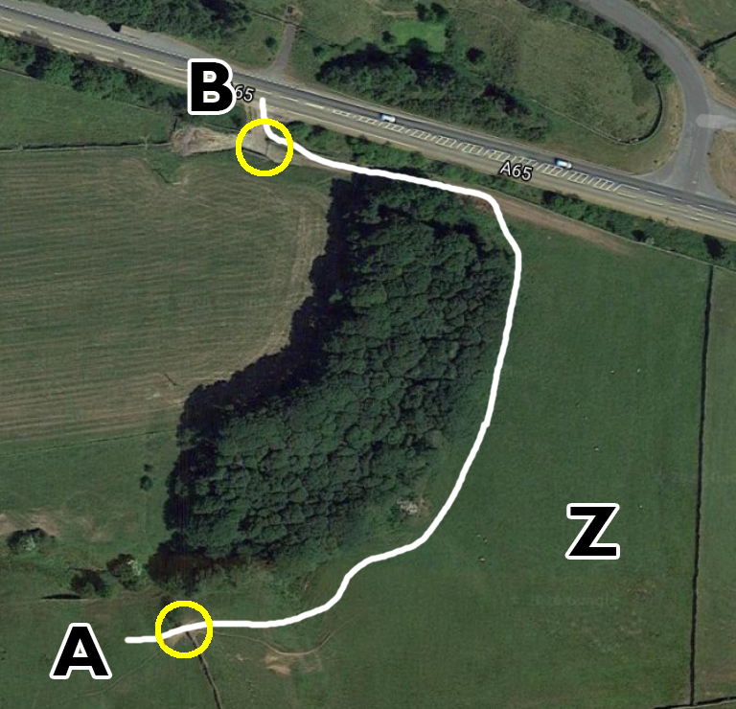
Respect Everyone
The Countryside code
Lots of sheep in field A, some sheep in field Z
Gates at the yellow circles are both open.
Would you leave them open or close them as you pass through?
Notes:
This exercise is in the workbook too

Slide 5
Respect Everyone
The Countryside code
Be considerate of those living, working and enjoying the countryside
Leave gates and property as you find them
Be nice, say hello
Follow local signs and keep to paths unless on Access Land
Notes:
On follow local signs and keep to paths, don’t climb walls or fences

Slide 6
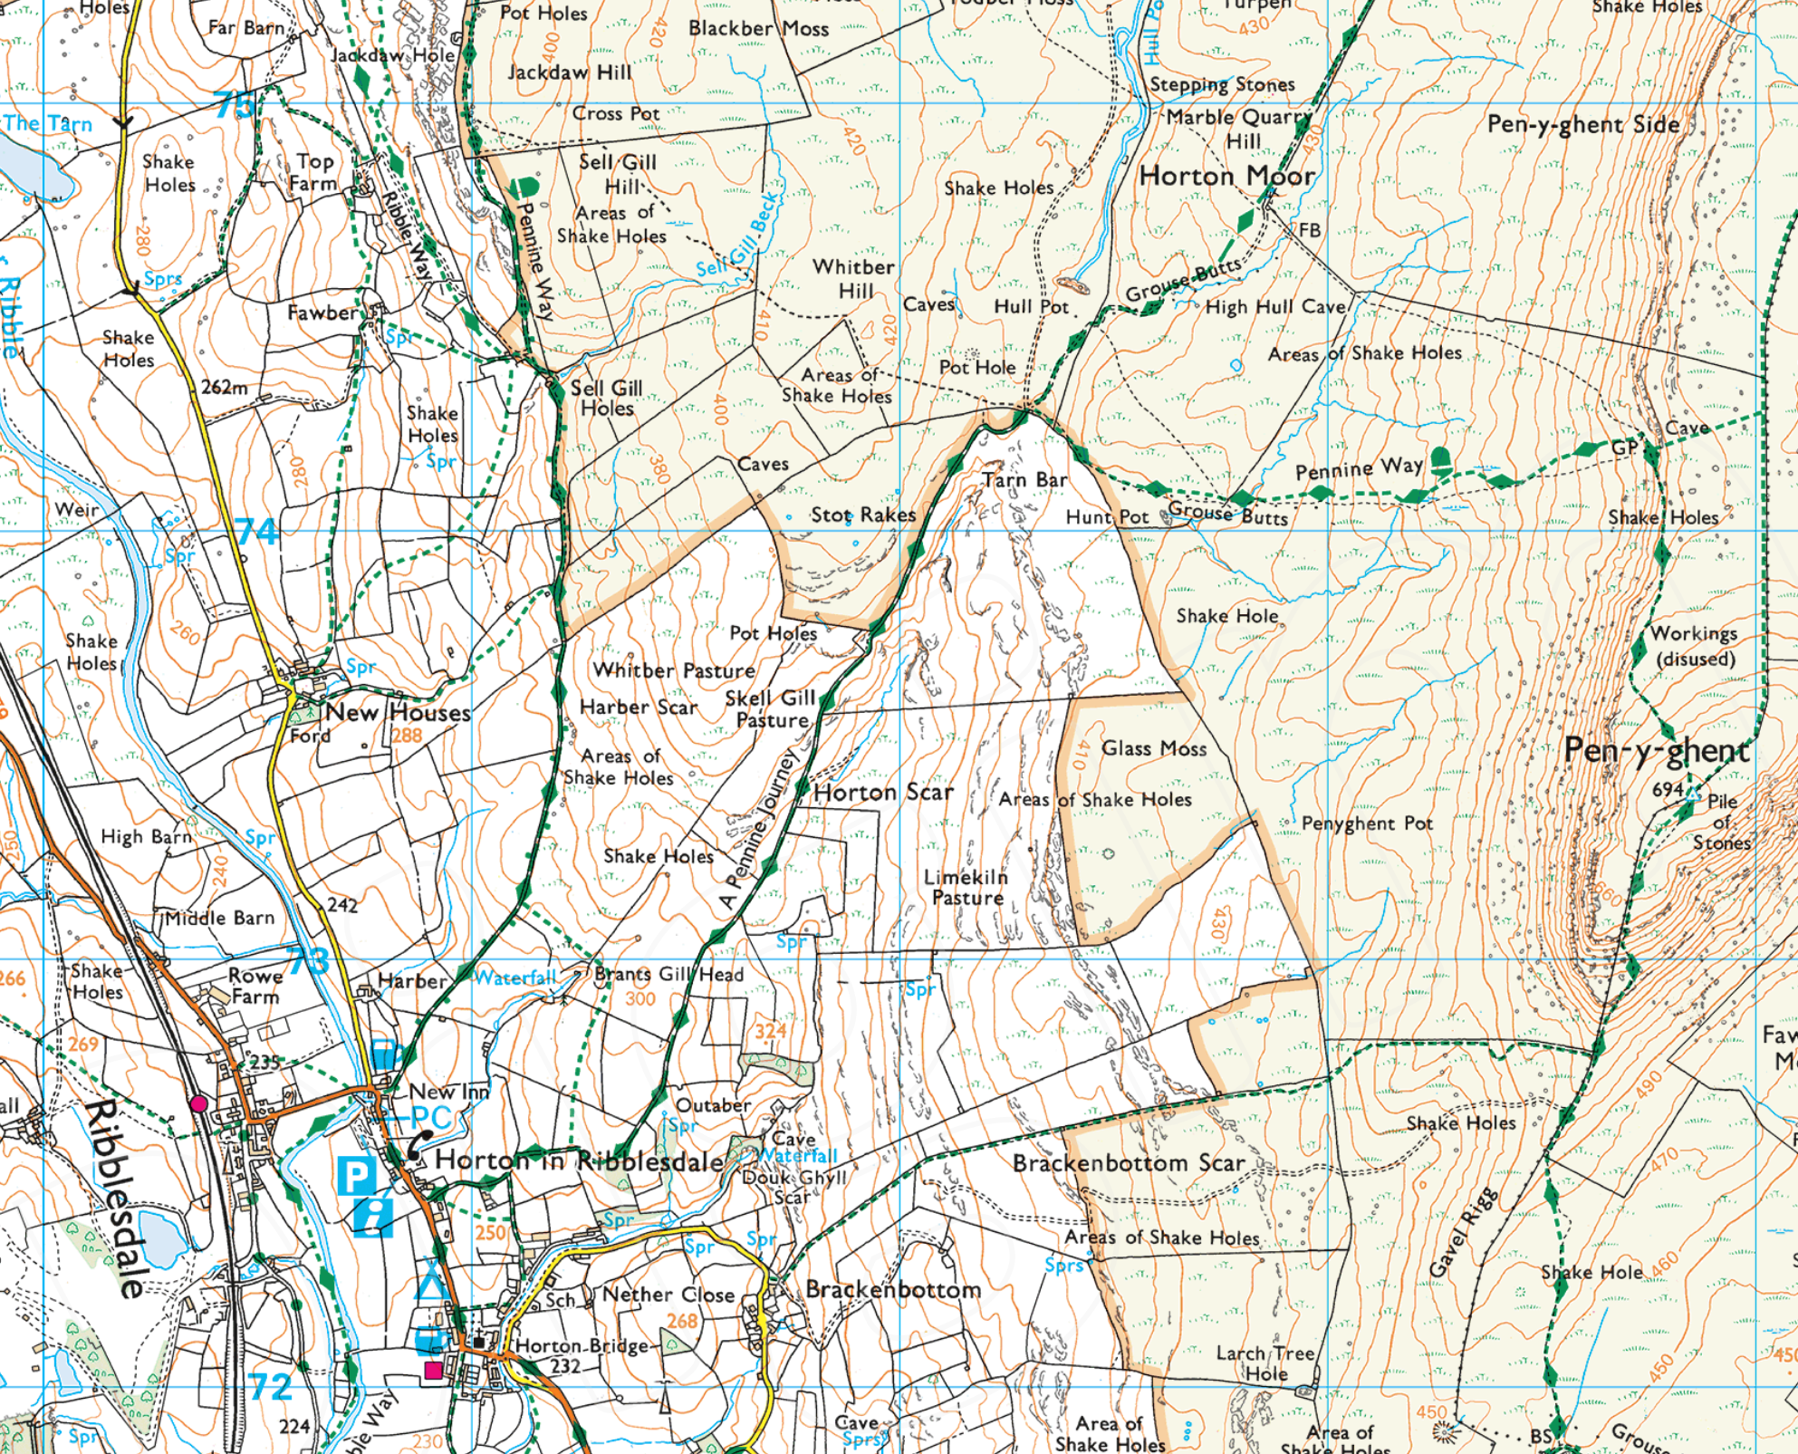

Respect Everyone
The Countryside code
Notes:
This is access land, this logo is often on styles as you enter access land

Slide 7
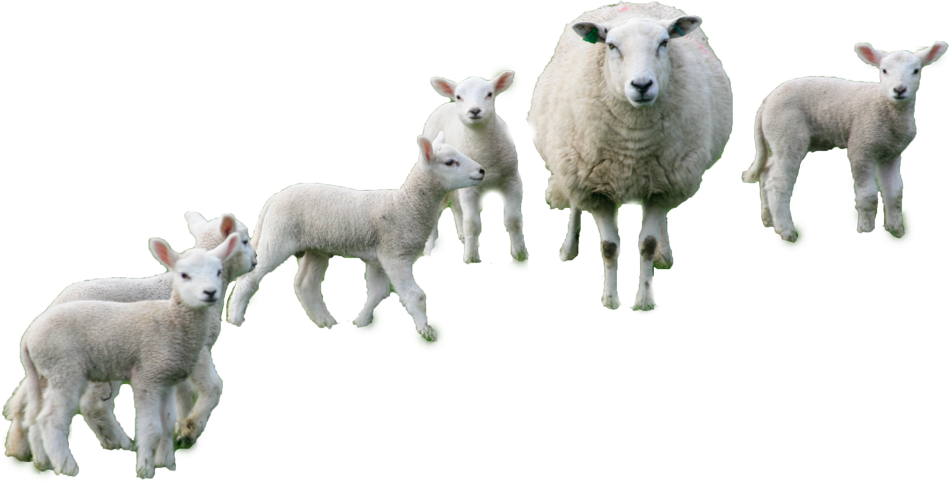
Protect the environment
The Countryside code
Take your litter home – Leave no trace
Think about erosion
Don’t go to the toilet close to streams
Don’t wash up in streams
Be careful with fire
Take care around animals
Notes:
Take your litter home, what about banana skins, orange peal, apple cores
Single file, walk on the path not next to it

Slide 8
Enjoy the outdoors
The Countryside code
Check your route and local conditions
Plan your adventure, know what to expect
Enjoy your visit
Notes:
Check for access land closures
Check the weather and weather history (water levels)
Go prepared, the better prepared you are the more comfortable you will be

Slide 9
Information for teachers and instructors
This presentation is designed for use alongside our ‘Course notes’ and ‘Workbook’ booklets, and lesson plans all of which are downloadable for free from our website https://www.lupineadventure.co.uk/downloads/dofe-downloads.html
or google ‘Lupine DofE downloads’.
The presentations are designed so that they can be used at all DofE levels simply tailor the depth that you go into each subject and maybe skip some slides accordingly.
The presentations are designed to be used in a classroom or remotely over Zoom / Teams etc. One of the versions of the Workbook is editable so you can ask students to fill this in and email to you, alternatively, on our website there are Google and Microsoft Forms relating to some lessons that you can copy to your accounts and share with students.
You are free to edit the presentation for your organisation however you wish but please don’t distribute further, we would rather you point people to our website.
If you would like to be informed of future releases then subscribe to our mailing list from our website.
If you would like early copies of, and to be involved in shaping, future resources then join our Facebook group for this purpose https://www.facebook.com/groups/859994524494945/
Lupine Adventure Co-op are an approved activity provider for the expedition section of the DofE. Please do get in touch if you would like assistance with running any part, or all of your expedition programme.

