Slide 1
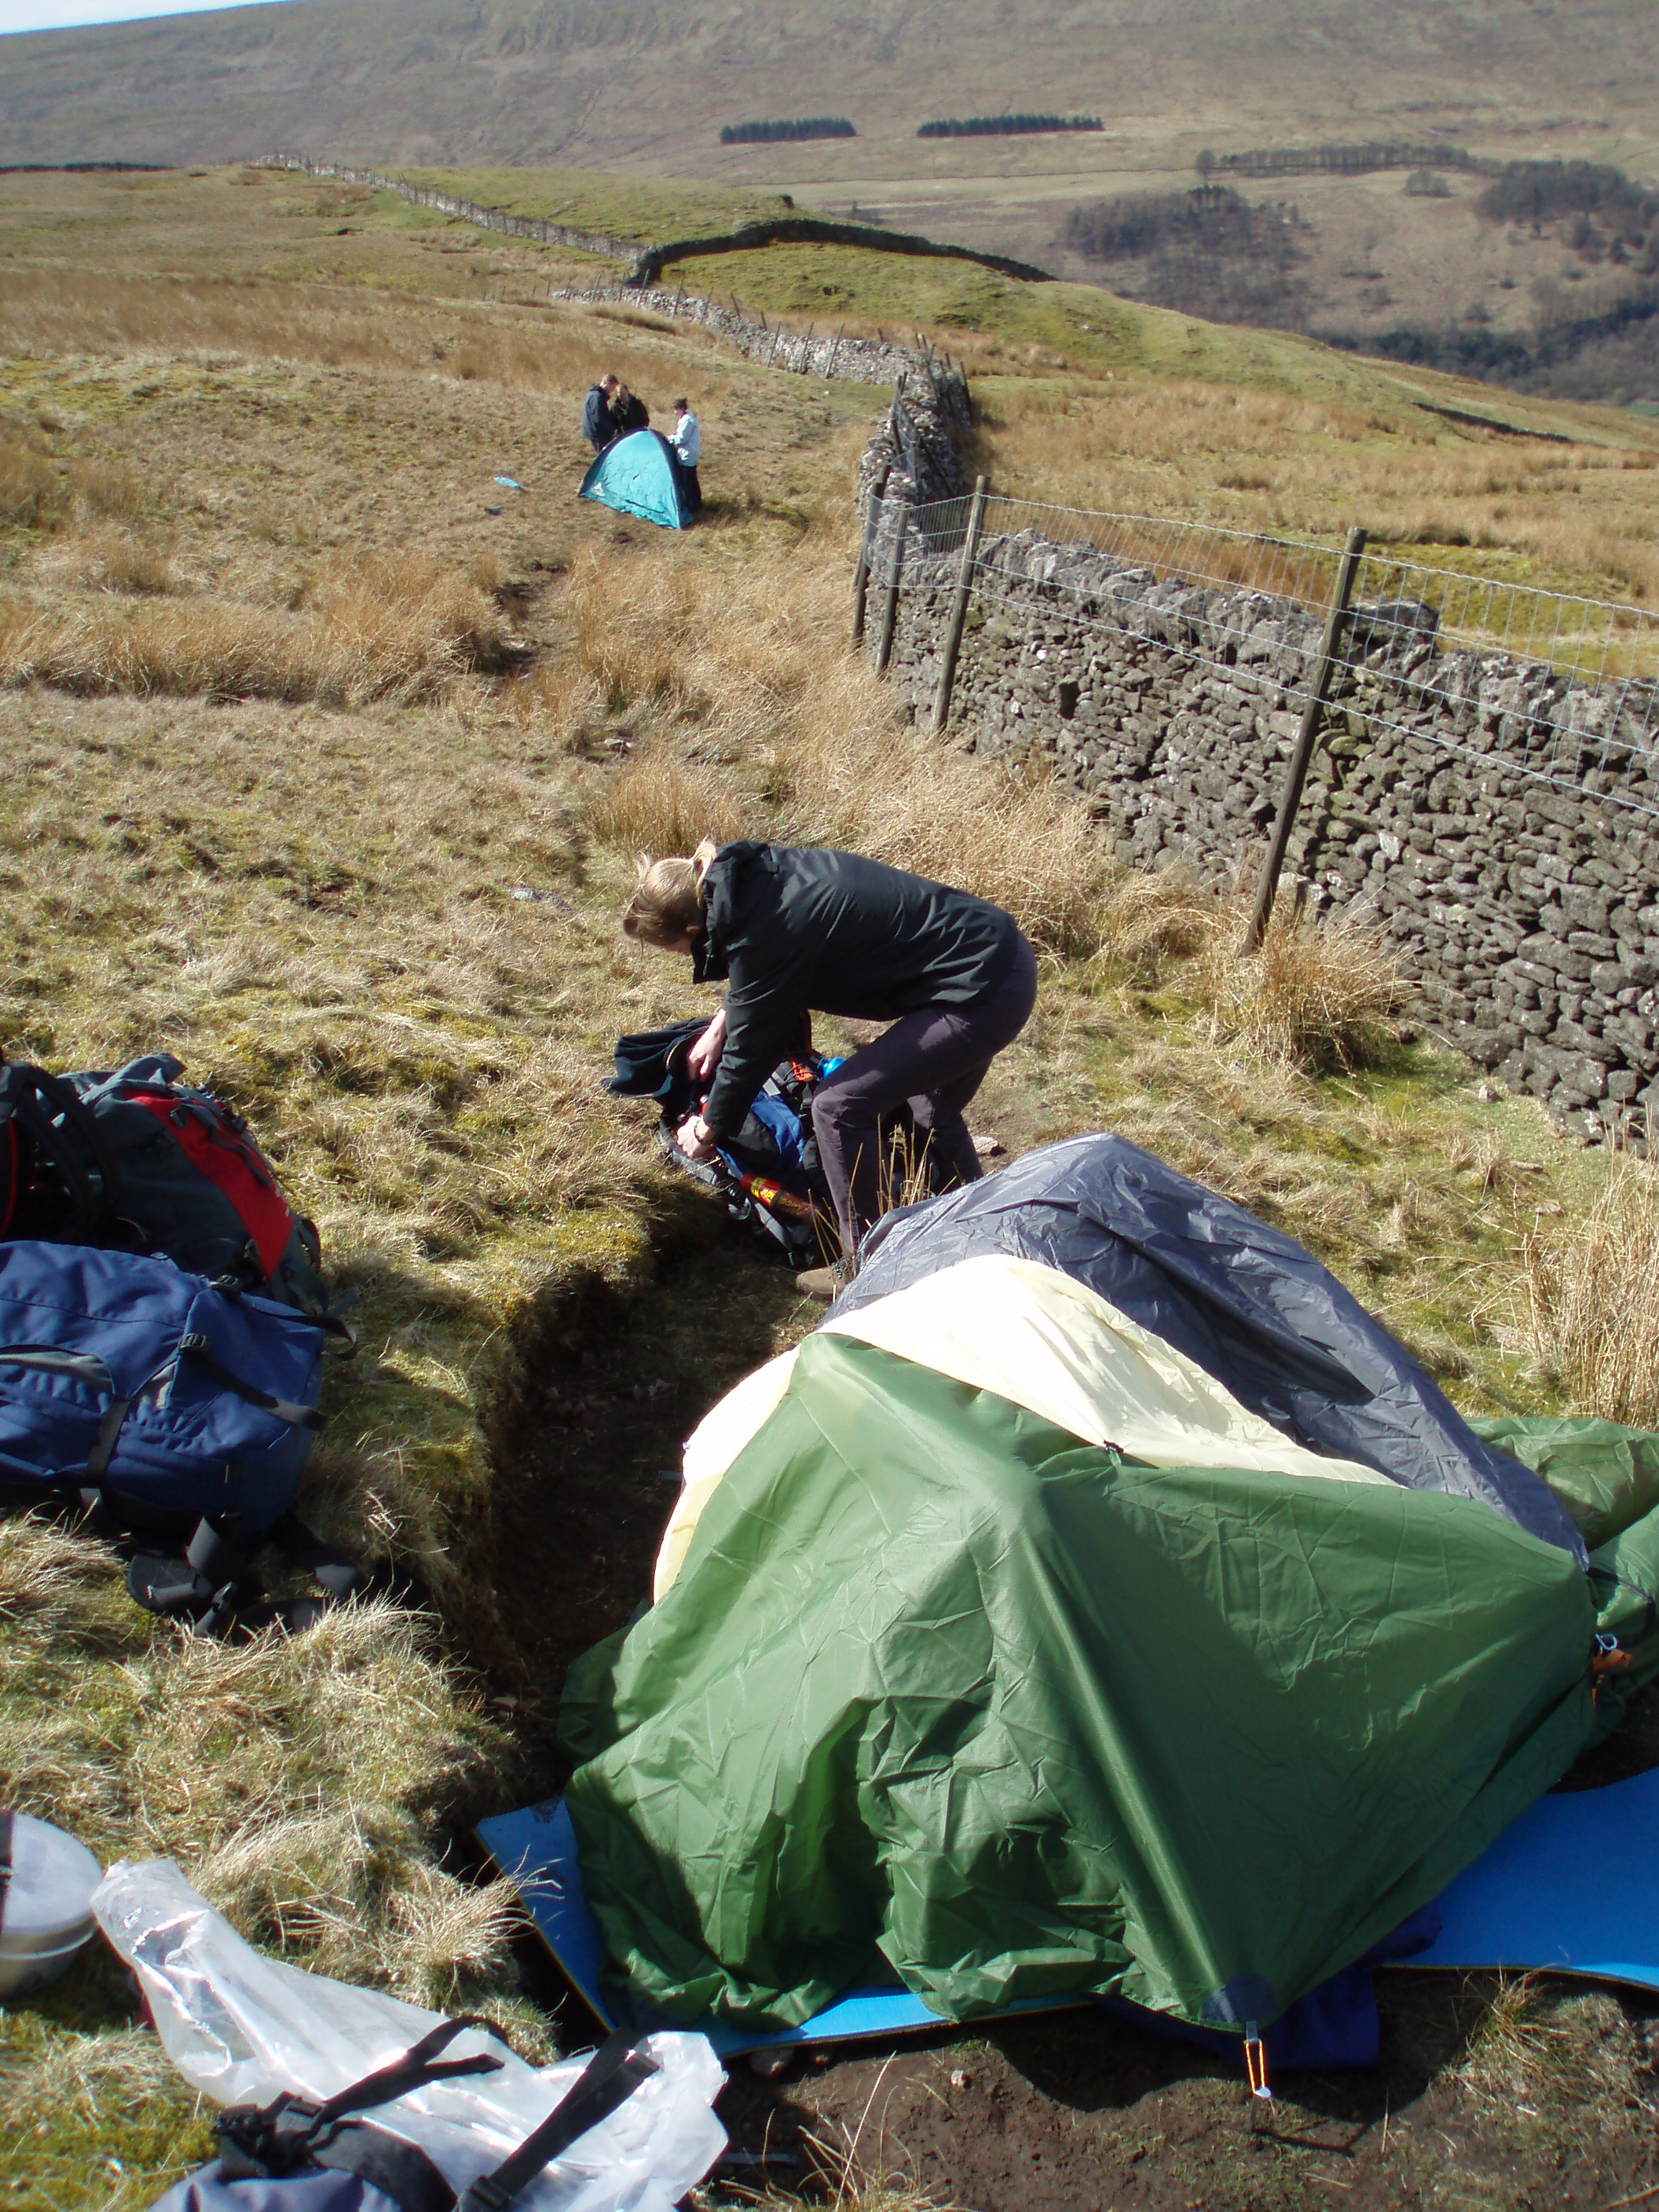
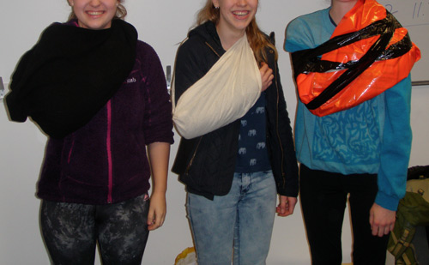
Emergency Procedures and First Aid

Slide 2
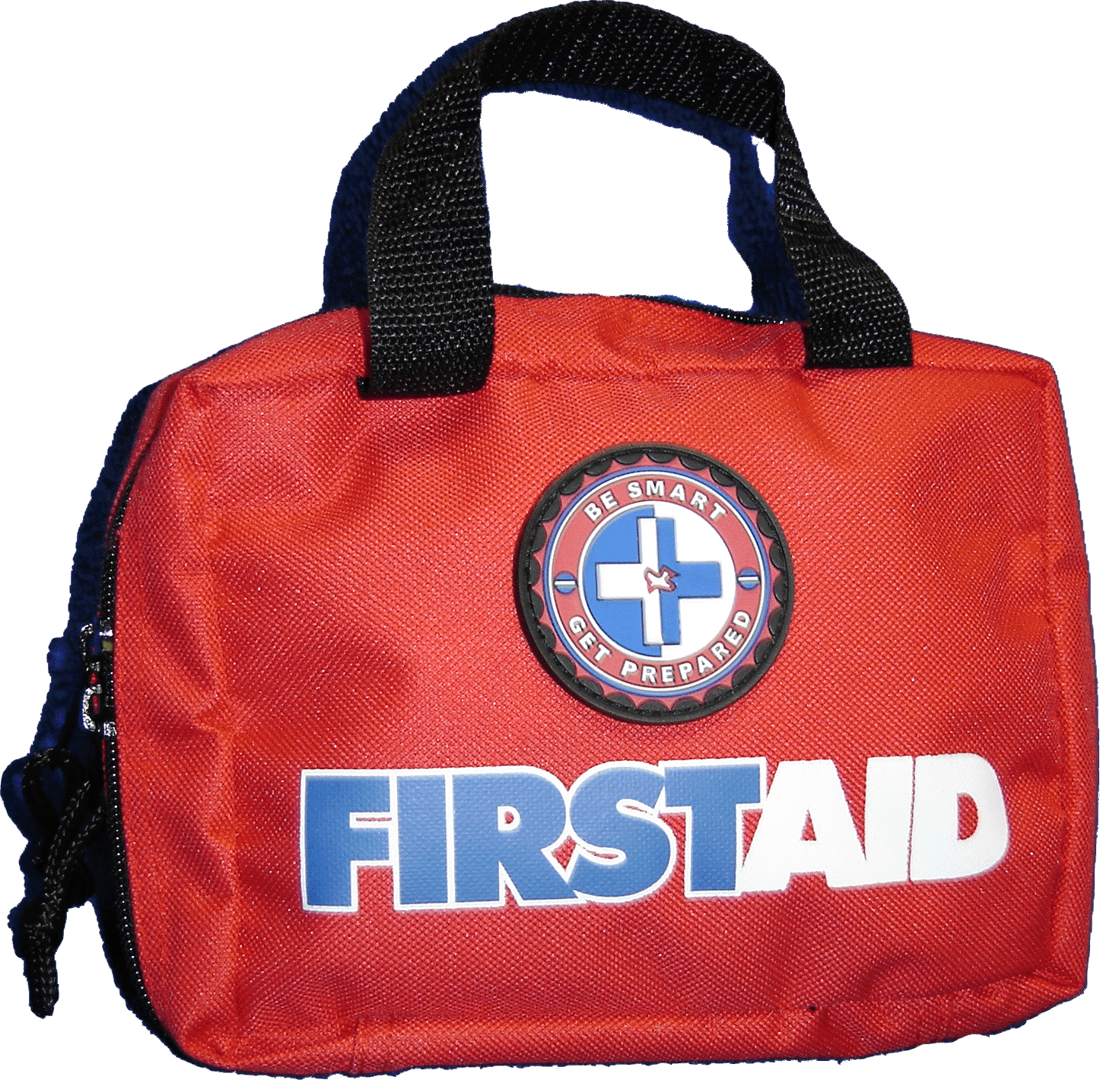
Emergency Procedures and First Aid
Emergency procedures
Evaluate the situation
Stop the situation getting worse
Apply first aid if necessary
Do you need help? If so from whom?
Does your supervisor need to be informed anyway
Notes:
<click> ensure what you do is safe, put on warm clothing if necessary etc
<click> Apply first aid
<click> Help can be summoned by shouting, whistling (6 long blasts) texting, phoning (if leaving a voice mail always send by text as well) or maybe some sort of PLB, or even walking to a building or hill top
<click> If it is a minor incident that you sort out you may need to text your supervisor anyway to say that all is ok but you are delayed

Slide 3
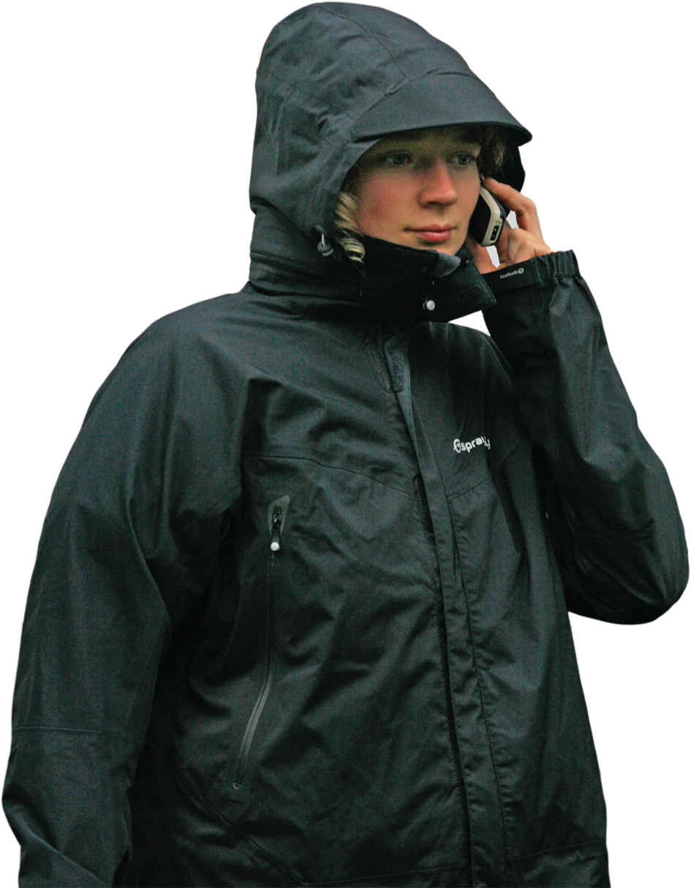
Emergency Procedures and First Aid
Emergency procedures
Calling the emergency services
Dial 999 ask for the police and tell them that you need mountain rescue (if remote)
They will ask lots of questions. Either before you call or as you are calling, have someone write down;
  Location
  Other phone numbers in the group
  Supervisors phone number
Notes:
<click> Ask for the police. They may well take all sorts of details before passing it on to MR then you may have to go through it again.
<click> They will ask lots of questions most of them you will be able to tell them like, who is injured, what the injuries are, are you safe or is there a danger of thigs getting worse. But some information you will need to work out or find.
<click> location. Other phone numbers in case your battery dies or if they have better signal to receive a text message for their locating system. Your supervisors number so they can tell us there is a problem (you may only have a signal for 999)

Slide 4
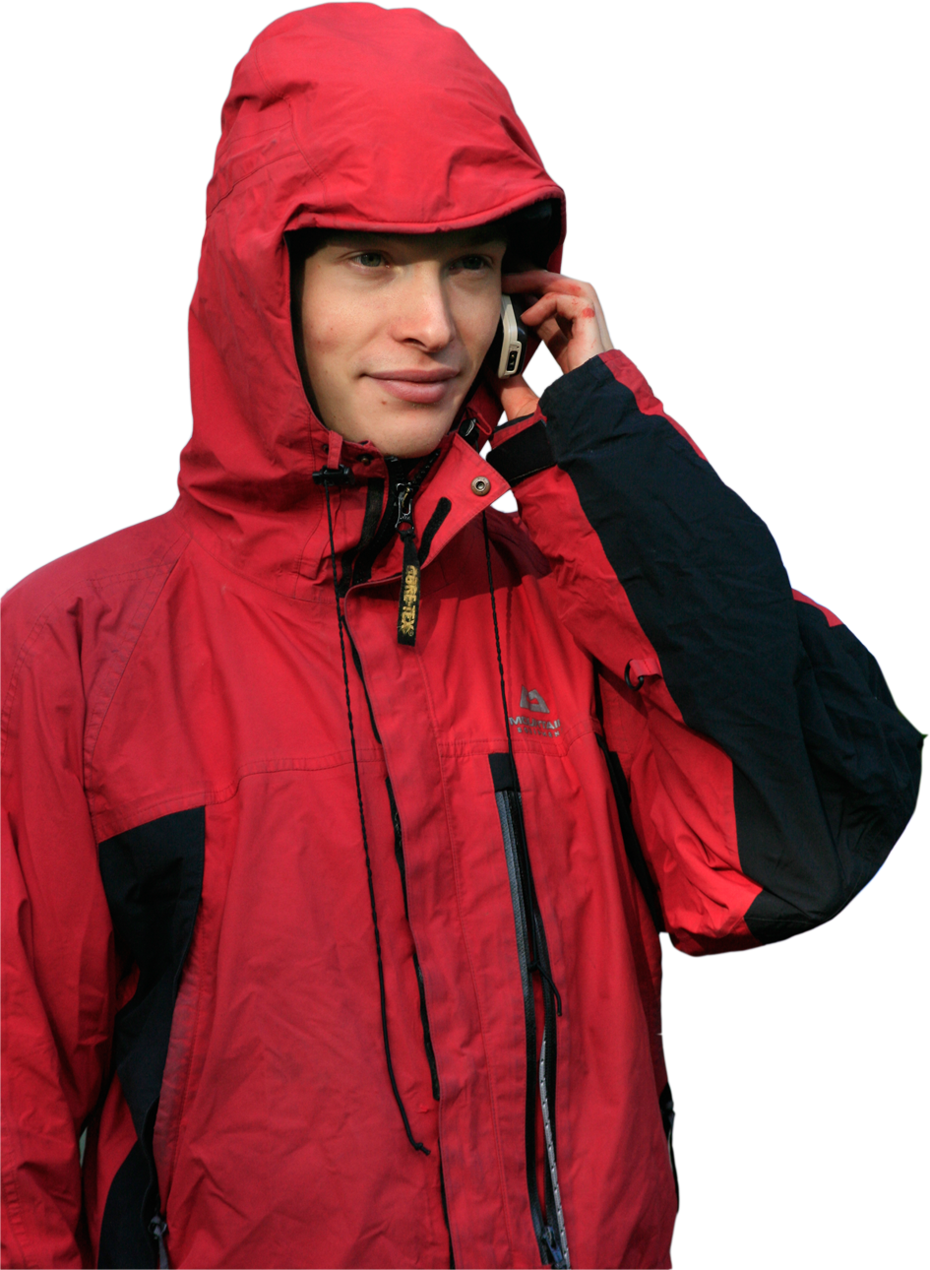
Emergency Procedures and First Aid
Emergency procedures
Texting the emergency services
Intended for the hard of hearing
Register your phone by sending a text with the word ‘register’ to 999
Police – details of incident - location
Police – Broken leg – Brecon beacons 993 834
Police – Broken leg – TQ645 543
Police – Broken leg – Goat Fell TQ645543
Notes:
<click>
It will text back asking to confirm, follow instructions
This is the format
<click> here are some examples (maybe give a bit more info than just broken leg that is for illustration purposes)
<click> Mention the Grid reference letter prefix
<click> mention putting other references like hill names is good to confirm

Slide 5
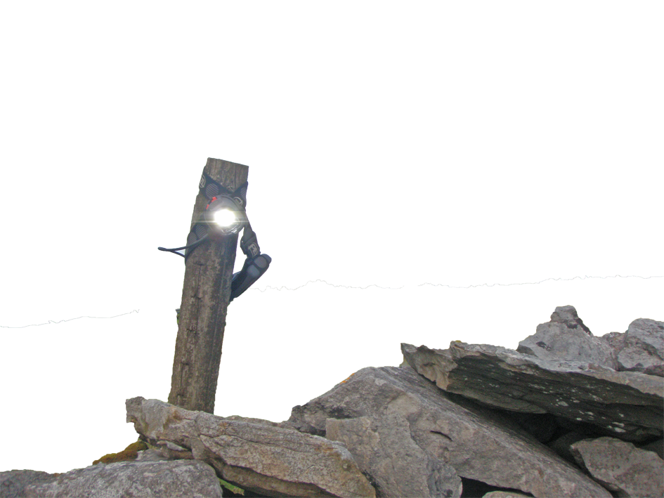
Emergency Procedures and First Aid
Emergency procedures
Going for help
Decide where to go for help
Write down all important information of casualties and location. Make sure those staying know where you have gone
Make sure there are two of you to go together
Take enough equipment to ensure your safety
When you get in contact get clear instructions or agreement on what you should do next (stay put? go back to team?)
Notes:
<click><click><click><click><click>The survival bag and torch on a pole shown are for if you are just off a path, you can say go to the flashing torch and we are 50 meters to the east

Slide 6
Emergency Procedures and First Aid
First aid
The three broad areas of an outdoor education first aid course
Injuries and ailments
Unresponsive casualty procedure
Cardiopulmonary resuscitation (CPR)
Only going to cover injuries and ailments in this presentation
Notes:
Who has done some first aid training?
What have they done?
What was covered?
Advise that first aid training is a good thing to do.
First aid is a massive topic.
As someone working in outdoor education I have to have a 16 hour (2 day) course every 3 years.
That course covers 3 broad area’s
<click> <click><click> <Click>
We’re not going to cover CPR and un-responsive casualty procedure as they are big topics within themselves and really require a lot of covid unsafe moving about
Do a first aid course – google St johns ambulance dofe self teach workbook

Slide 7
Emergency Procedures and First Aid
Possible injuries & ailments
Blisters
Cuts and scrapes
Breaks, sprains and strains
Tick bites
Burns and scalds
Heat exhaustion
Sickness
Anaphylaxis
Asthma attack (serious)
Hypothermia
This is not an exhaustive list of possible injuries but the ones that we have dealt with over the last 14 years
Notes:
Ask the group for examples of possible injuries
<Click>
<click>
This is a list of first aid issues that we have had to deal with over the last 14 years pretty much in order of frequency.
From blisters which happen all the time down to Hypothermia which we have never had

Slide 8
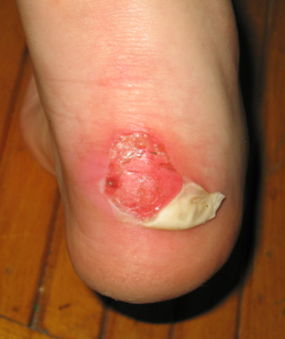
Emergency Procedures and First Aid
Blisters
Prevalence: A lot
Prevention
Treatment
Well fitting boots
Clean dry socks
(Some say 2 pairs is good)
Early treatment
Blister plasters
Don’t burst
Keep it covered
Notes:
Most people treat their own blisters so we don’t get to hear about them
<click>
Break in new boots <click>
Clean socks next to skin each day, try and keep feet dry (talk about how?) <click>
Treat as soon as you feel a hot spot <click>
Plasters will do, gaffa tape will do <click>
Bursting will make an infection more likely <click>
Keep it covered (if it does burst then clean and keep covered)
ASK if anyone minds a horrible photo, if they do then press
The number of the next slide then <enter> to skip to the next slide or <click>
Talk about cutting off flap, cleaning and covering

Slide 9
Emergency Procedures and First Aid
Cuts and scrapes
Prevalence: 20-30 a year
Prevention
Treatment
Taking care on steep, uneven or slippery ground
Covered limbs?
Clean
Dry
Cover
Monitor, re-clean, re-dry, re-cover
Notes:
<click>
The worst of these types of injuries happens through falling over
Covering limbs prevents scratches (knees !!) (but are you going to do that??)
<click>
Important to clean, dry and cover even cuts that you wouldn’t normally bother with
<Click>
Consider uncover over-night then re-dress in the morning

Slide 10
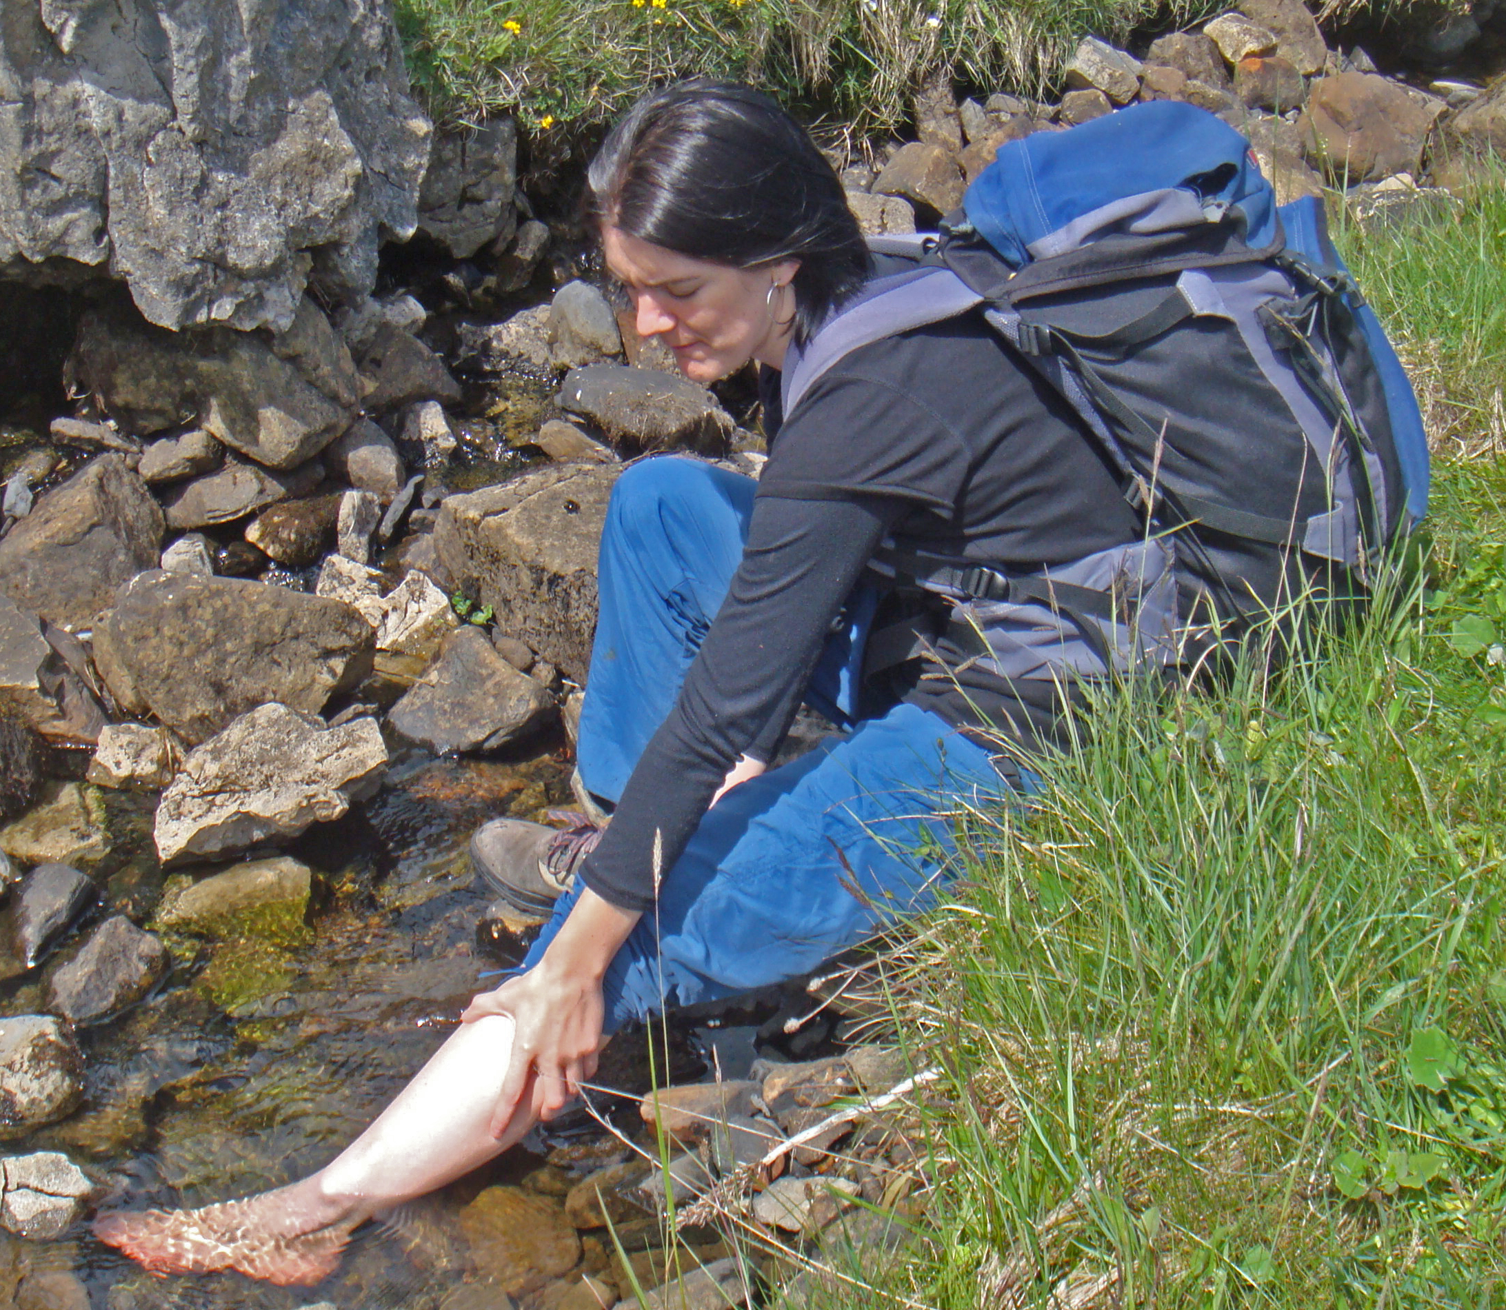
Emergency Procedures and First Aid
Breaks, sprains and strains
Prevalence: 10 per year
Prevention
Treatment
Good tread on footwear
Taking care on wet, slippery, uneven and steep ground
Taking care on stiles
Fitness
Rest
Ice (cool)
Compress
Elevate
RICE
Notes:
Breaks are very rare, sprains and strains are more common
<click>
Good tread<click> taking care, this kind of Injuries occur when falling over (extra weight on back) <click> stiles, people do jump from them sometimes
<click>
If you are fitter and stronger then your joints will be more stable
<click>
Basic Rice
Ice – mean cool,
Compress – bandage
Elevate

Slide 11
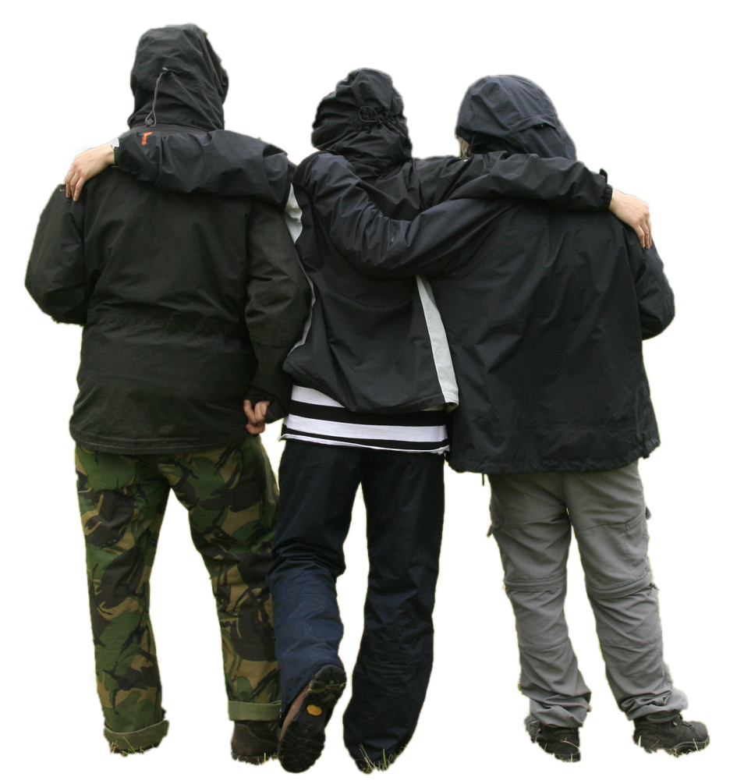
Emergency Procedures and First Aid
Breaks, sprains and strains
Leg injury treatment – possible process
Sit down for a bit (Rest)
You might take the boot off and have a look (is there swelling)
Try walking on it after a few minutes
Ice , Compress, Elevate
Do you need carrying off or help from your supervisor?
Can some of your team carry more kit?
Do not take pain killers to mask a mechanical injury to enable you to continue
Notes:
<Click>Sit down for a bit – Rest <click> <click> If it isn’t better after a few minutes you may want to give it longer and while you wait you could <click>
ICE<click>
It may be better but not ideal so if not better in 15-20 minutes need to consider other options<click><Click>

Slide 12
Emergency Procedures and First Aid
Breaks, sprains and strains
Arm injury treatment
Treat with RICE
Consider immobilising
Notes:
<click> Treat with Rice
<click> If it is painful unless held in a certain position then immobilise to free up the other hand

Slide 13
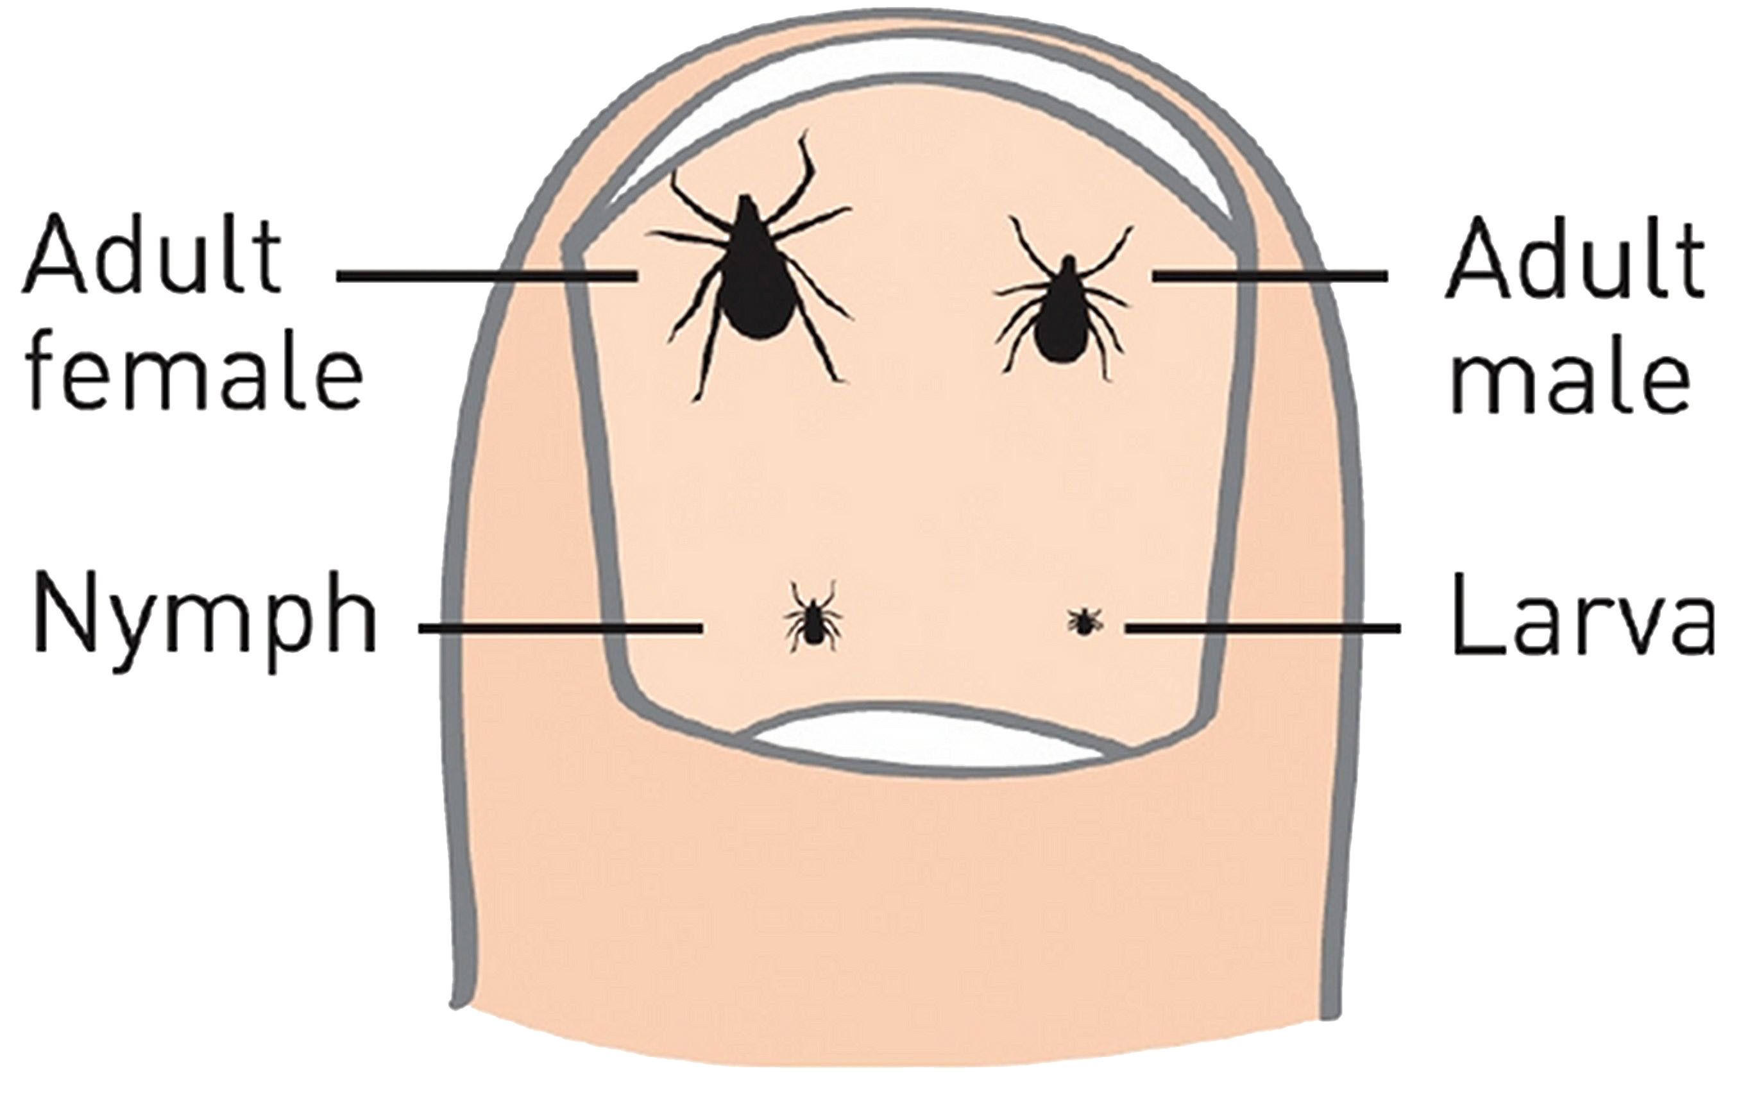
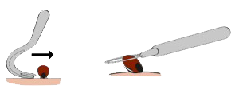
Emergency Procedures and First Aid
Tick bites
Prevalence: 4 a year
Prevention
Treatment
Cover limbs
Treat clothing with a repellent
Check exposed skin
Remove with a tick tool
Wipe with antiseptic
wipe
Notes:
Tick bites important due to lyme disease
Rare, very serious condition that is treatable if caught early
I’ve spent my life in the mountains much of it in shorts and have had one tick that I got in my 3m x 5m back garden in Leeds
<click>
I rarely wear shorts these days, <click>
I don’t treat my clothing as it is a pretty nasty chemical <click>
Check exposed skin< Click>if you do remove a tick then try and save it and send it to public health England’s tick surveillance scheme

Slide 14

Emergency Procedures and First Aid
Tick bites – Lyme Disease
Prevention
Treatment
Remove ticks within 24 hours of them attaching
Tell your supervisor you have had a tick bite
Read up on early symptoms of Lyme Disease
Blood test
Antibiotics
Notes:
<Click>
Getting a tick is rare, for that tick to have lyme disease is rare, for that tick to pass it on is even rarer. It is unlikely to pass lyme disease on if it is attached for less than 24 hours
<click> <click><click>
A blood test might be negative in the first couple of weeks since a bite <click>
The treatment is antibiotics, If you have a rash you should be treated immediately
Basically insist on a course of antibiotics

Slide 15
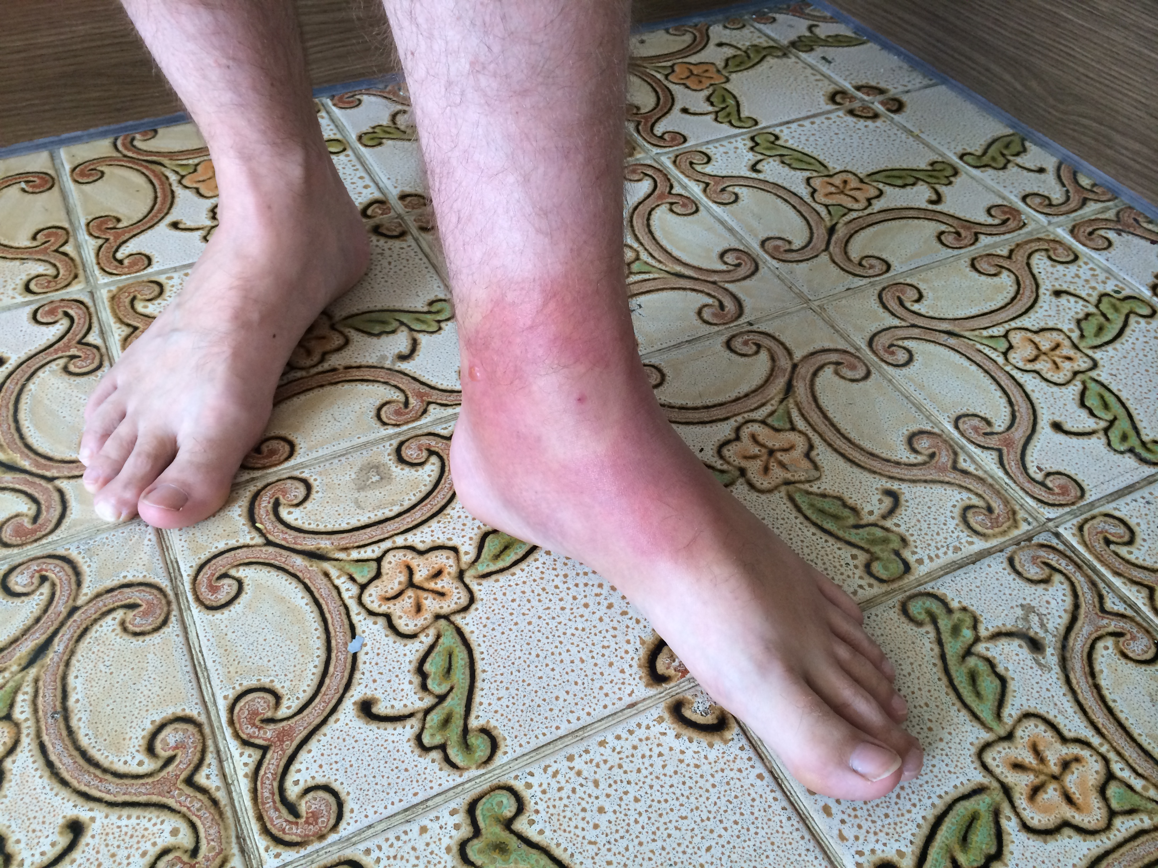
Emergency Procedures and First Aid
Tick bites – Lyme Disease
Symptoms can include
Bulls eye rash
Headaches
Stiff neck
Facial palsy
Extreme fatigue
Muscle and joint pain
Disturbances of sight, hearing,
co-ordination, digestive system and sleep

Slide 16
Emergency Procedures and First Aid
Burns and Scalds
Prevalence: 1 every few years
Prevention
Treatment
Care when cooking
Running water for at least 10 minutes
Dry
Dress
Tell supervisor
Notes:
<click> <click> <click>
10 minute rule is really, really hard and painful, take someone with you for encouragement
We would advise against cooking in the day time away from water source

Slide 17
Emergency Procedures and First Aid
Heat exhaustion
Prevalence: 1 or 2 every few years
Prevention
Treatment
Sun screen, hats and shirts
Drinking water
Eating food
Rest
Shade
Drinking water
Aggressive cooling
(applying water and fanning)
Notes:
<click>
Usually a lovely day, you’re having a great time and one of your friends starts acting really weird
<click>

Slide 18
Emergency Procedures and First Aid
Sickness
Prevalence: 1 or 2 every few years
Prevention
Treatment
Hand hygiene
Reporting symptoms
Physical distancing
Masks
Reduction of shared items
Isolate
Go home
Notes:
During Covid we haven’t had a problem
About 10 years ago we had half a team go home half way through a gold expedition
We all know about this stuff now
<click> number 1 hand hygiene
<click> report your symptoms so you don’t spread your illness. We’ve always taught these two but with covid we also<click><click><click>
Not really a treatment but it is the action we have to take

Slide 19
Emergency Procedures and First Aid
Anaphylaxis
Prevalence: 1 ever
Prevention
Treatment
Tell people if you have an allergy
Epi Pen

Slide 20
Emergency Procedures and First Aid
Serious Asthma attack
Prevalence: 1 ever
Prevention
Treatment
Preventative Drugs
Monitoring capacity (Rest)
Drugs
Remaining calm

Slide 21
Emergency Procedures and First Aid
Hypothermia
Prevalence: Never (not seriously)
Prevention
Treatment
Warm clothing
Waterproof and windproof clothing
Sufficient rest
Sufficient food
Early stage
Feed high energy food
Take some weight off
Keep moving (slowly)
Later stage
Get into shelter
Replace clothing
Notes:
Important to cover as it is possible and is life threatening
<click>
Can be thought of as cold exhaustion. Keep warm, <click> keep rested, <click> keep energy intake high.
There will be a slow build up and it is hard to detect in yourself (mention symptoms here)
<click>
Early stage, feed sugar, take some things from bag keep moving slowly
If that doesn’t help
Get shelter, replace wet clothes (or put more clothing over the top
If serious put up a tent and get in sleeping bags. Get help

Slide 22
Information for teachers and instructors
This presentation is designed for use alongside our ‘Course notes’ and ‘Workbook’ booklets, and lesson plans all of which are downloadable for free from our website https://www.lupineadventure.co.uk/downloads/dofe-downloads.html
or google ‘Lupine DofE downloads’.
The presentations are designed so that they can be used at all DofE levels simply tailor the depth that you go into each subject and maybe skip some slides accordingly.
The presentations are designed to be used in a classroom or remotely over Zoom / Teams etc. One of the versions of the Workbook is editable so you can ask students to fill this in and email to you, alternatively, on our website there are Google and Microsoft Forms relating to some lessons that you can copy to your accounts and share with students.
You are free to edit the presentation for your organisation however you wish but please don’t distribute further, we would rather you point people to our website.
If you would like to be informed of future releases then subscribe to our mailing list from our website.
If you would like early copies of, and to be involved in shaping, future resources then join our Facebook group for this purpose https://www.facebook.com/groups/859994524494945/
Lupine Adventure Co-op are an approved activity provider for the expedition section of the DofE. Please do get in touch if you would like assistance with running any part, or all of your expedition programme.

