Slide 1
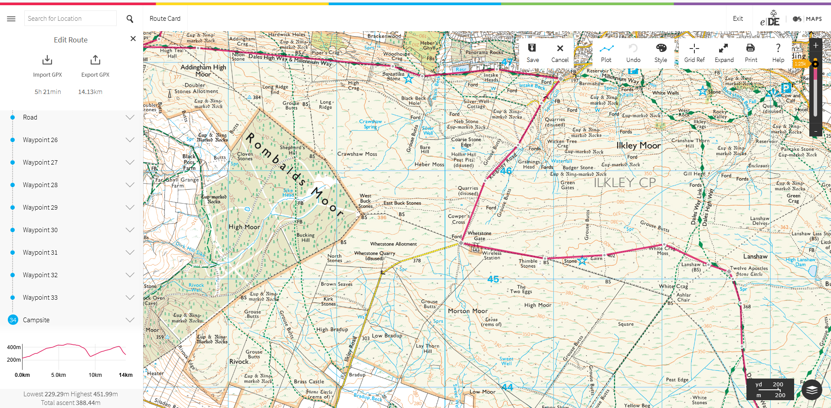
Planning a route using e-DofE mapping

Slide 2
Route planning using eDofE
Why route plan?
To ensure that a viable route exists
To ensure that you are out for the required amount of time
To ensure you aren’t out for too long
To make sure you take in close by places of interest
Why make a route card?
So your supervisor knows roughly where you are
To help you keep to navigate and keep to time when walking
So that the DofE know who is out and where in case of incidents

Slide 3
Route planning using eDofE
Equipment required
Details of your day’s start, finish and via points
Expected distance to travel
Dates and times of your expedition
Computer with access to the internet
Your eDofE login details

Slide 4
Route planning using eDofE
Plotting a route
Draw a straight line between your start and end points
Add any ‘via’ points
Wiggle the route around public rights to follow your route
Change the style of the line (red, thinner & more transparent)
Ask your supervisor to check it and agree suitable ends of legs
Edit the waypoints at the end of legs to put in names of the checkpoints and descriptions of the legs
Ask your supervisor to check it
Complete the rest of the route card
Save, export and email the route
A video telling you how to use eDofE mapping can be found here https://youtu.be/ZlQwm5fdVe4
and here http://bit.ly/plotaroute
Notes:
The video is also linked from the DofE downloads page of our website.
The video fails to mention bearings, escape notes or project time

Slide 5
Information for teachers and instructors
This presentation is designed for use alongside our ‘Course notes’ and ‘Workbook’ booklets, and lesson plans all of which are downloadable for free from our website https://www.lupineadventure.co.uk/downloads/dofe-downloads.html
or google ‘Lupine DofE downloads’.
The presentations are designed so that they can be used at all DofE levels simply tailor the depth that you go into each subject and maybe skip some slides accordingly.
The presentations are designed to be used in a classroom or remotely over Zoom / Teams etc. One of the versions of the Workbook is editable so you can ask students to fill this in and email to you, alternatively, on our website there are Google and Microsoft Forms relating to some lessons that you can copy to your accounts and share with students.
You are free to edit the presentation for your organisation however you wish but please don’t distribute further, we would rather you point people to our website.
If you would like to be informed of future releases then subscribe to our mailing list from our website.
If you would like early copies of, and to be involved in shaping, future resources then join our Facebook group for this purpose https://www.facebook.com/groups/859994524494945/
Lupine Adventure Co-op are an approved activity provider for the expedition section of the DofE. Please do get in touch if you would like assistance with running any part, or all of your expedition programme.

