Slide 1
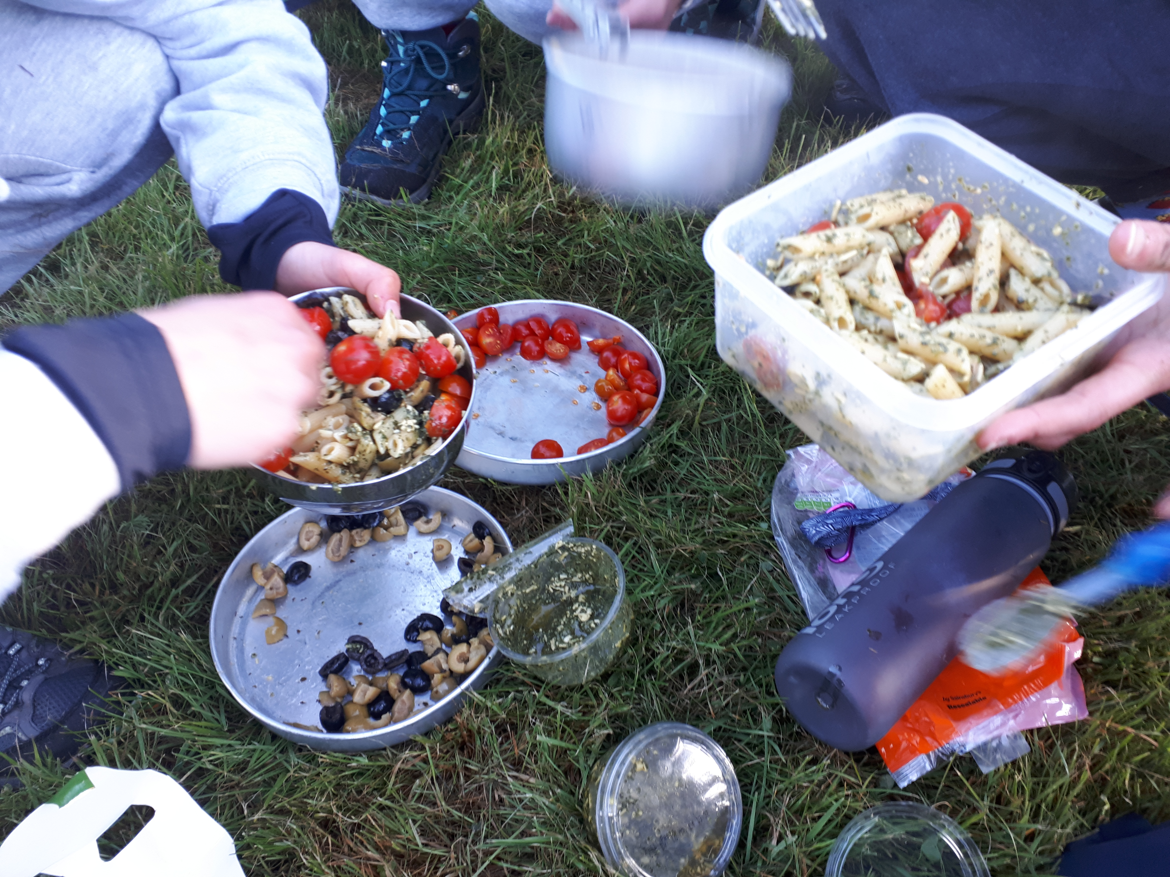
Menu Planning

Slide 2
Menu Planning
Food choices are key to your expedition success
You have to carry everything for the entire expedition
Much of this is down to personal taste
However, cooking in a team will save time, effort and fuel
Notes:
Food choices are key to your expedition success but it is often the most overlooked part.
You have to remember that you need to be able to carry everything for the entire expedition.
Much of this is down to personal taste so everyone's ideal will be different.
However, cooking in a team will save time, effort and fuel, This could be in pairs, 3’s or the whole team

Slide 3
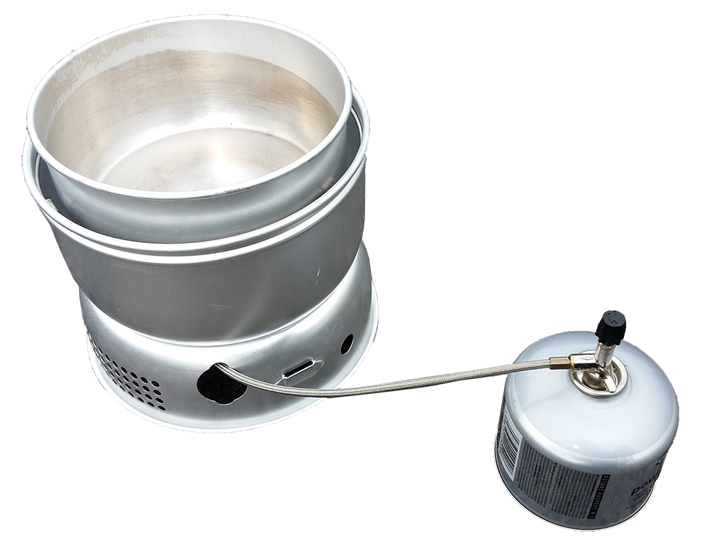
Menu Planning
Considerations – Stove limitations
What stove will you be cooking on?
How many pans will you have?
What fuel will you be using?
Can you practice at home?
Notes:
The type of stove may determine what you are able to cook.
Bear this in mind when making your choices
Give some examples of good evening meals
It is possible to cook really great meals on camping stoves but it does take practice.
It is possible to take a stove home to practice some ‘wow dishes’

Slide 4
Menu Planning
Other considerations
Weight
Speed and ease of preparation
Tastiness and variety
Durability and longevity
Calorific intake
Notes:
Weight: The lighter the better, consider removing packaging, cooking in a team, dehydrated foods
Speed of prep: you have to cook outside your tent so if raining you want it to be quick and easy
Tastiness: if you aren’t going to want to eat it you aren’t going to eat it
Durability. Fresh fruit won’t last well in a rucksack, some plastic packaging is brittle and will break (pot noodles)
Calorific intake: You need it to be high as you will be expending a large amount of energy 3000-3500 Kcal. While some sugars are great the vast majority of these calories want to be from protein, fat and complex carbs

Slide 5
Menu Planning
Breakfast and Lunch
Porridge is great for breakfast
Have a hot drink lined up for breakfast too
Other than porridge breakfast and lunch are usually the same sort of items
Please don’t plan to cook for lunch
Notes:
Porridge is a great breakfast. I don’t really like it so I go for a sweet one and sometimes put half a hot chocolate sachet it in.
If you get the porridge in a sachet, put the sachet in a mug, hold the mug and eat it out of the sachet you will only have to spoon to wash up.
Other than porridge breakfast items and lunch items are pretty much the same thing.
Please don’t plan to cook for lunch for 4 reasons. 1) Risk of a burn injury in remote area, 2) risk of skipping a meal if raining, 3) risk of starting wild fire in some areas and conditions. 4) It is a right faff and I don’t know anyone who would do that on an expedition

Slide 6
Menu Planning
Evening Meal
There are 3 basic types of evening meal
  Dehydrated
  Boil in the bag
  Cooking from scratch
Eat and drink soon after arriving at the campsite for maximum energy uptake into muscles
Drink a hot chocolate later in the evening
Notes:
Dehydrated is light,
Boil in the bag heavy but tastier,
cooking from scratch is tastier and keeps you occupied but is more of a faff
Eating complex carbohydrates soon after stopping exercise aids the carbs getting stored the muscle which will help you on the next day
Having a hot chocolate before bed will help top up your energy and keep you warm

Slide 7
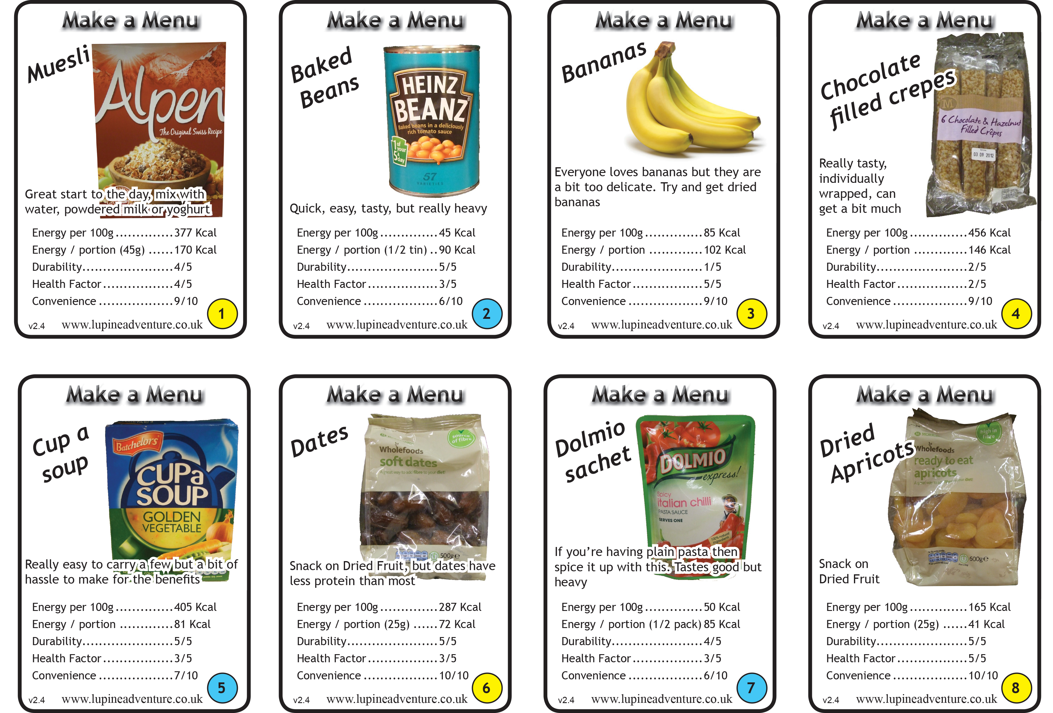
Menu Planning
Notes:
The following slides have a range of items on you might want to just skim through them saying what is good or bad about each. Tell participants they don’t need to be able to read the figures, they are just pictorial examples
You may ask someone to pick a good example on each slide and say why they think it is good
Yellow circle is breakfast / lunch / snacks
Blue circle is evening meal

Slide 8
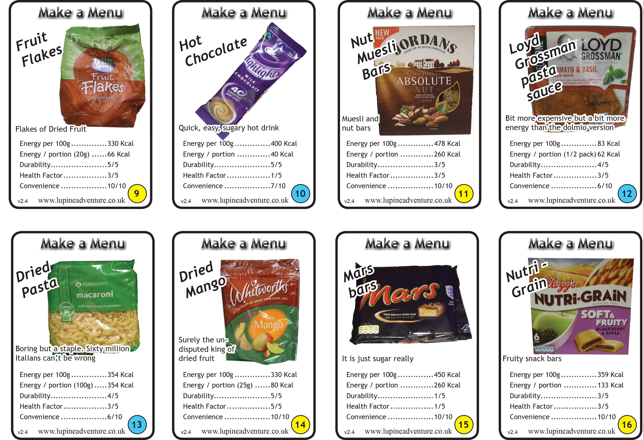
Menu Planning
Notes:
The following slides have a range of items on you might want to just skim through them saying what is good or bad about each. Tell participants they don’t need to be able to read the figures, they are just pictorial examples
You may ask someone to pick a good example on each slide and say why they think it is good
Yellow circle is breakfast / lunch / snacks
Blue circle is evening meal

Slide 9
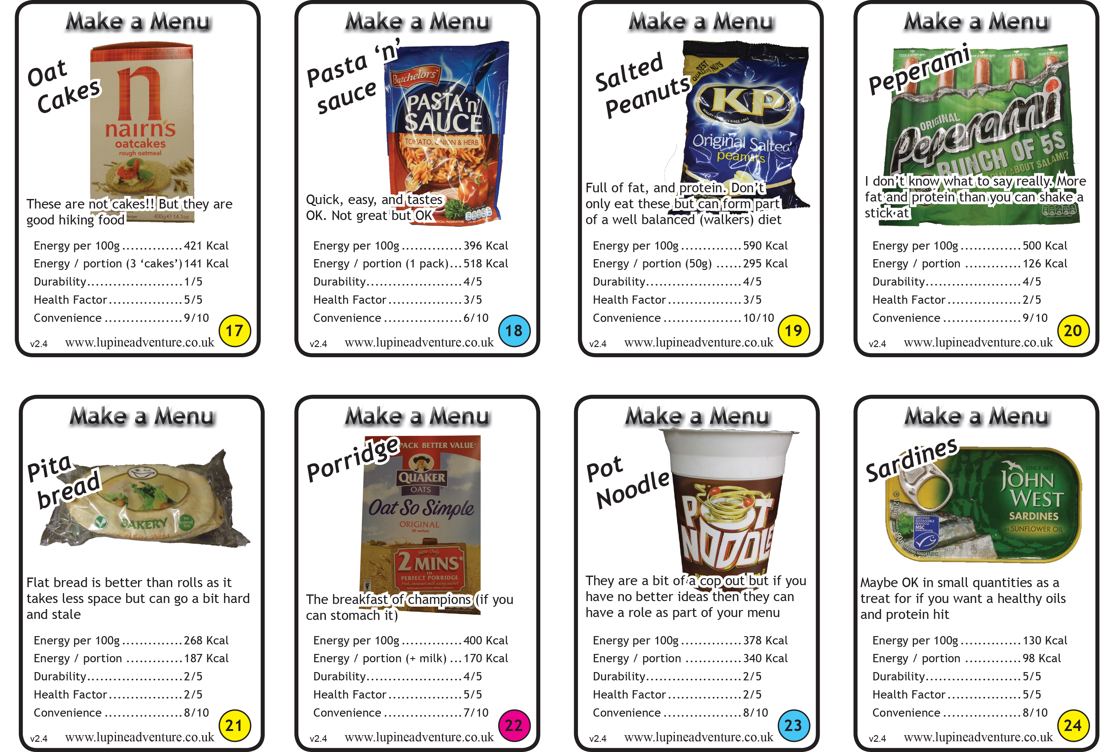
Menu Planning
Notes:
The following slides have a range of items on you might want to just skim through them saying what is good or bad about each. Tell participants they don’t need to be able to read the figures, they are just pictorial examples
You may ask someone to pick a good example on each slide and say why they think it is good
Yellow circle is breakfast / lunch / snacks
Blue circle is evening meal

Slide 10
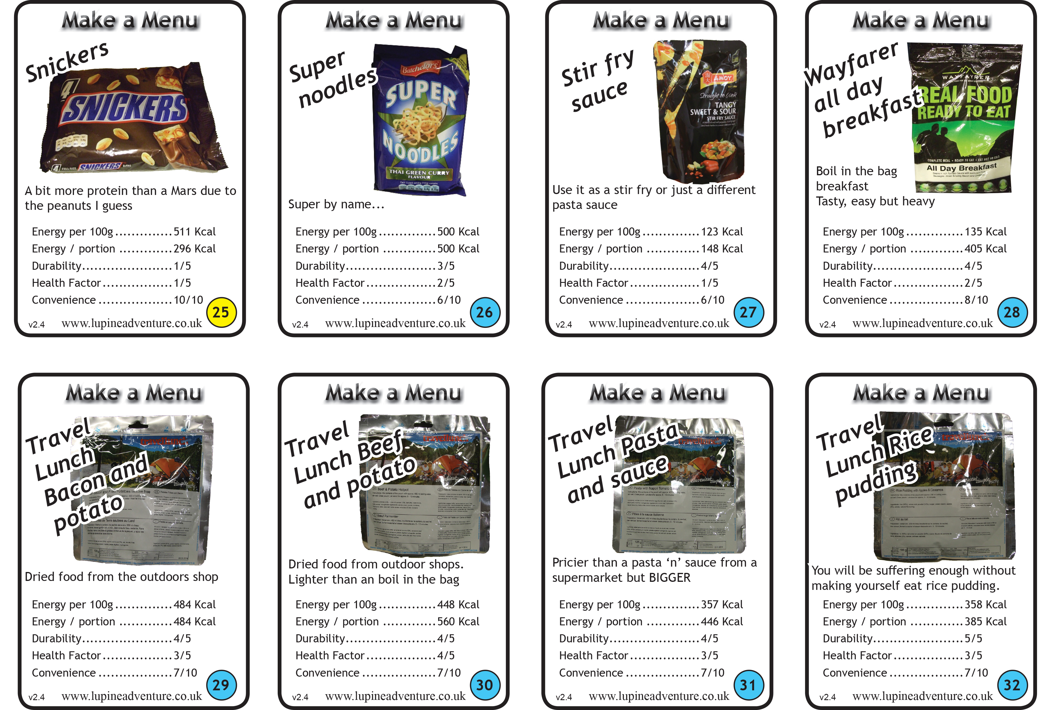
Menu Planning
Notes:
The following slides have a range of items on you might want to just skim through them saying what is good or bad about each. Tell participants they don’t need to be able to read the figures, they are just pictorial examples
You may ask someone to pick a good example on each slide and say why they think it is good
Yellow circle is breakfast / lunch / snacks
Blue circle is evening meal

Slide 11
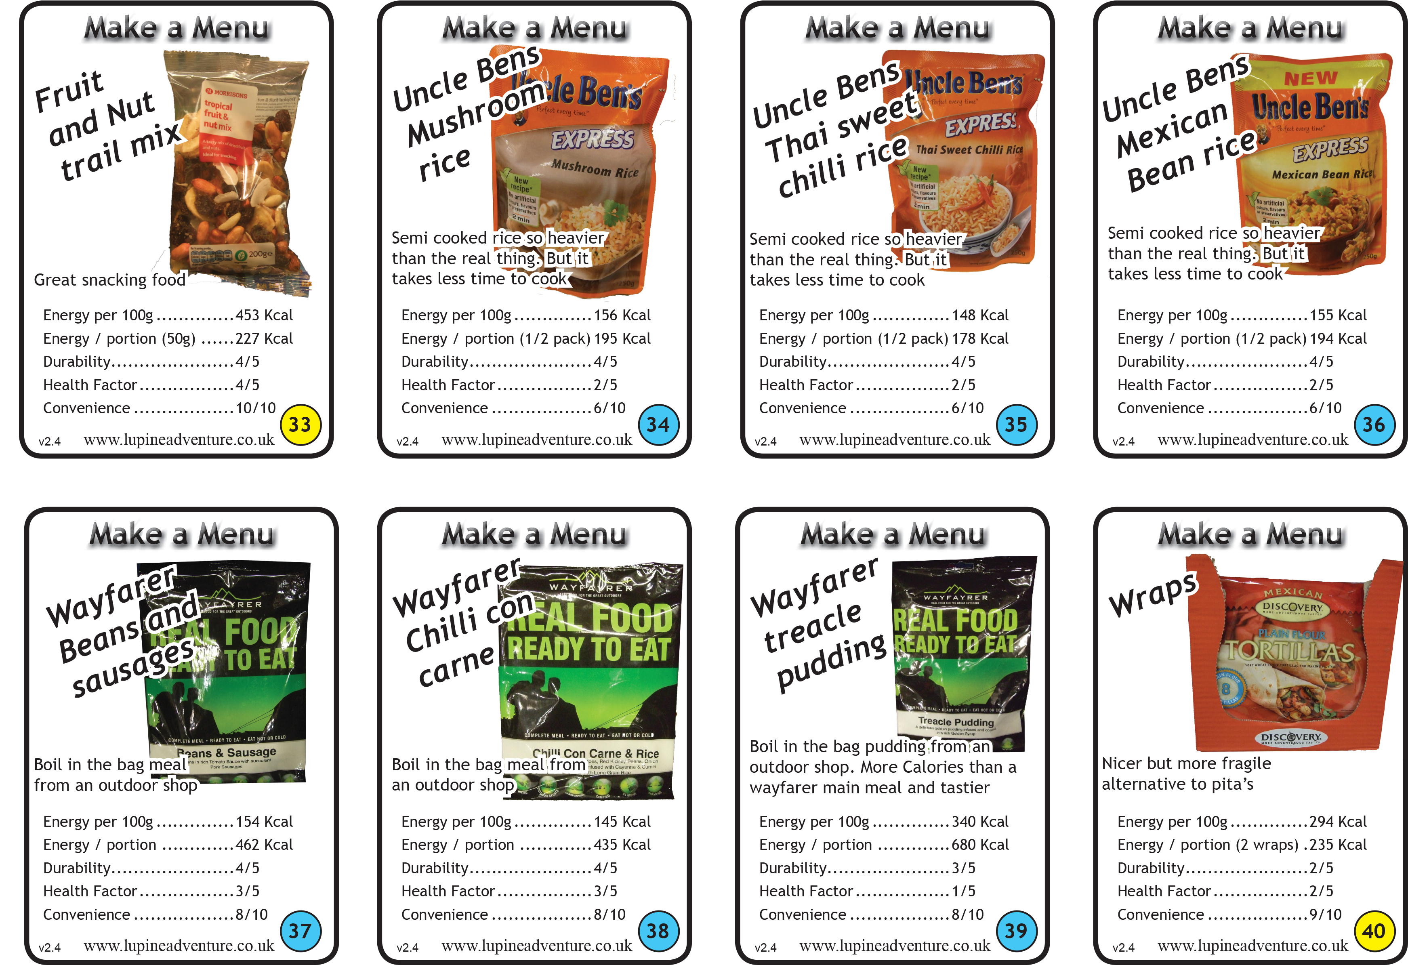
Menu Planning
Notes:
The following slides have a range of items on you might want to just skim through them saying what is good or bad about each. Tell participants they don’t need to be able to read the figures, they are just pictorial examples
You may ask someone to pick a good example on each slide and say why they think it is good
Yellow circle is breakfast / lunch / snacks
Blue circle is evening meal

Slide 12
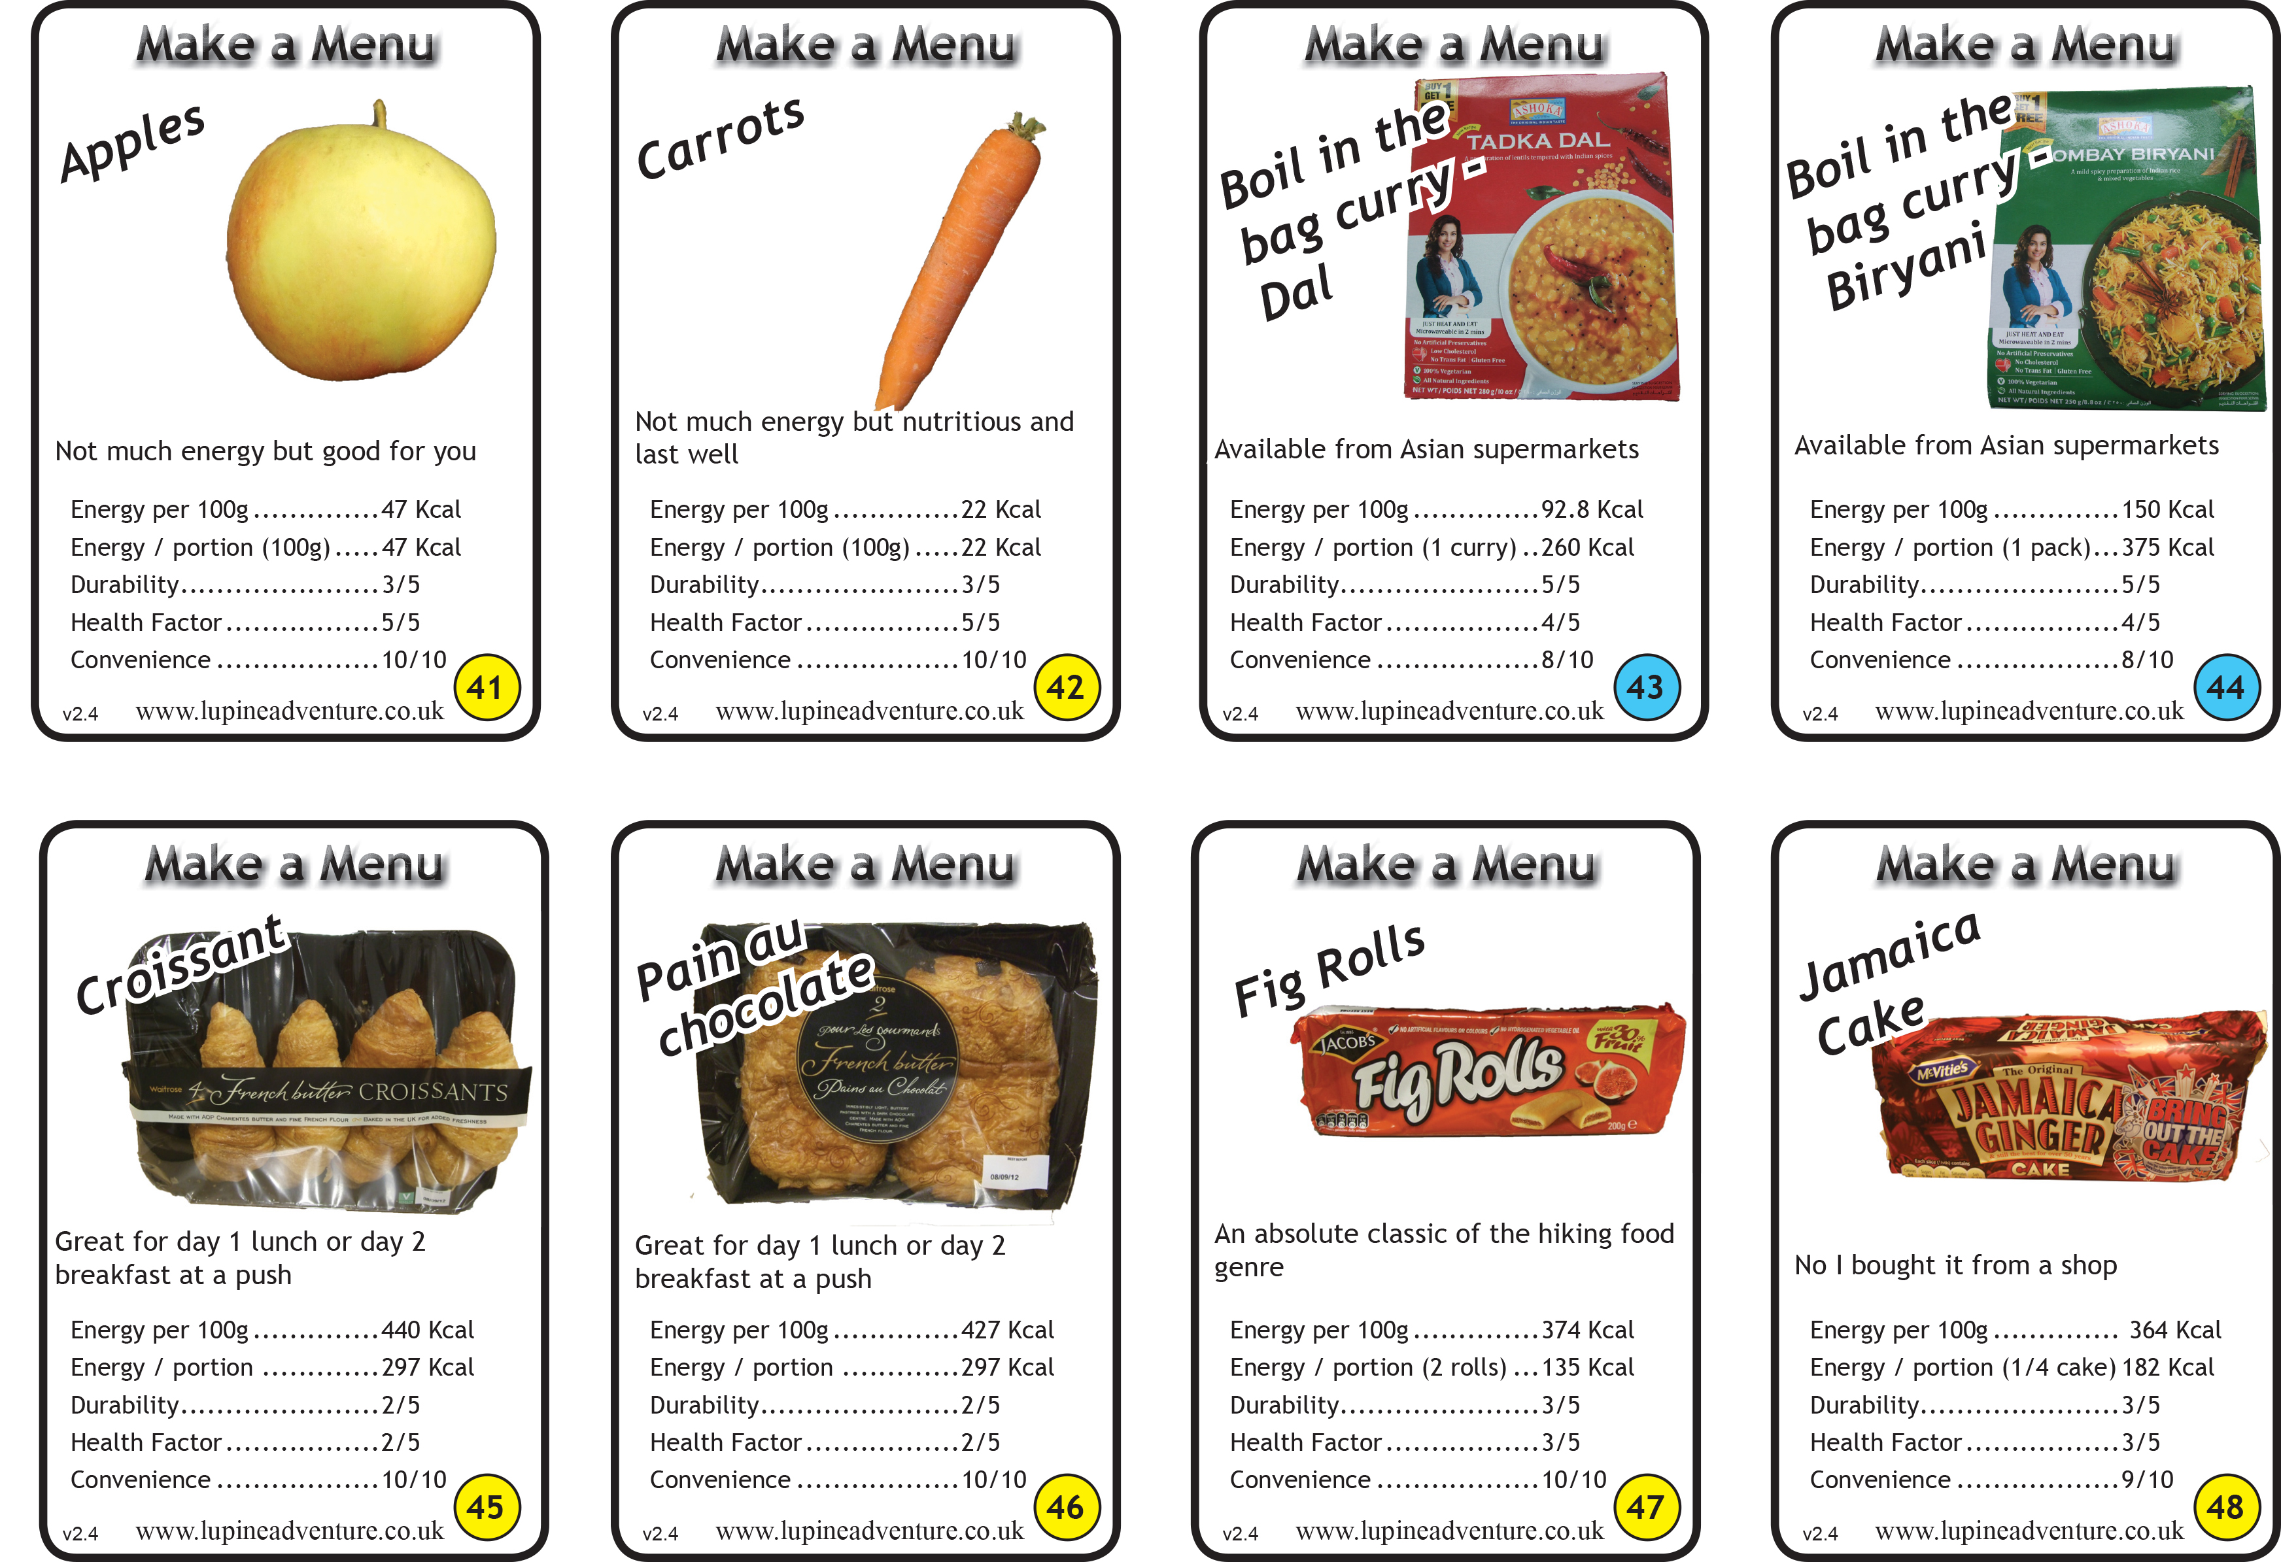
Menu Planning
Notes:
The following slides have a range of items on you might want to just skim through them saying what is good or bad about each. Tell participants they don’t need to be able to read the figures, they are just pictorial examples
You may ask someone to pick a good example on each slide and say why they think it is good
Yellow circle is breakfast / lunch / snacks
Blue circle is evening meal

Slide 13
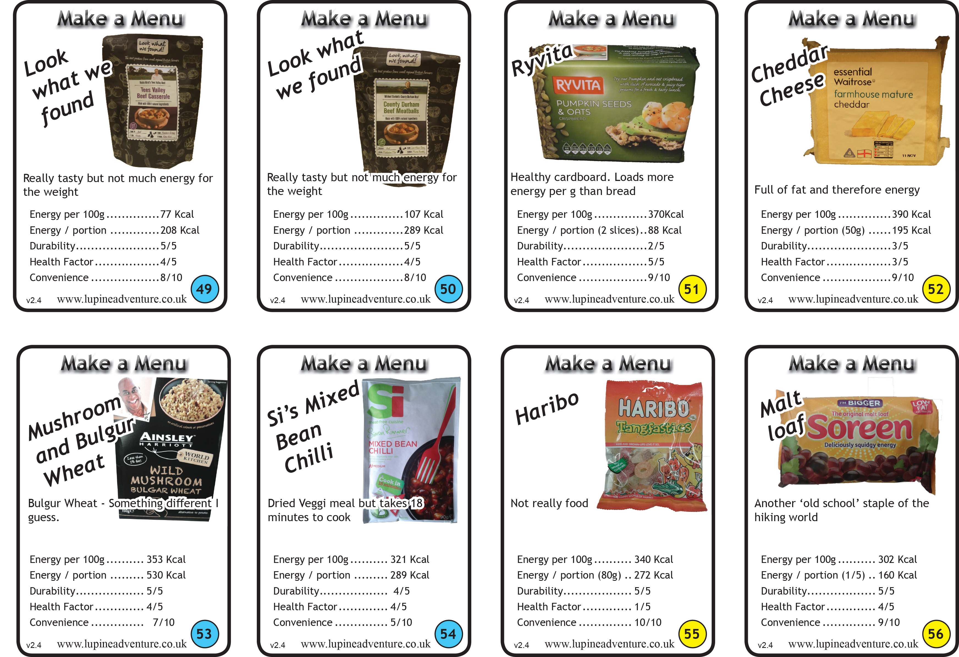
Menu Planning
Notes:
The following slides have a range of items on you might want to just skim through them saying what is good or bad about each. Tell participants they don’t need to be able to read the figures, they are just pictorial examples
You may ask someone to pick a good example on each slide and say why they think it is good
Yellow circle is breakfast / lunch / snacks
Blue circle is evening meal

Slide 14
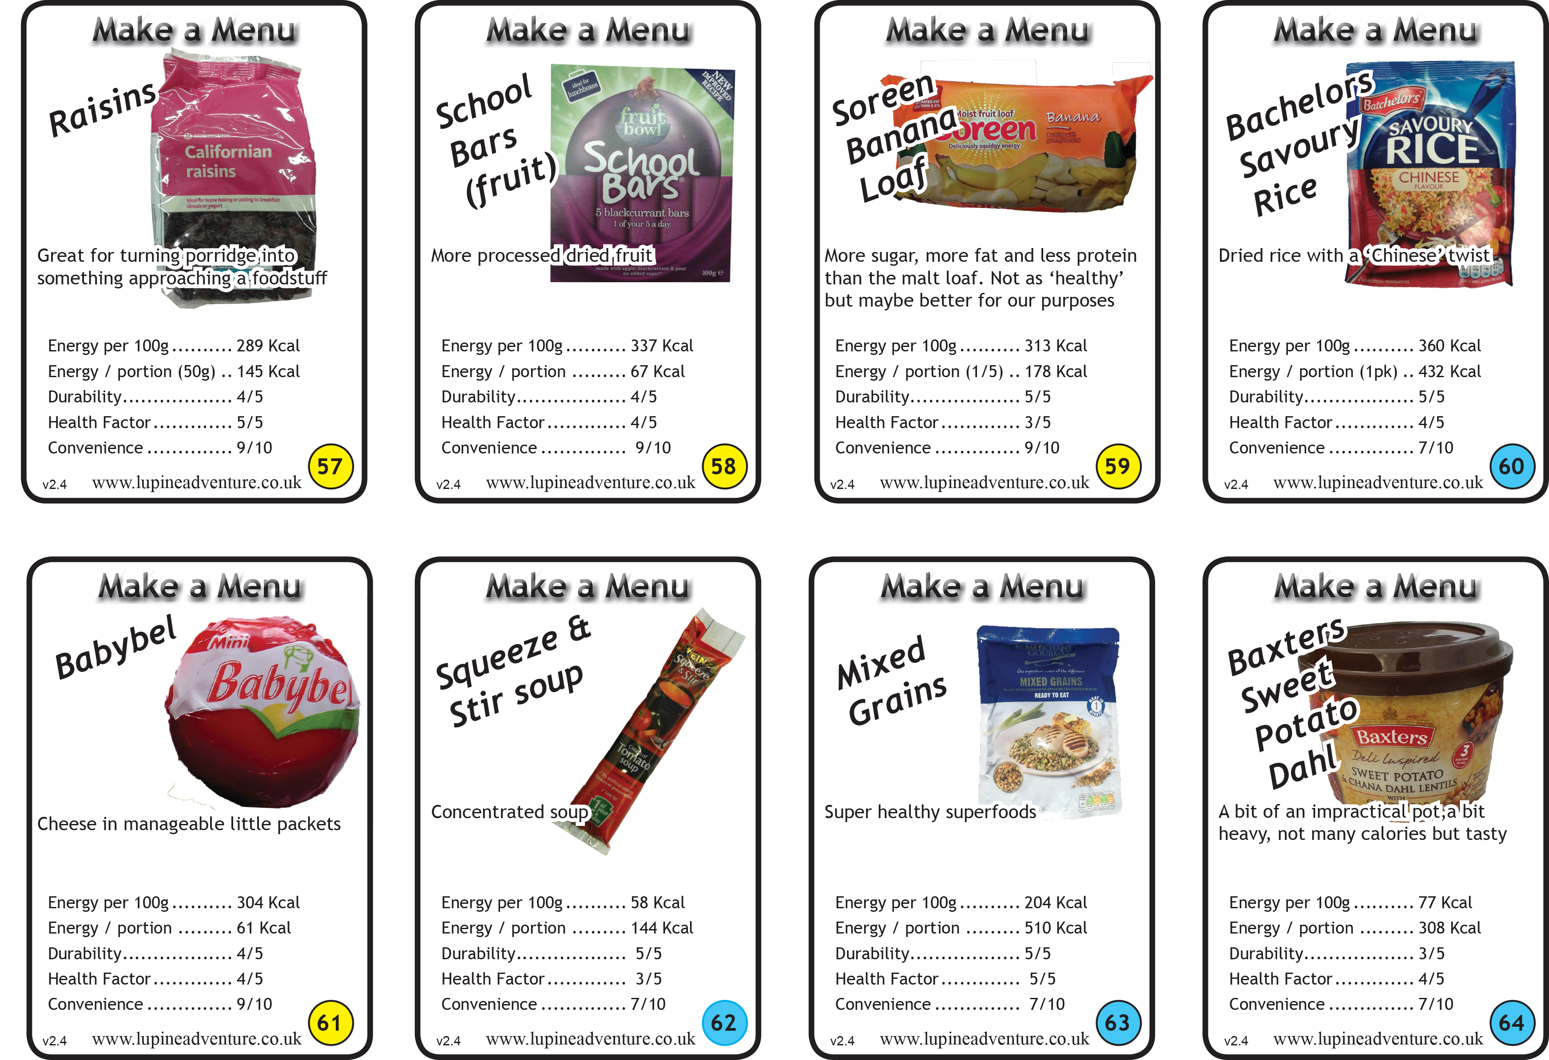
Menu Planning
Notes:
The following slides have a range of items on you might want to just skim through them saying what is good or bad about each. Tell participants they don’t need to be able to read the figures, they are just pictorial examples
You may ask someone to pick a good example on each slide and say why they think it is good
Yellow circle is breakfast / lunch / snacks
Blue circle is evening meal

Slide 15
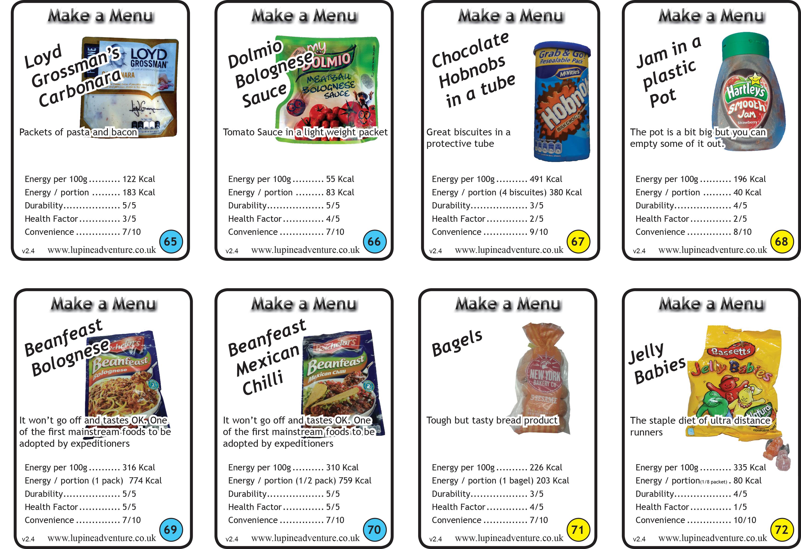
Menu Planning
Notes:
The following slides have a range of items on you might want to just skim through them saying what is good or bad about each. Tell participants they don’t need to be able to read the figures, they are just pictorial examples
You may ask someone to pick a good example on each slide and say why they think it is good
Yellow circle is breakfast / lunch / snacks
Blue circle is evening meal

Slide 16
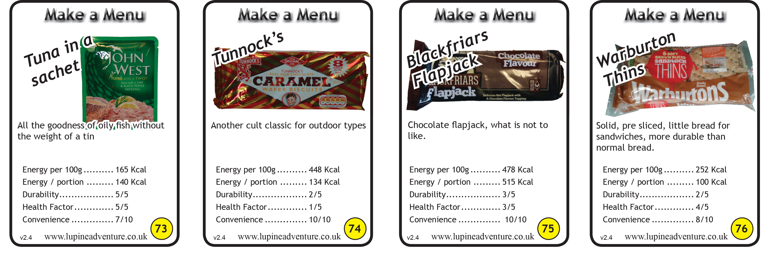
Menu Planning
Notes:
The following slides have a range of items on you might want to just skim through them saying what is good or bad about each. Tell participants they don’t need to be able to read the figures, they are just pictorial examples
You may ask someone to pick a good example on each slide and say why they think it is good
Yellow circle is breakfast / lunch / snacks
Blue circle is evening meal

Slide 17
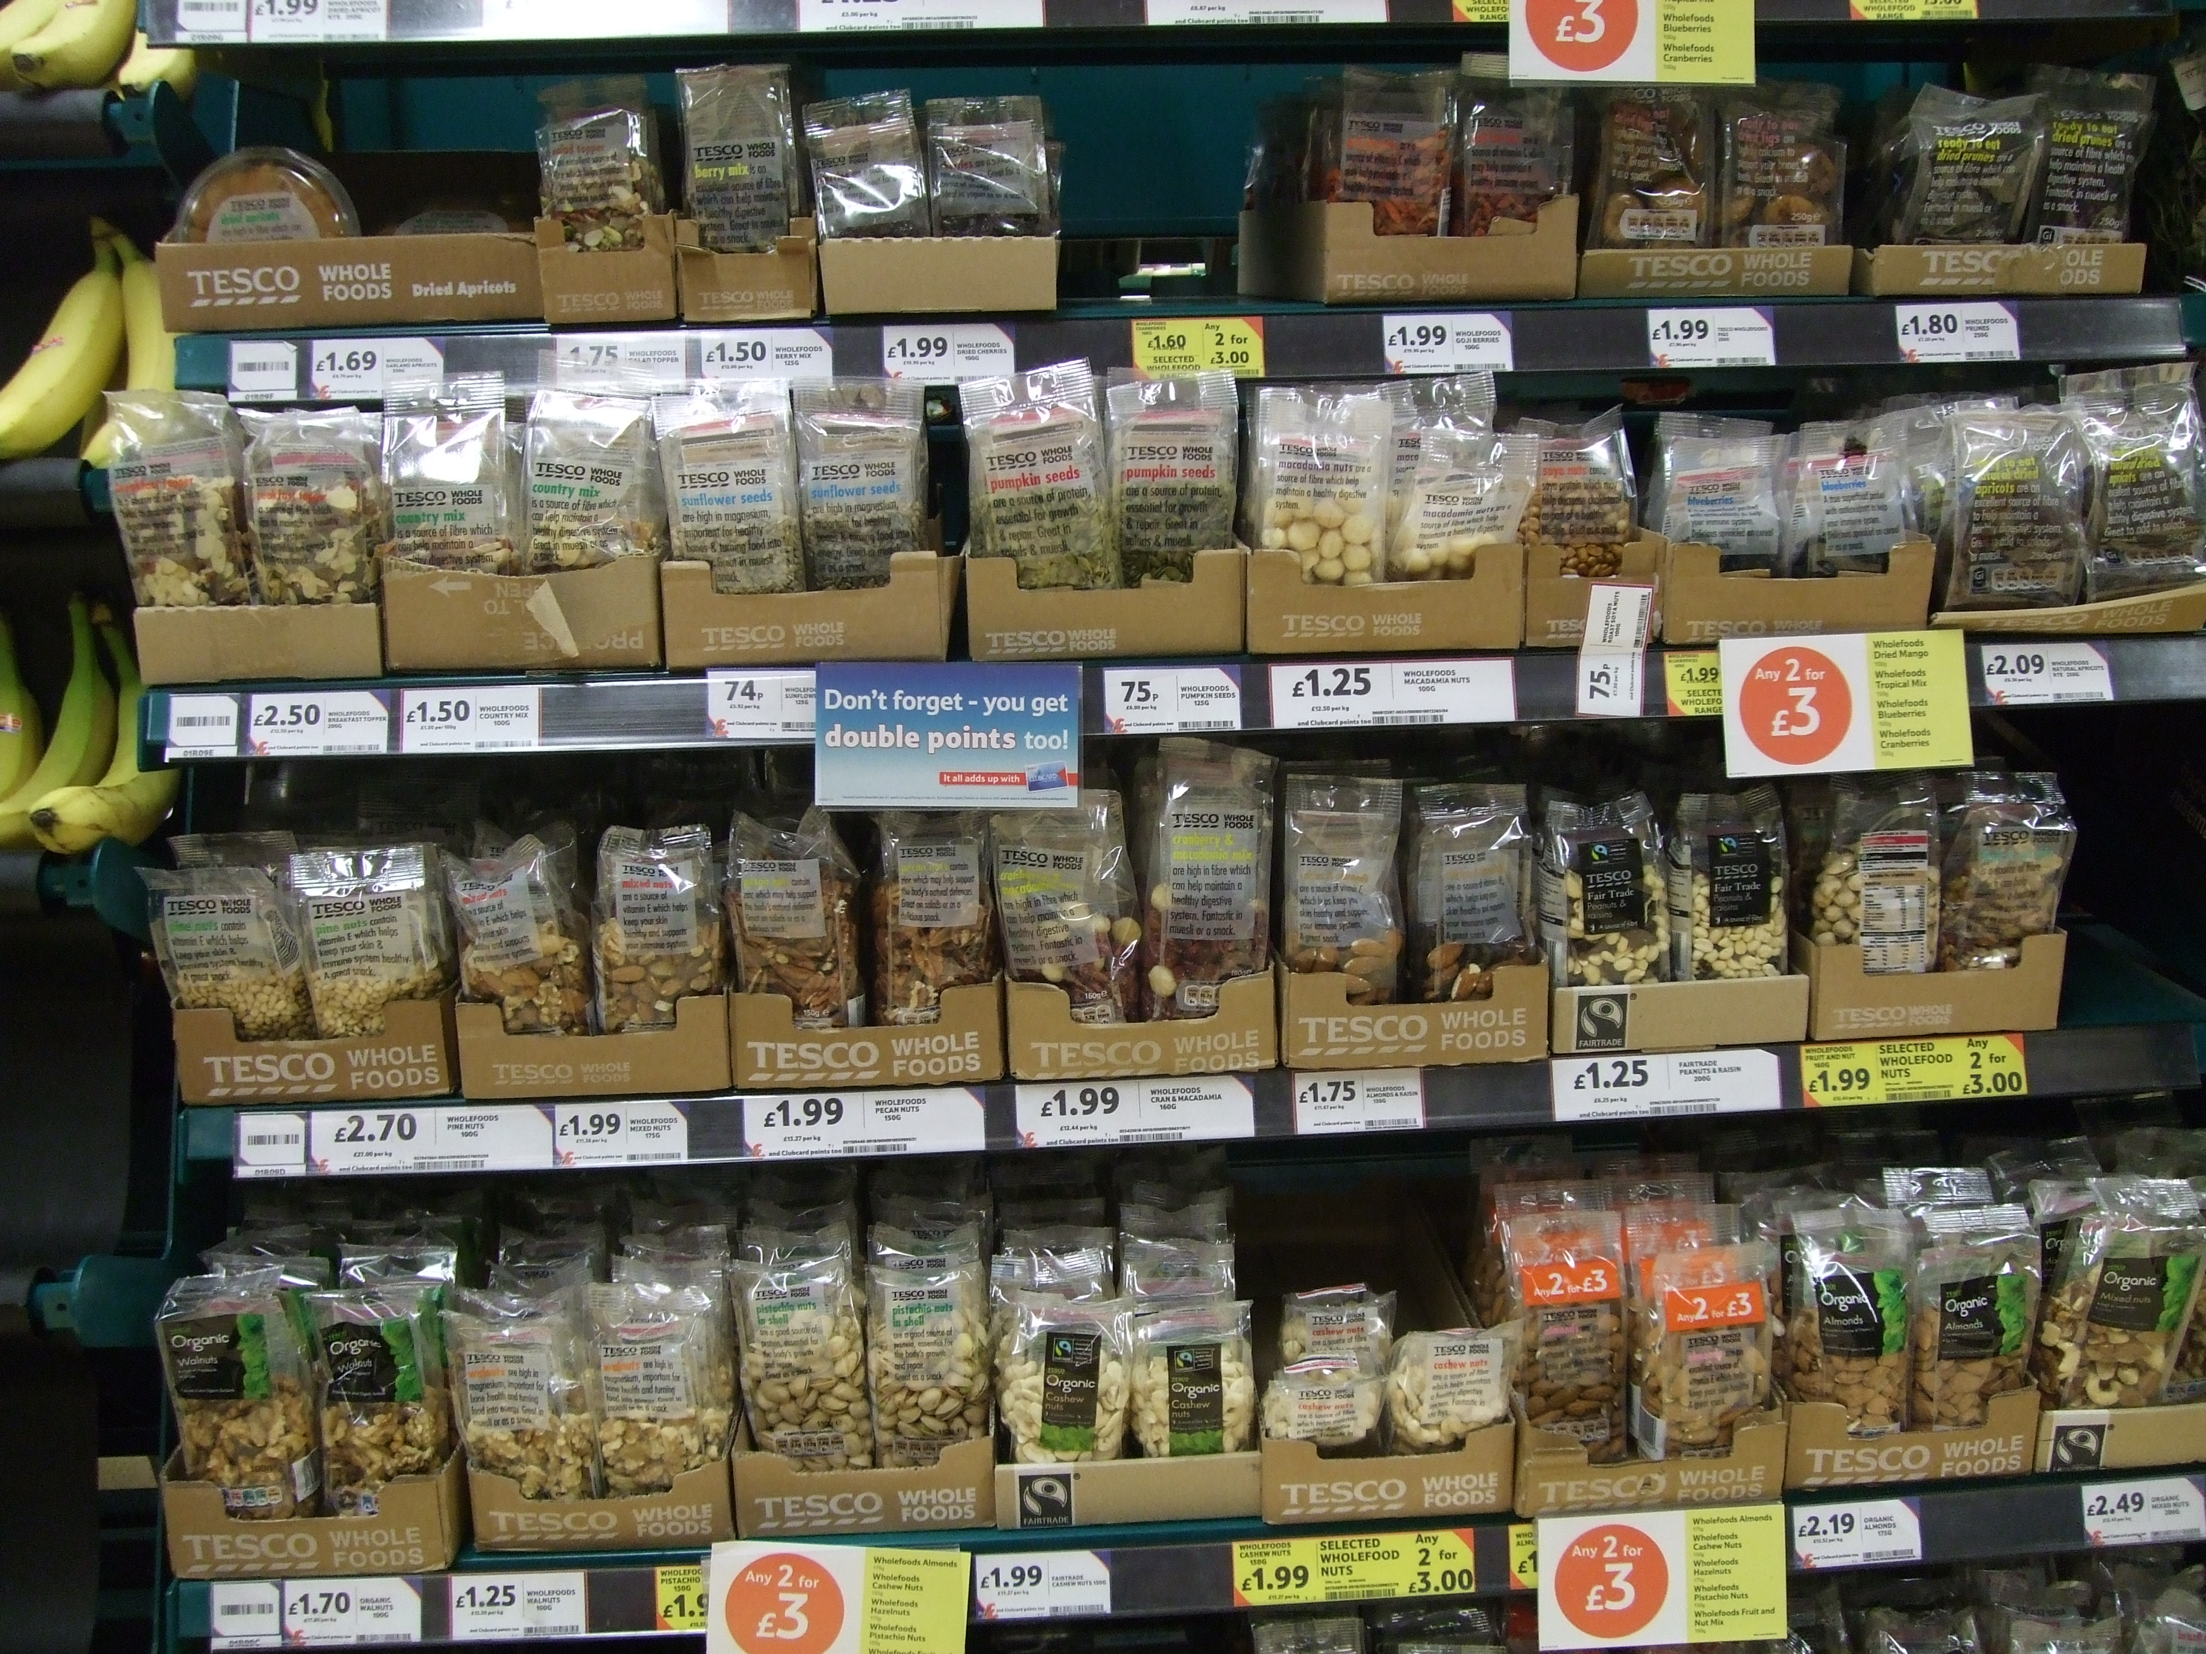
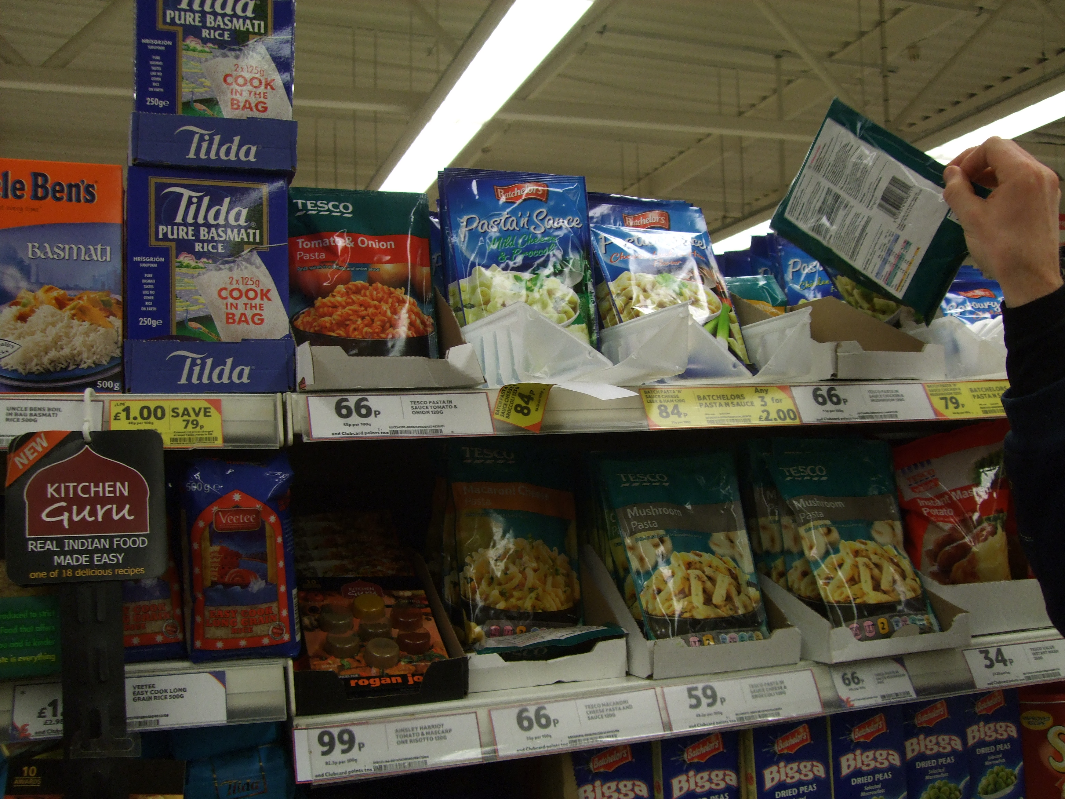
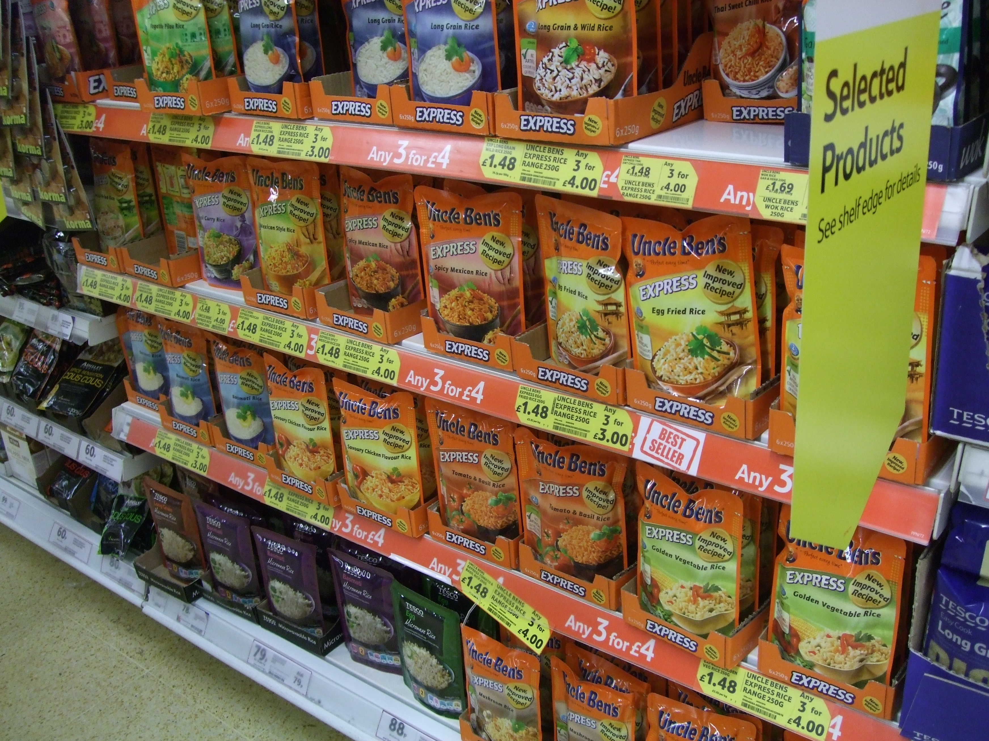
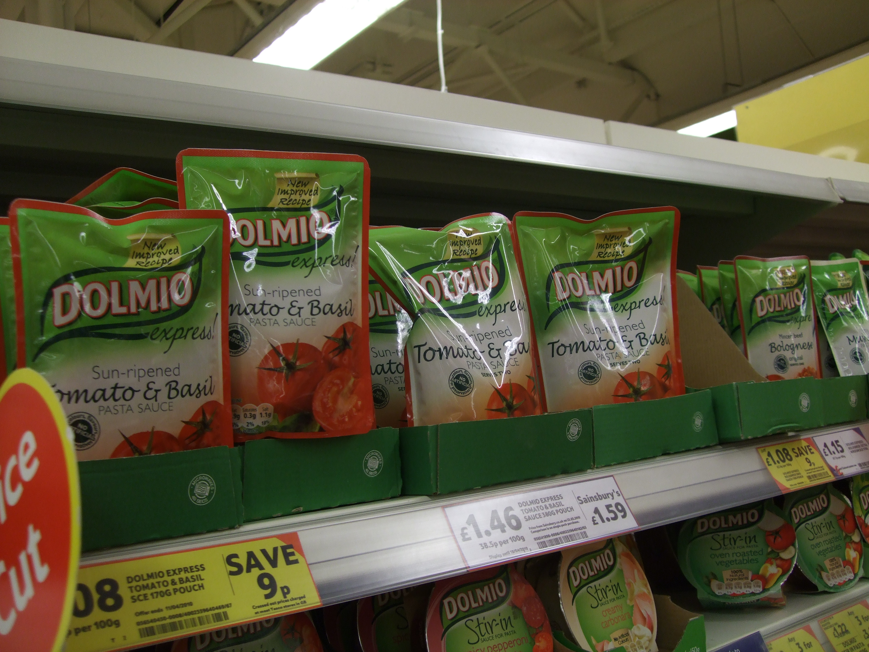
Menu Planning
Most Supermarkets have an aisle pretty much dedicated to good DofE type foods

Slide 18
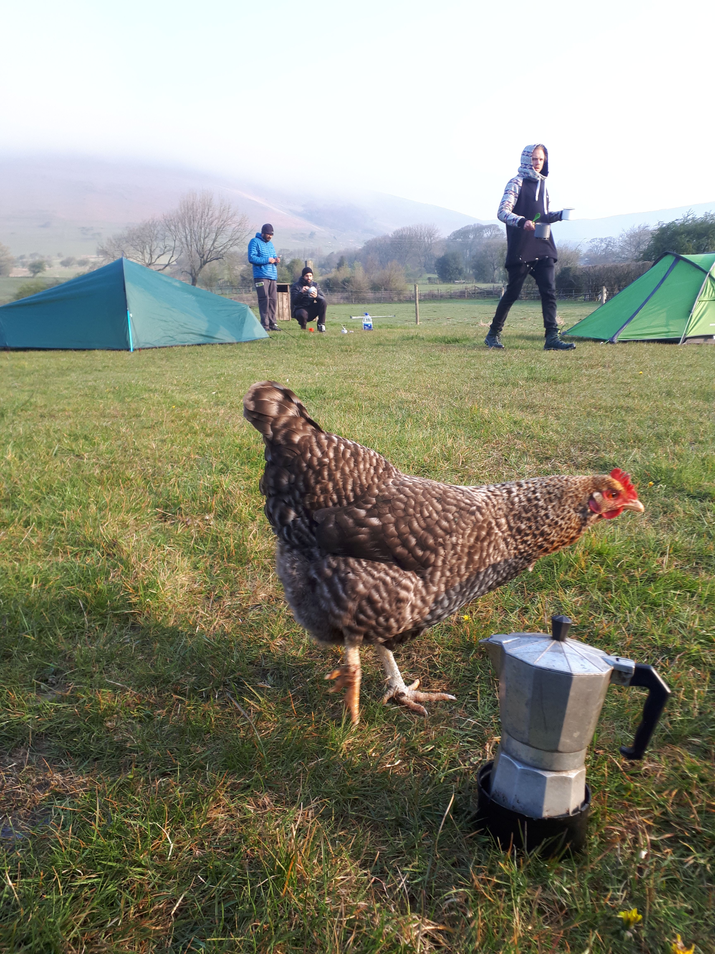
Menu Planning
Complete the menu plan on page 14 of your Workbook

Slide 19
Information for teachers and instructors
This presentation is designed for use alongside our ‘Course notes’ and ‘Workbook’ booklets, and lesson plans all of which are downloadable for free from our website https://www.lupineadventure.co.uk/downloads/dofe-downloads.html
or google ‘Lupine DofE downloads’.
The presentations are designed so that they can be used at all DofE levels simply tailor the depth that you go into each subject and maybe skip some slides accordingly.
The presentations are designed to be used in a classroom or remotely over Zoom / Teams etc. One of the versions of the Workbook is editable so you can ask students to fill this in and email to you, alternatively, on our website there are Google and Microsoft Forms relating to some lessons that you can copy to your accounts and share with students.
You are free to edit the presentation for your organisation however you wish but please don’t distribute further, we would rather you point people to our website.
If you would like to be informed of future releases then subscribe to our mailing list from our website.
If you would like early copies of, and to be involved in shaping, future resources then join our Facebook group for this purpose https://www.facebook.com/groups/859994524494945/
Lupine Adventure Co-op are an approved activity provider for the expedition section of the DofE. Please do get in touch if you would like assistance with running any part, or all of your expedition programme.

