Slide 1
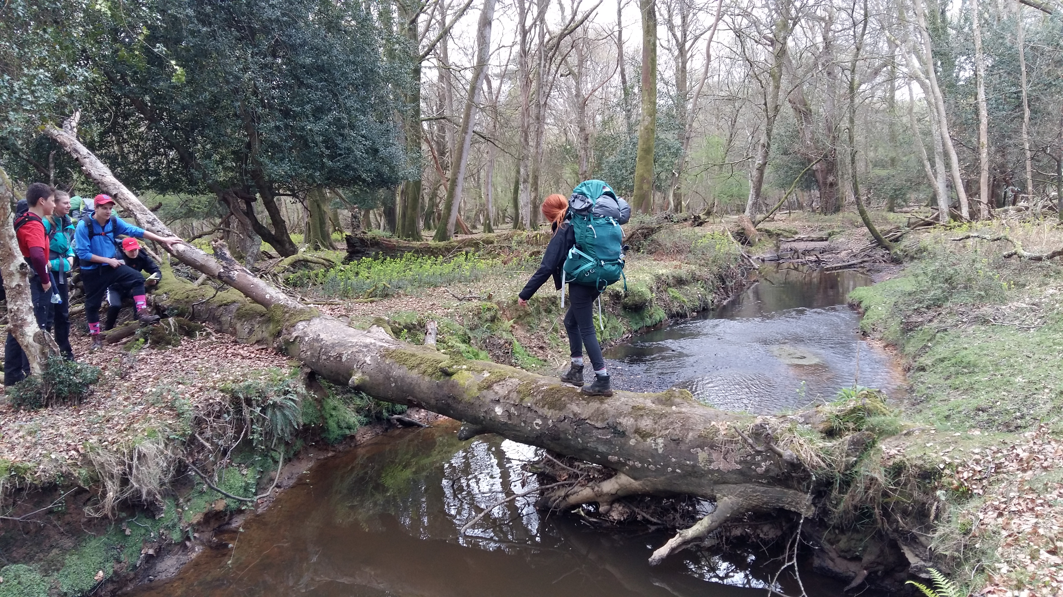
Hazards

Slide 2
Definitions
Hazards
Hazard
  Something that could harm you
Risk
  The likelihood that you will be harmed if exposed to the hazard
  What might happen to you if you are exposed to the hazard
  ‘If I play with that knife there is a risk that I will cut myself’
Mitigation
  Steps you can put in place to minimise the risk of a hazard
Notes:
Hazard: something that can harm you
Risk: This can be the likelihood that you become harmed if exposed to the risk but we are also using it as what my happen you to if you are exposed to the risk
Mitigation: Things you can to to reduce the risk of something happening to you

Slide 3
Hazards
Animals and People | Weather and Conditions | Terrain | Other
Notes:
Split the group into 4 and ask them to make notes of hazards that fit into the following 4 categories.
Maybe create a word document with the 4 headings in a table and type them up as they are called out
Or write them on a board.
Once you have a list talk about mitigations for each hazard

Slide 4
Hazards
Animals and People | Weather and Conditions | Terrain | Other
Farm animals Ticks Other walkers (kicking rocks off) Angry people Dogs | Heat Cold Rain Lightning Wind | Crags, (rock falls or you might fall off) Rivers, lakes Steep ground Mines / Shakeholes Roads | Stoves Existing medical conditions Bacteria in food Exhaustion Getting lost
Identify the most likely hazard and the hazard that poses the most serious risk and complete the table on page 11 of your workbook
Notes:
These are what we came up with

Slide 5
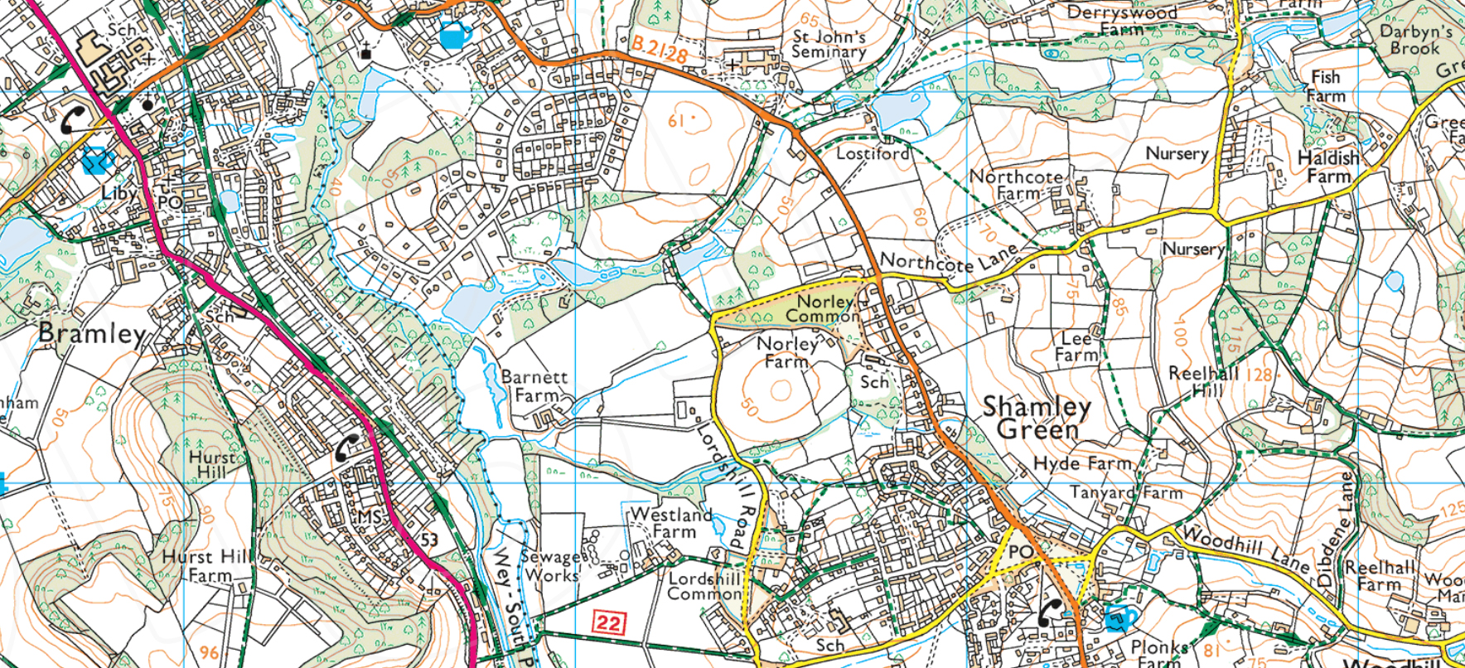
Hazard Identification
Hazards – Bronze
^{© Crown copyright 2020}
Notes:
Highlight a route and ask them to identify hazards on that route.
Maybe phone box in Shamley Green to phone box on A road
Walking on minor road, very flat and level with water courses (flooding / boggy) crossing water courses, A road

Slide 6
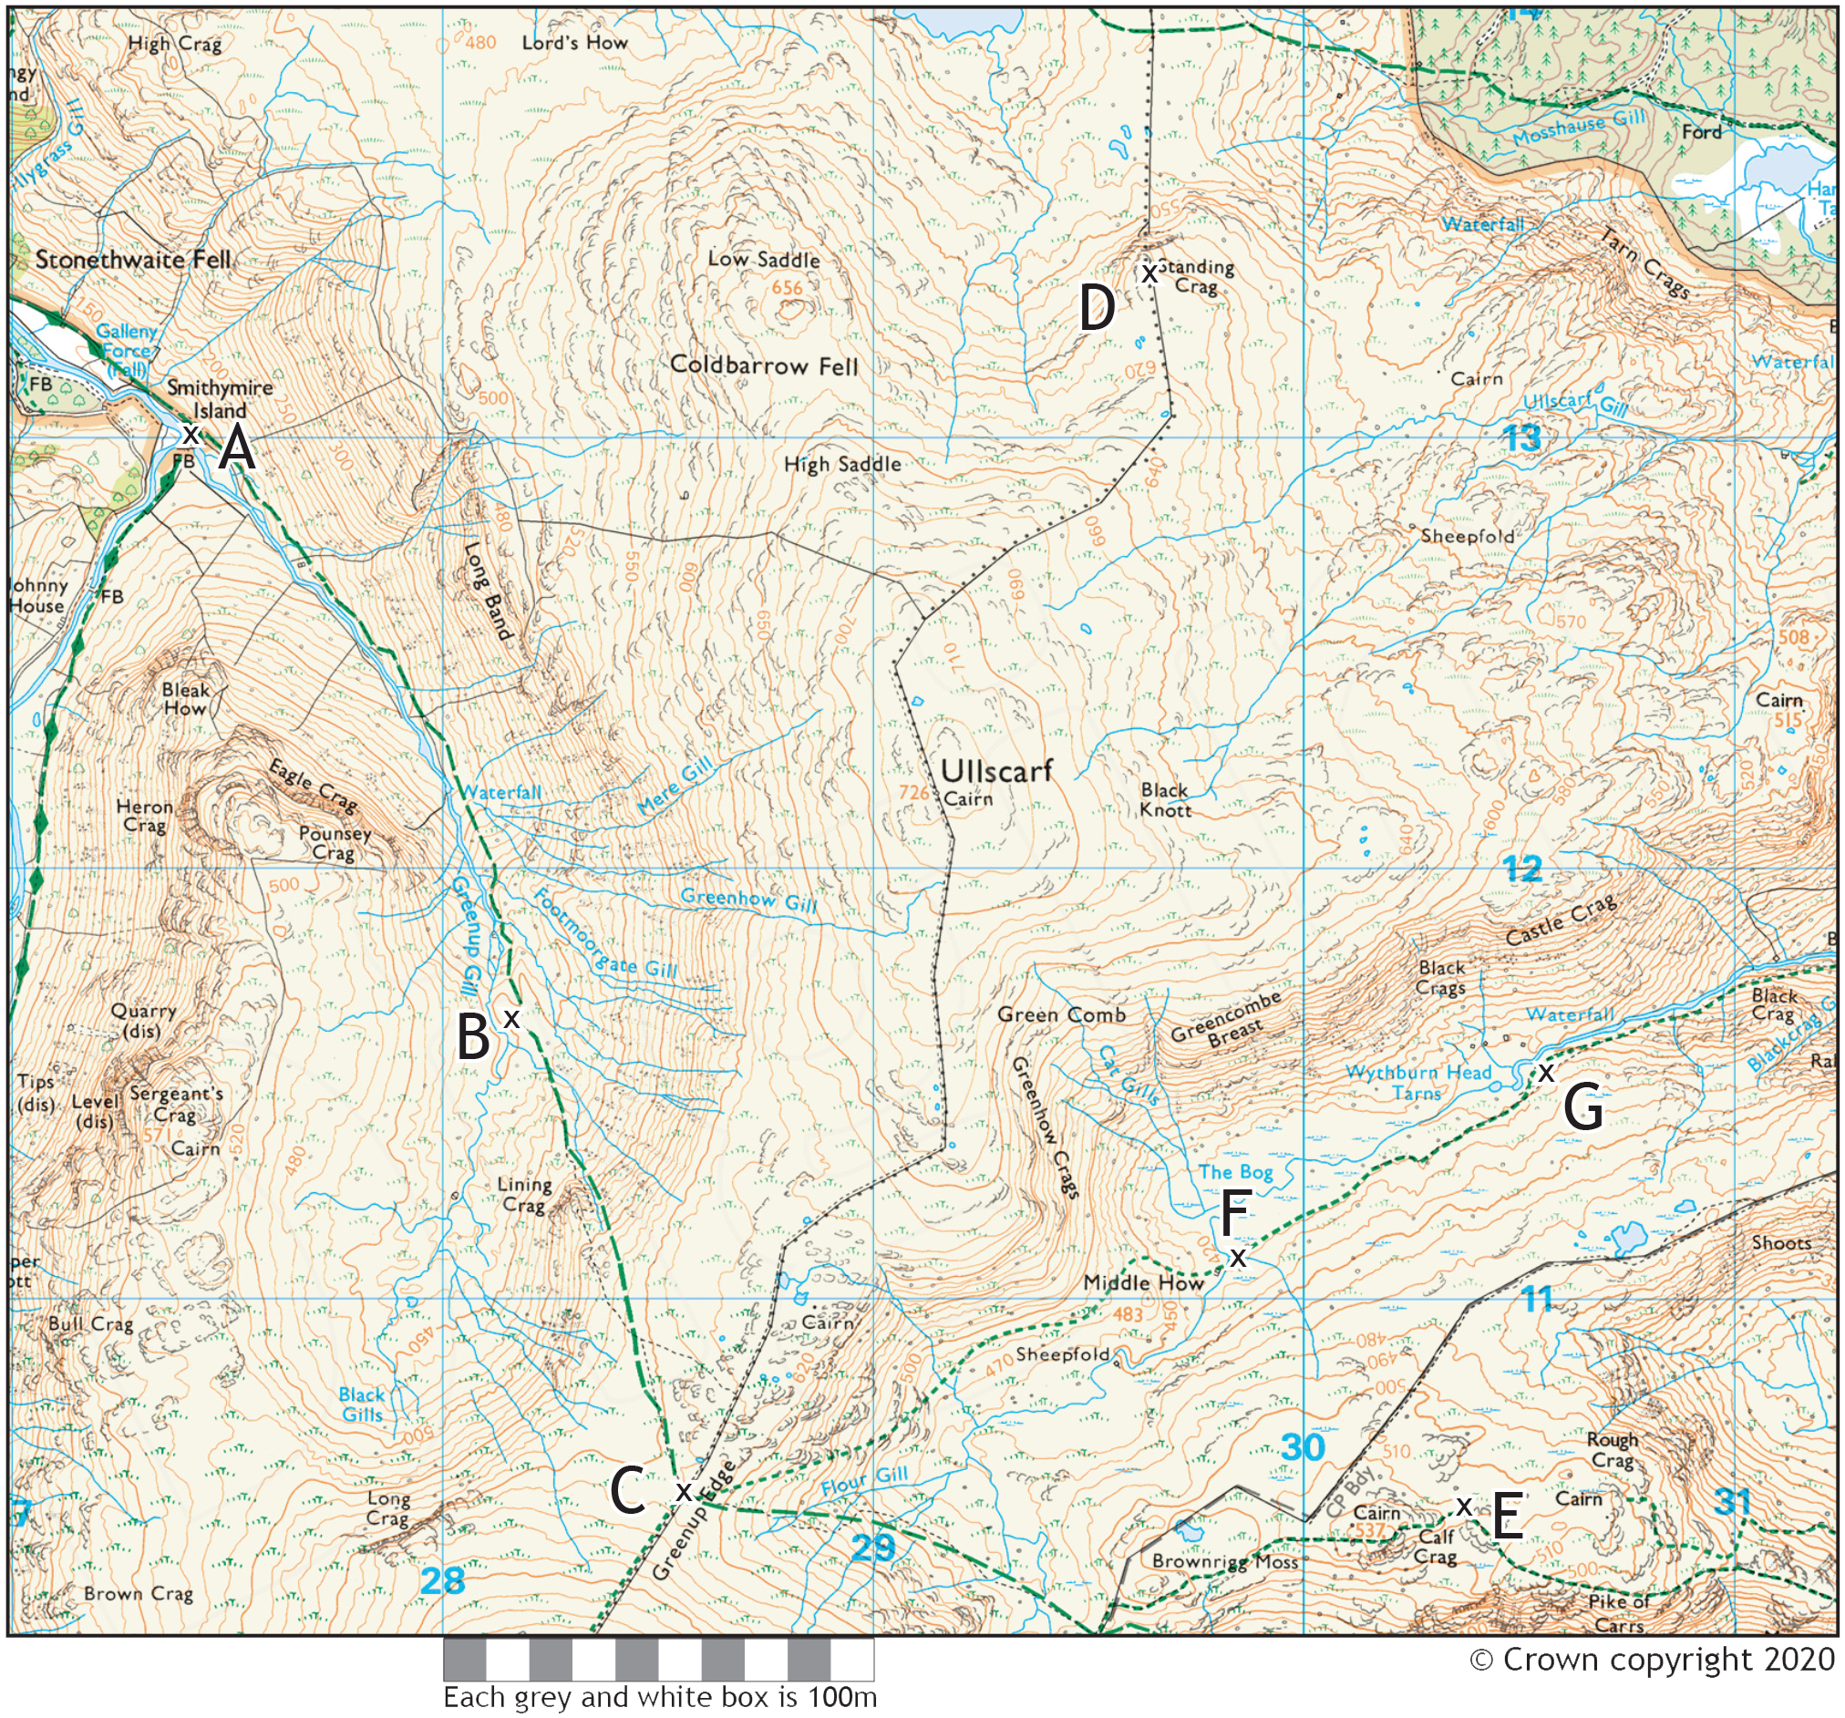
Hazard Identification
Hazards – Silver / Gold
Notes:
Highlight a route and ask them to identify hazards on that route
Maybe point A to point E
Water course, Waterfall implies cliffs to me, Lining crag, steep ground, going over a pass (windy??) Brown rigg moss (boggy?) calf crag

Slide 7
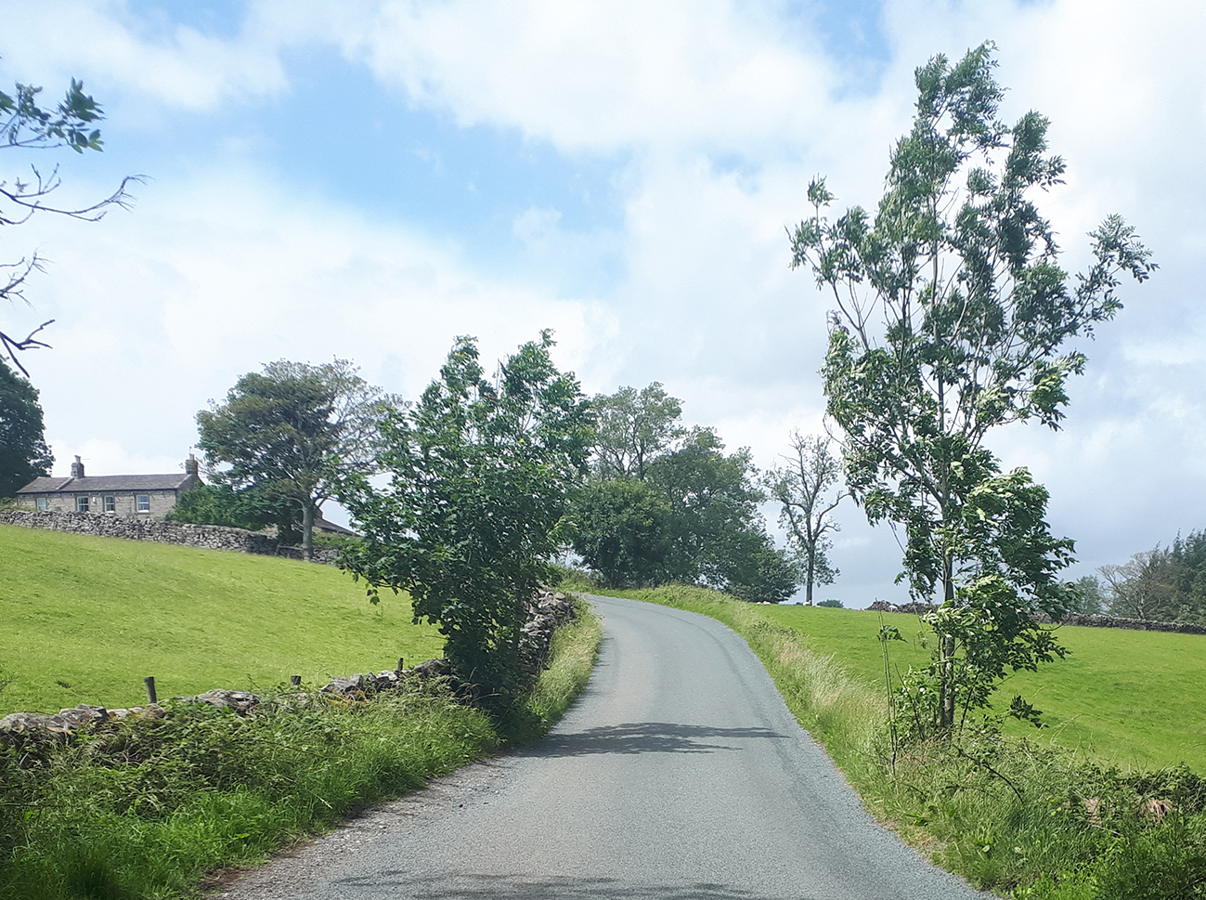
Road Safety
Hazards – Silver / Gold
Crossing roads
  Accompanied crossings
  Cross busy roads in pairs or 3’s
Walking on roads
  Wear something bright
  Brief the group
  Single file
  Don’t chat
  Think about what side of road is best
Do the exercise on page 12 of your Workbook
Notes:
Your supervisor may wish to meet you at some road crossings.
If you are having to wait for traffic cross in pairs or 3’s so you don’t obstruct each others view of the road
Have bright clothing, high viz or bright rucksack covers at the front and back of the group
Before walking on a road make sure the whole group knows how long for and how you (the navigator) plan to do it (which side?, might you cross, single file, how long for, tick features on the way, which side of the road is the next footpath etc)
Always walk in single file when on a road
Walk fast, don’t chat, concentrate on the navigation and being aware of traffic
On thin, bendy roads it might be best to cross to the outside of tight bends, think about when a driver will see you

Slide 8
Information for teachers and instructors
This presentation is designed for use alongside our ‘Course notes’ and ‘Workbook’ booklets, and lesson plans all of which are downloadable for free from our website https://www.lupineadventure.co.uk/downloads/dofe-downloads.html
or google ‘Lupine DofE downloads’.
The presentations are designed so that they can be used at all DofE levels simply tailor the depth that you go into each subject and maybe skip some slides accordingly.
The presentations are designed to be used in a classroom or remotely over Zoom / Teams etc. One of the versions of the Workbook is editable so you can ask students to fill this in and email to you, alternatively, on our website there are Google and Microsoft Forms relating to some lessons that you can copy to your accounts and share with students.
You are free to edit the presentation for your organisation however you wish but please don’t distribute further, we would rather you point people to our website.
If you would like to be informed of future releases then subscribe to our mailing list from our website.
If you would like early copies of, and to be involved in shaping, future resources then join our Facebook group for this purpose https://www.facebook.com/groups/859994524494945/
Lupine Adventure Co-op are an approved activity provider for the expedition section of the DofE. Please do get in touch if you would like assistance with running any part, or all of your expedition programme.

