Slide 1
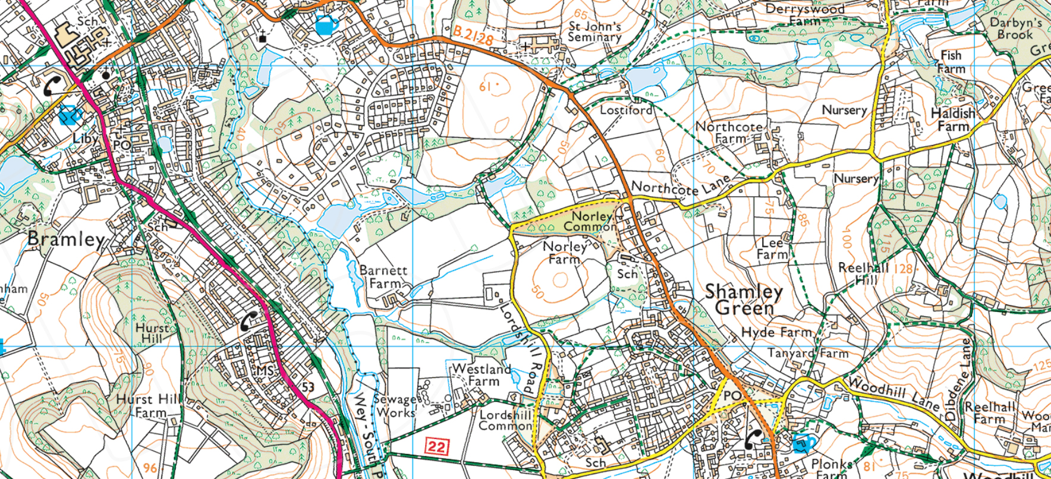
Introduction to OS Maps
^{© Crown copyright 2020}
Notes:
All participants should have.
Copy of the course notes
Copy of the work book
A physical map (not essential)
Ruler or compass
String
Blank sheet of paper (for measuring)
Pen
^{Crown Copyright}
Permission has been granted by Ordnance Survey to use the OS maps contained within this presentation. You are free to use with your groups for educational purposes.

Slide 2
What is a Map?
Introduction to OS Maps
A map is a scaled diagram of the features found in an area of land
Notes:
Start with asking them for a definition.
Reveal the definition shown
This is just one definition. There are star maps (not an area of land.)
Tube maps (not to scale)
Some definitions say it is a 2 dimensional representation of a 3 spherical area

Slide 3
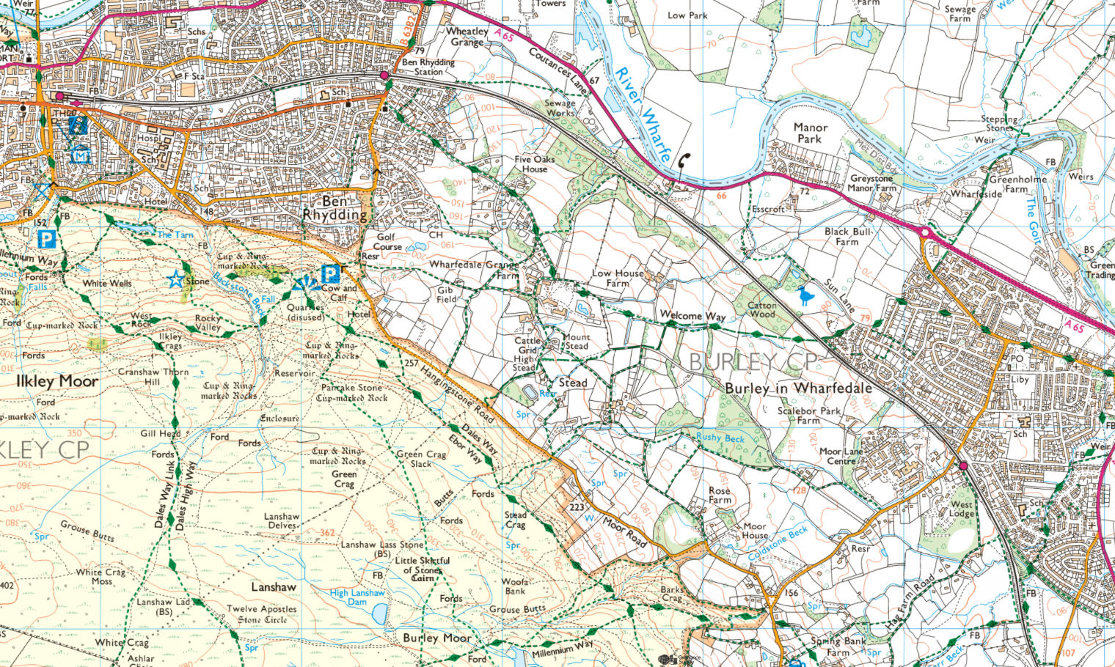
Introduction to OS Maps
^{© Crown copyright 2020}
Notes:
This is an Ordnance Survey Explorer map of Ilkley in Yorkshire
OS are an organisation responsible for mapping in the UK

Slide 4
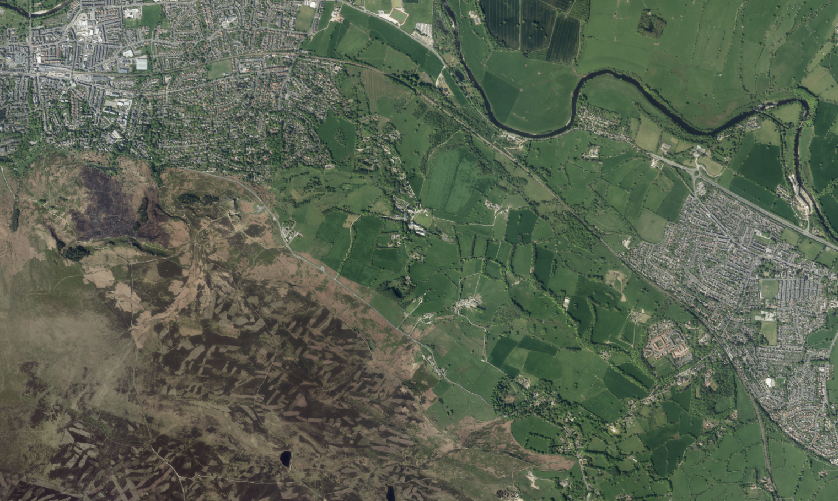
Introduction to OS Maps
Notes:
This is an Arial photo of the same area

Slide 5
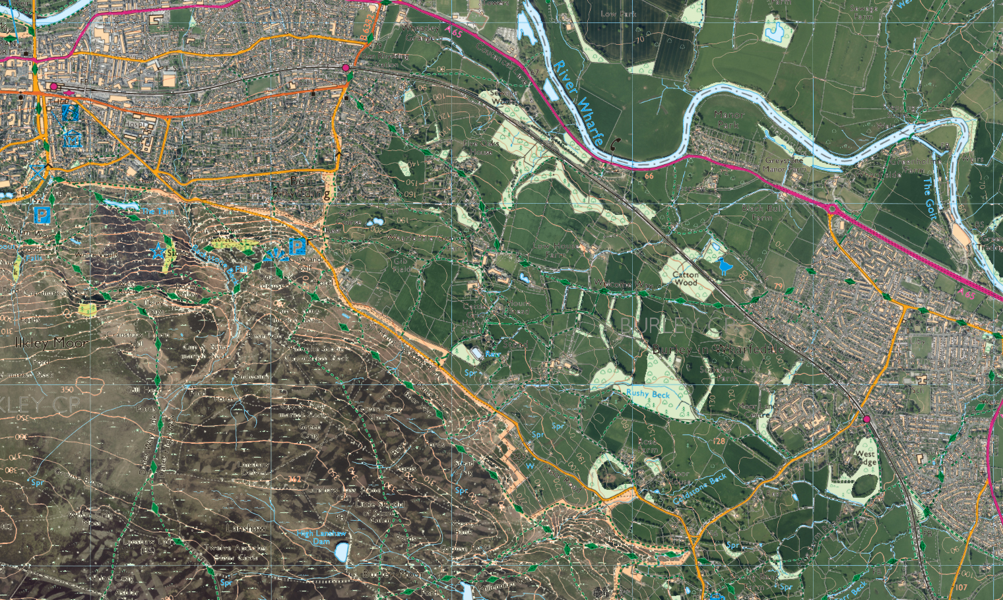
^{© Crown copyright 2020}
Notes:
This is the map over the top of the photo
Flip between these 3 slides (you can use arrow keys to do this) to illustrate that the map is very accurate
Highlight the roads to them.
The field boundaries
Farm tracks
Woods etc

Slide 6
Introduction to OS Maps
What is a map?
A map is a scaled diagram of the features found in an area of land
^{© Crown copyright 2020}
Notes:
Back to our definition …
We’ll talk about scale in a bit but.
First we’re going to look at how things (features) are represented on UK Ordnance Survey maps like the one shown

Slide 7
Map Features
Introduction to OS Maps
Map features can be split into 3 broad categories
Linear Features
Area Features
Spot Features
Notes:
Just mention the categories. And define what they are. Maybe give one example of each
We are going into more depth in a bit

Slide 8
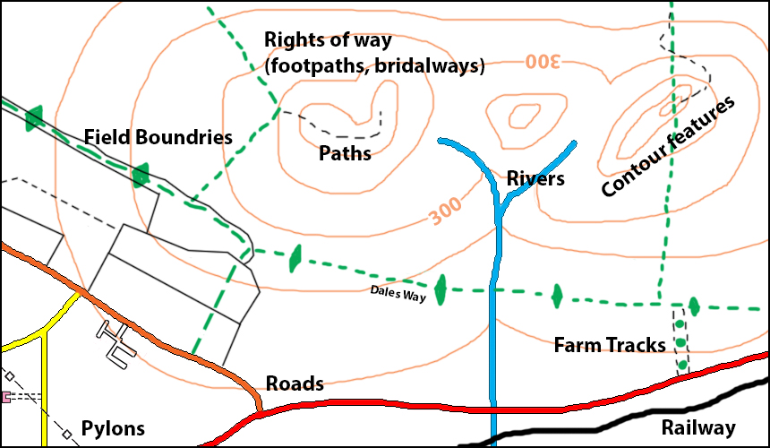
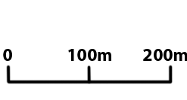
Map Features – Linear features
Introduction to OS Maps
Notes:
Ask them for examples of linear features before you click to show this map.
Key points
Roads are different colours
Different types of public rights of way
In remote country paths may not follow public rights of way.
Field boundaries (not just walls but could be hedges, fences or walls)
Contours show hills but can be linear features (ridges, valleys). Each brown circle links points at the same height above sea level. We’ll talk more about contours later.

Slide 9
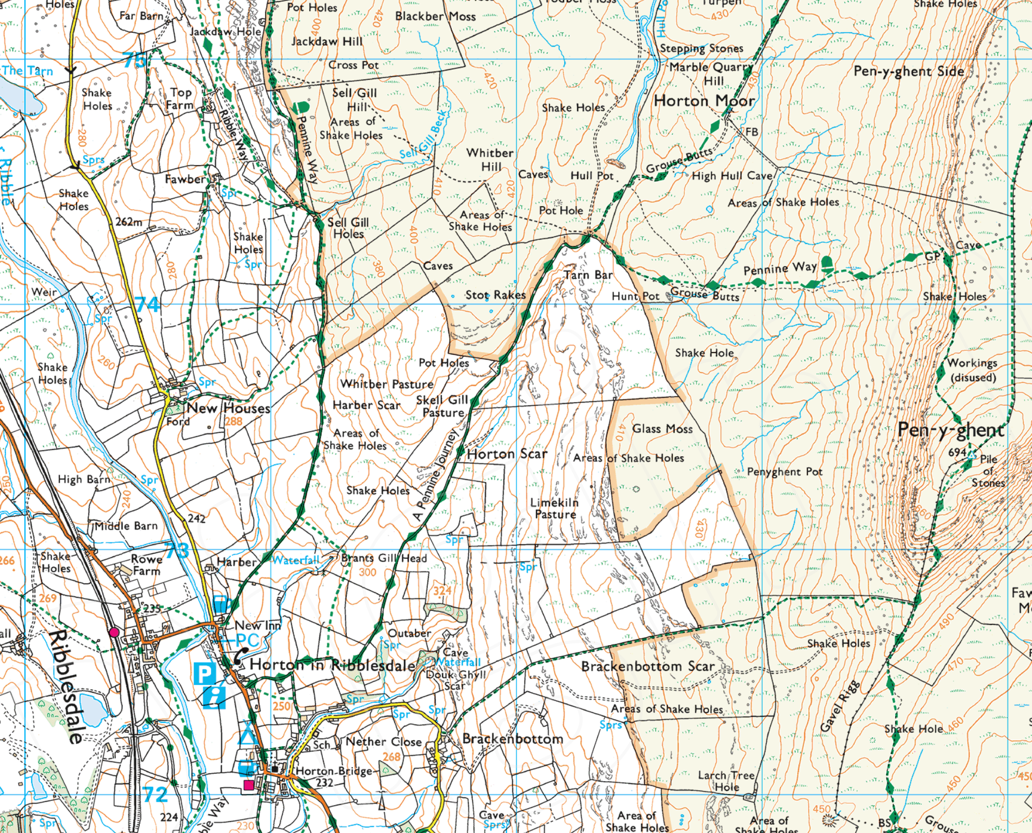
Map Features – Linear features
Introduction to OS Maps
Notes:
Show the mentioned features from the previous slide on this real map.
Maybe zoom into the slide if you know how

Slide 10
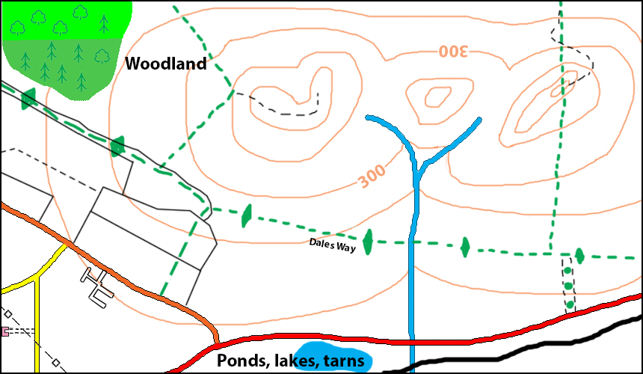
Map Features – Area features
Introduction to OS Maps
Notes:
Ask them for examples of area features before you click to show this map.
Talk about the different shades of woodland (bright green is access land)
Different types of trees

Slide 11
Map Features – Area features
Introduction to OS Maps
Notes:
Show the mentioned features from previous slide on this real map
Also mention the access land
Maybe zoom into the slide if you know how

Slide 12
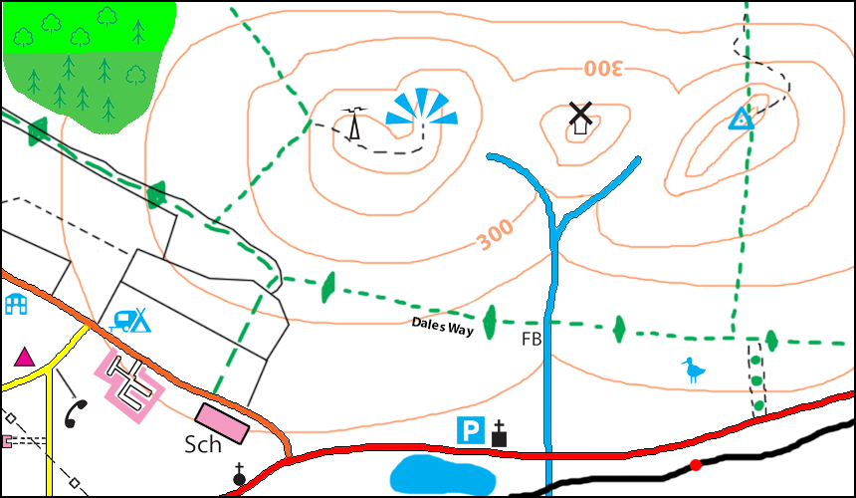
Map Features – Spot features
Introduction to OS Maps
Notes:
Ask them for examples of spot features before you click to show this map.
Identify the different features.
Mention the black line at the phone box pointing to where it is when the map it too busy
Mention that the tourist features are not always great to navigate by

Slide 13
Map Features – Spot features
Introduction to OS Maps
Notes:
Show the mentioned features from the previous slide on this real map
Maybe zoom into the slide if you know how

Slide 14
Introduction to OS Maps
What is a map?
A map is a scaled diagram of the features found in an area of land
^{© Crown copyright 2020}
Notes:
Back to our definition …
We’re now going to talk about scale.

Slide 15
Scale
Introduction to OS Maps
Ordnance Survey (OS) Explorer maps are to the scale of 1:25 000
What does 1:25 000 mean?
^{© Crown copyright 2020}
Notes:
1:25 000 means that one unit on the map is 25 000 units on the ground
1cm = 25000cm More commonly referred to as 250m

Slide 16
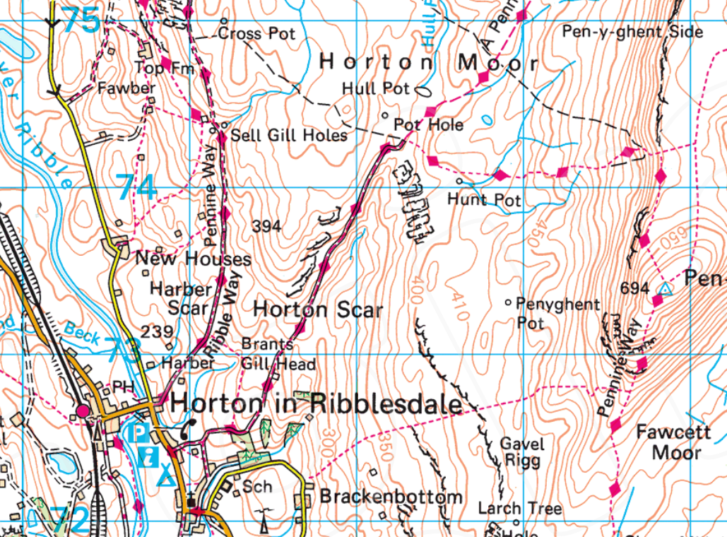
Scale
Introduction to OS Maps
75
75
74
74
73
73
72
80
81
82
83
84
1:50 000
72
80
81
82
83
84
1: 25 000
^{© Crown copyright 2020}
Notes:
You do get other Scales of maps for walkers
Two maps of the same area. What are some of the differences between them
Talk about advantages and disadvantages of each
1:50000 less cluttered, clear contours, fewer maps required
1:25000 more detail (walls) more tourist features, access land, more accurate measuring etc

Slide 17
Go to page 2 of your Workbook and answer the questions on map scales
Introduction to OS Maps
An editable PDF of the Workbook can be downloaded from https://www.lupineadventure.co.uk/downloads/dofe-downloads.html#workbook
Or Google ‘Lupine Adventure dofe downloads’
Notes:
These are just a couple of questions on what they have covered so far or visit our website for links to google and Microsoft forms to copy to your area’s and send them a link

Slide 18
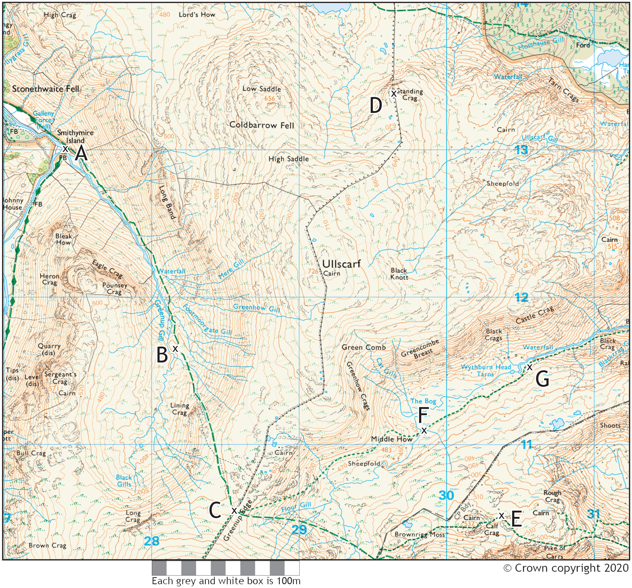
Measuring Distance
Introduction to OS Maps
1:25 000
4cm = 1km
1cm = 250m
4mm = 100m
Try measuring distances using
String
Edge of a sheet of paper
Your compass or a ruler
There is a distance measuring exercise on page 3 of your Workbook
How accurately do you think you can measure?
Notes:
They can use their workbook for this (page 3) or if they have a physical map then you could set them a challenge on that. There are some PDF’s in the ‘sample maps’ folder of areas that we work in so you may have some examples there

Slide 19
Map Familiarisation
Introduction to OS Maps
Grid lines
Legend / Key
North is at the top.
Most text is orientated top to north
They are multi purpose, there is some irrelevant information (to us) on them.
^{© Crown copyright 2020}
Notes:
Take a little time out to talk about some of these aspects.
Mention the grid lines (if you haven’t already) and how they are 1km²
The legend or key they may have used in the features exercise
Talk about orientation (north at the top)
Talk about what bits are useful to us and which bits are not so useful.
Maybe show them how to fold a map (though this could wait until the end)

Slide 20
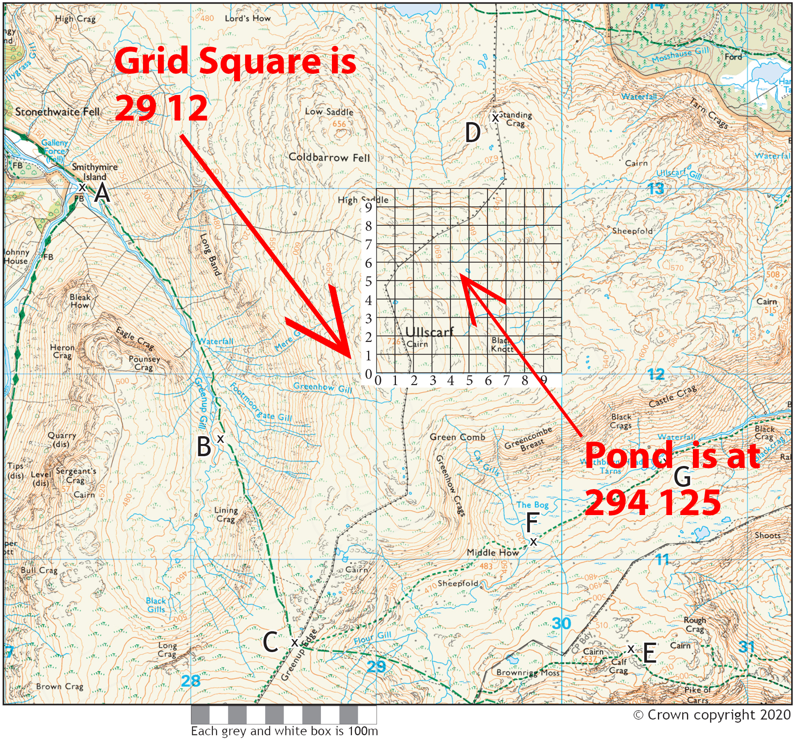
Grid References
Introduction to OS Maps
14
The grid references is a way of identifying a location on a UK map
13
Identify the bottom left hand corner of the Grid square
Get the 4 figure grid reference
First two numbers are left to right
Second two numbers are how far up
Add precision by making a 6 figure grid reference
12
11
There is a grid reference exercise on pages 2 & 3 of your Workbook
27
28
29
30
31
Notes:
They can use their workbook for this or if they have a physical map then you could set them a challenge on that. There are some PDF’s in the ‘sample maps’ folder of areas that we work in so you may have some examples there.
Mention that when it gets to 99 the next number is 0 so the 4 or 6 figure grid reference like this is not unique as it covers 100km x 100km. How many km wide do you think the UK is? (pictorial answer on next slide)

Slide 21
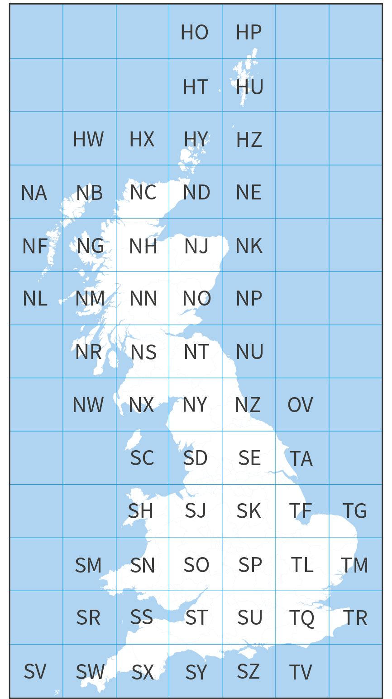
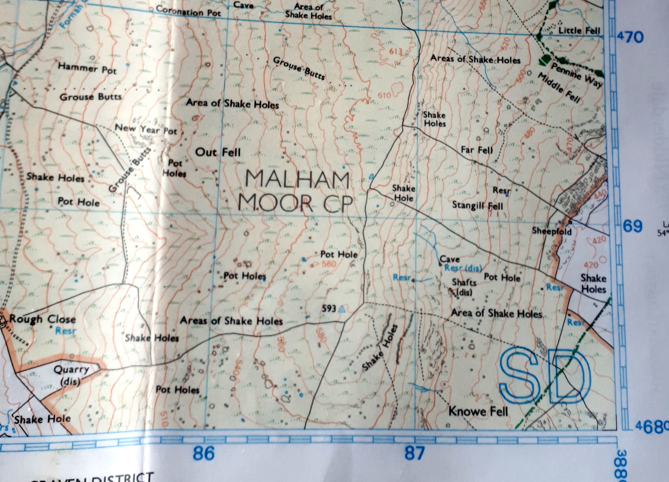
Grid
References
Introduction to OS Maps
^{© Crown copyright 2020}
Notes:
So each 4 or 6 figure grid reference refers to a point within a big square of 100km x 100km.
The picture on the left shows all of those 100km squares.
Each 100km2 has a 2 letter prefix to add to all grid references which is usually ignored. Why?
Participants will need to know these grid letters if using e-DofE to search for a point in their route planning
It can always be found in each corner of a physical map

Slide 22
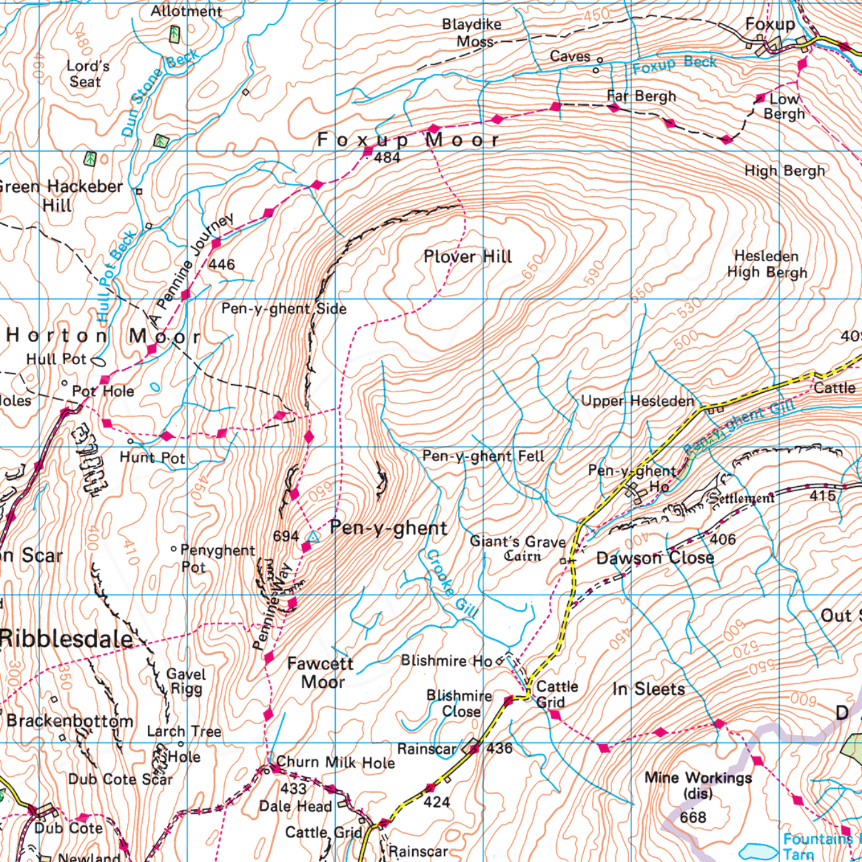
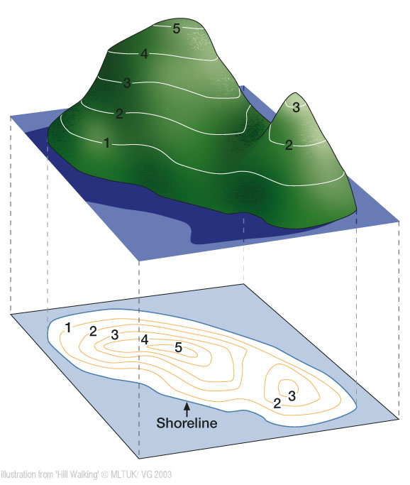
Contour Lines
Introduction to OS Maps
Contour lines show us the 3D shape of the land, they therefore tell us about hills.
They connect all points the same height above sea level on a map.
Show us where a hill is steep and where is it shallow?
There are quite a few pointers to tell us which way is uphill and which is downhill
The contour interval on an OS explorer map could be 5m or 10m
^{© Crown copyright 2020}
Notes:
We’re using a 1:50 000 map on this slide as contour lines are clearer on these maps
Which way is up? You could mention things like…
The top of brown contour line coloured height markings is up hill (most other text is top to north)
Contour lines in valleys (with streams) seem to point up hill (nice example right in the middle of the map

Slide 23
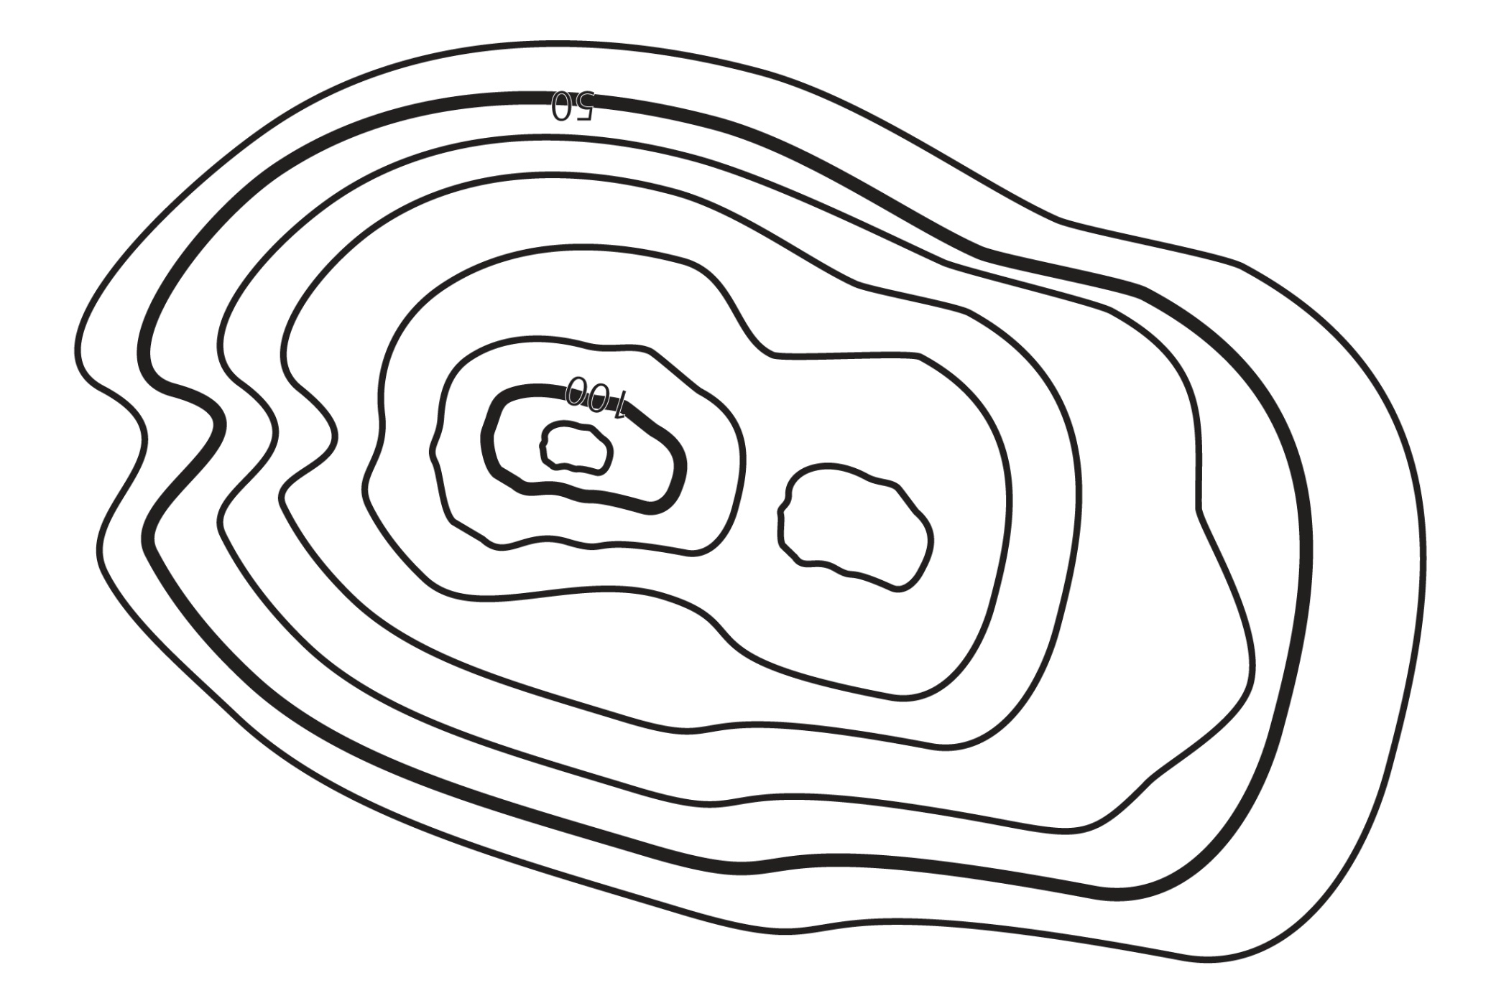
Contour Lines
Introduction to OS Maps
This contour lines exercise is on page 4 of your Workbook
Notes:
This is on page 4 of the work book. Ask them to complete this and page 5 (next slide) and then individuals can come up and show on the screen where each thing is

Slide 24
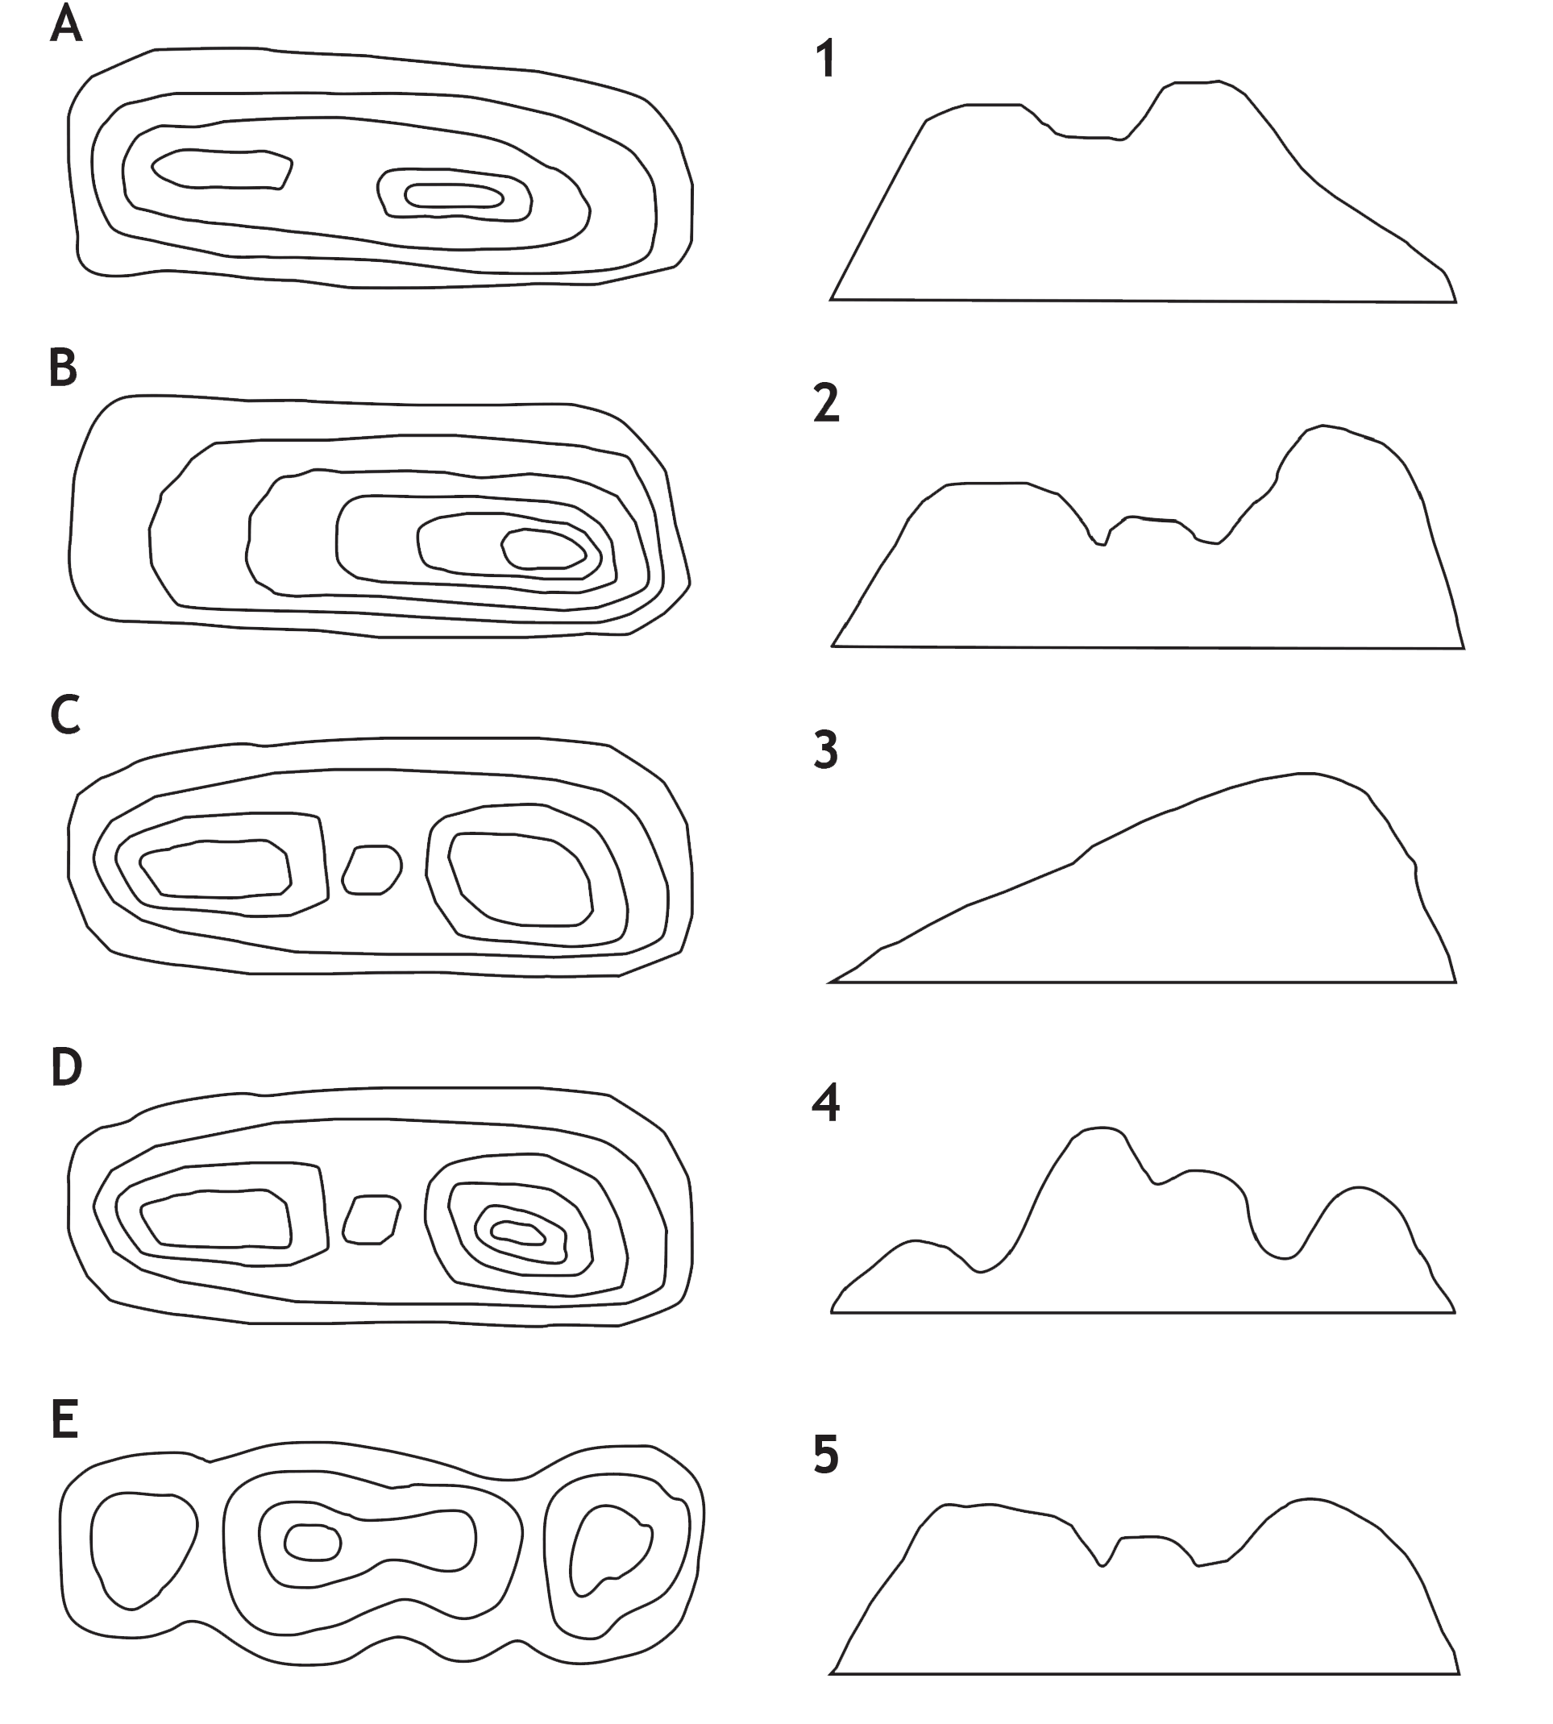
Contour Lines
Introduction to OS Maps
This contour lines exercise is on page 5 of your Workbook
There are further advanced contour lines exercises on page 6 of your Workbook
Notes:
This is on page 5 of the work book. Page 6 also has an advanced exercise on contours so you could ask them to do them too.

Slide 25
Contour Lines and route planning
Introduction to OS Maps
Walking up hill takes longer than walking on the flat
We usually add 1 minute for every 10 meters of assent
We usually ignore downhill
eDofE works all this out for you
There is a contour lines exercise regarding time taken on page 7 of your Workbook
Notes:
We need to add time for walking up hill.
We add 1 minute for each 10 m of climbing (this is sometimes one contour line and sometimes 2)
We ignore downhill, sometimes it is faster sometimes it is slower (if very steep) so we just ignore it
If you are using eDofE to plan your route it works it all out for you

Slide 26
Information for teachers and instructors
This presentation is designed for use alongside our ‘Course notes’ and ‘Workbook’ booklets, and lesson plans all of which are downloadable for free from our website https://www.lupineadventure.co.uk/downloads/dofe-downloads.html
or google ‘Lupine DofE downloads’.
The presentations are designed so that they can be used at all DofE levels simply tailor the depth that you go into each subject and maybe skip some slides accordingly.
The presentations are designed to be used in a classroom or remotely over Zoom / Teams etc. One of the versions of the Workbook is editable so you can ask students to fill this in and email to you, alternatively, on our website there are Google and Microsoft Forms relating to some lessons that you can copy to your accounts and share with students.
You are free to edit the presentation for your organisation however you wish but please don’t distribute further, we would rather you point people to our website.
If you would like to be informed of future releases then subscribe to our mailing list from our website.
If you would like early copies of, and to be involved in shaping, future resources then join our Facebook group for this purpose https://www.facebook.com/groups/859994524494945/
Lupine Adventure Co-op are an approved activity provider for the expedition section of the DofE. Please do get in touch if you would like assistance with running any part, or all of your expedition programme.

