Slide 1
DofE Expedition Training
Introduction to Expedition
Notes:
This is a brief 10-15 minute segment to make sure participants understand the requirements and purpose of expedition, know what to anticipate in training, know what skills they need to develop and have a chance to ask general questions about expedition.

Slide 2

What is Expedition?
Introduction to Expedition
6 Hours – 1 night – 6 Hours
An unaccompanied, self-reliant journey completed by your own efforts
Before your journey you must Train, Plan and Practice
An Expedition must have a Goal
Notes:
Some ideas you might want to introduce:
The Expedition is different from other sections of the Award, you have to work in a team and there’s less individual choice than other sections
Acknowledge – The Expedition may be a section you are really looking forward to or for you it might be the biggest challenge of the Duke of Edinburgh Award
The Expedition is intended to be a challenge but should also be fun. It develops and demonstrates loads of valuable skills including teamwork, perseverance, problem-solving, being organised, navigation, caring for one another and the environment.

Slide 3

What is Expedition?
Introduction to Expedition
7 Hours – Night 1 – 7 Hours – Night 2 – 7 Hours
An unaccompanied, self-reliant journey completed by your own efforts
Before your journey you must Train, Plan and Practice
An Expedition must have an Aim
Notes:
Some ideas you might want to introduce:
The Expedition is different from other sections of the Award, you have to work in a team and there’s less individual choice than other sections
Acknowledge – The Expedition may be a section you are really looking forward to or for you it might be the biggest challenge of the Duke of Edinburgh Award
The Expedition is intended to be a challenge but should also be fun. It develops and demonstrates loads of valuable skills including teamwork, perseverance, problem-solving, being organised, navigation, caring for one another and the environment.

Slide 4

What is Expedition?
Introduction to Expedition
8 Hours – Night 1 – 8 Hours - Night 2 – 8 Hours - Night 3 – 8 Hours
An unaccompanied, self-reliant journey completed by your own efforts
Before your journey you must Train, Plan and Practice
An Expedition must have an Aim
Notes:
Some ideas you might want to introduce:
The Expedition is different from other sections of the Award, you have to work in a team and there’s less individual choice than other sections
Acknowledge – The Expedition may be a section you are really looking forward to or for you it might be the biggest challenge of the Duke of Edinburgh Award
The Expedition is intended to be a challenge but should also be fun. It develops and demonstrates loads of valuable skills including teamwork, perseverance, problem-solving, being organised, navigation, caring for one another and the environment.

Slide 5
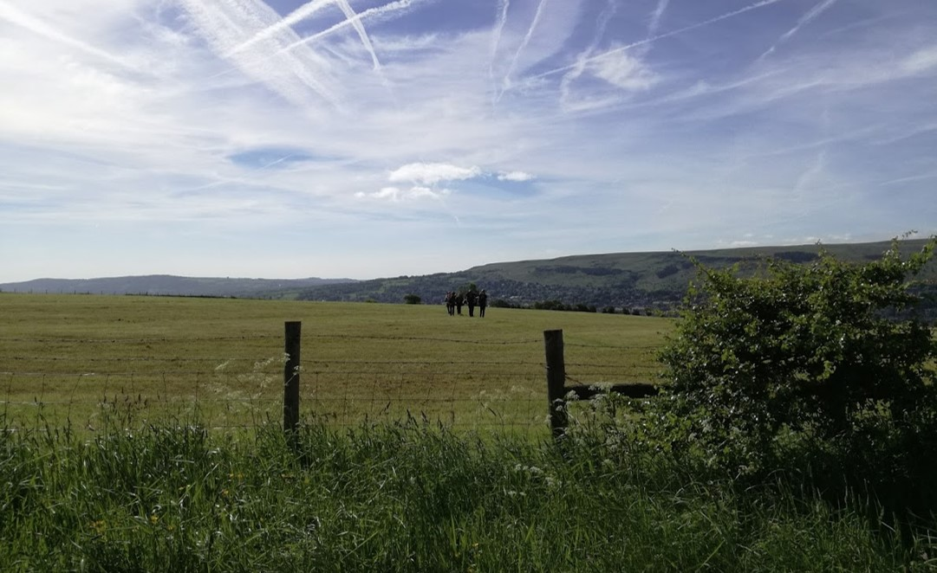
Introduction to Expedition
Notes:
Some ideas you might want to introduce:
The Expedition is different from other sections of the Award, you have to work in a team and there’s less individual choice than other sections
Acknowledge – The Expedition may be a section you are really looking forward to or for you it might be the biggest challenge of the Duke of Edinburgh Award
The Expedition is intended to be a challenge but should also be fun. It develops and demonstrates loads of valuable skills including teamwork, perseverance, problem-solving, being organised, navigation, caring for one another and the environment.

Slide 6
What’s covered in Expedition Training?
Introduction to Expedition
In the Classroom
Maps
Navigation
Food and Menu Planning
Hazards
Route Planning
Clothing and Equipment
Expedition Aims
On a training walk
More Navigation!
Campcraft
First Aid
Dealing with Emergencies
Countryside Code
Expedition Aims

Slide 7
Expedition Requirements
Introduction to Expedition
1) Expeditions must have a clearly defined team goal
2) Participants must plan an appropriate expedition menu, including cooking and eating a substantial hot meal each day (optional on the final day).
3) Participants must behave responsibly with respectfully and must understand and adhere to the Countryside, Scottish Outdoor Access, Highway and Water Sports Codes (as appropriate).
4) Expeditions must be unaccompanied and self-sufficient. The team must be properly equipped, and supervision must be carried out remotely.
5) Participants must actively participate in a debrief with their Assessor at the end of the expedition and, at Silver and Gold level, a presentation must be delivered after the expedition.
Notes:
The 20 conditions are in your course notes booklet. Most things are taken care of (time of year, size of group etc) before you go on your expedition but there are things that you need to ensure you do (or don’t do) on expedition (see 12-18)

Slide 8
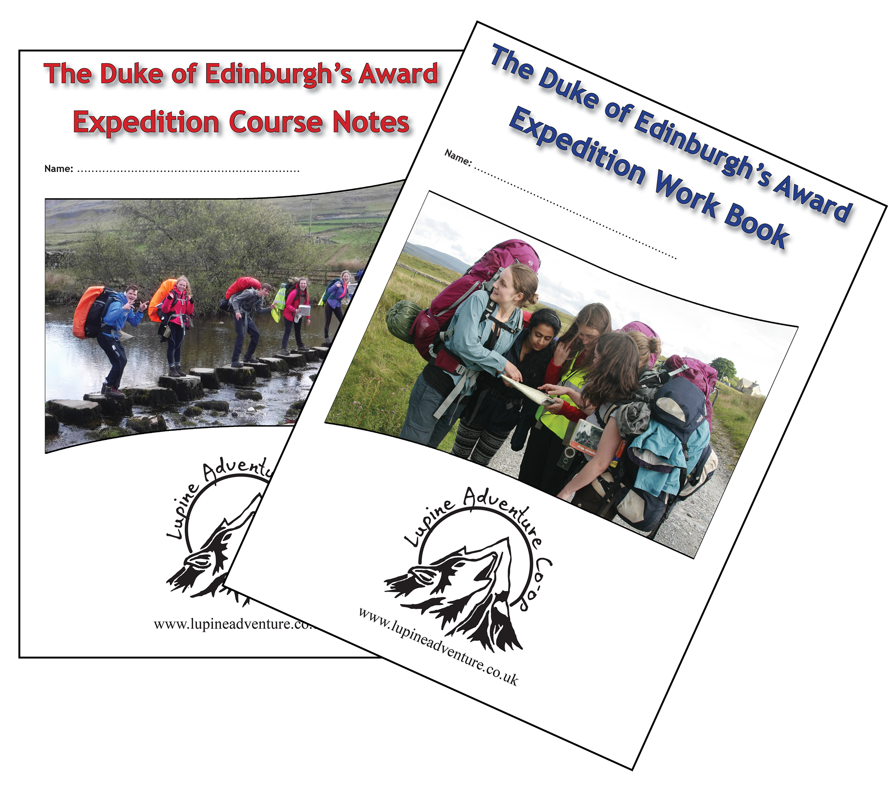
Introduction to Expedition
Further reading and exercises
Latest versions are downloadable from our website
www.lupineadventure.co.uk
Notes:
We won’t cover everything today. You are expected to read your course notes and complete the workbook in your own time.

Slide 9
Any Questions?
Introduction to Expedition
Notes:
Invite general questions about the Expedition section. Check that everyone feels confident they know what is expected of them. Avoid getting dragged into details that are covered later in the syllabus.

Slide 10
Information for teachers and instructors
This presentation is designed for use alongside our ‘Course notes’ and ‘Workbook’ booklets, and lesson plans all of which are downloadable for free from our website https://www.lupineadventure.co.uk/downloads/dofe-downloads.html
or google ‘Lupine DofE downloads’.
The presentations are designed so that they can be used at all DofE levels simply tailor the depth that you go into each subject and maybe skip some slides accordingly.
The presentations are designed to be used in a classroom or remotely over Zoom / Teams etc. One of the versions of the Workbook is editable so you can ask students to fill this in and email to you, alternatively, on our website there are Google and Microsoft Forms relating to some lessons that you can copy to your accounts and share with students.
You are free to edit the presentation for your organisation however you wish but please don’t distribute further, we would rather you point people to our website.
If you would like to be informed of future releases then subscribe to our mailing list from our website.
If you would like early copies of, and to be involved in shaping, future resources then join our Facebook group for this purpose https://www.facebook.com/groups/859994524494945/
Lupine Adventure Co-op are an approved activity provider for the expedition section of the DofE. Please do get in touch if you would like assistance with running any part, or all of your expedition programme.

