Slide 1
Duke of Edinburgh’s Award
Bronze First Aid Training
Week 1

Slide 2
Purposes of First Aid
Preserve life
Prevent further injury
Promote recovery

Slide 3
Principles of First Aid
Stay calm
Assess the situation
Carry out a primary survey – D R A B
Identify the injury or illness

Slide 4
Principles of First Aid cont
Give easy, appropriate and adequate treatment in a sensible order of priority -
Breathing, Bleeding, Burns, Bones
If casualty is not breathing & you need to commence CPR, call for help before you start
Organise removal of casualty to secondary care where appropriate
Make and pass on a report

Slide 5
Most Common Expedition Injuries
Blisters
Cuts & abrasions
Burns & scalds
Sprains

Slide 6
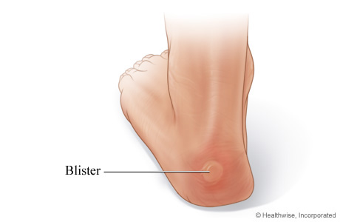
Blisters
Prevention:
Ensure footwear is broken in
Wear good walking socks, clean & dry
Change into dry socks & different footwear at campsite
STOP IMMEDIATELY if you begin to feel discomfort
Treatment:
If friction but no blister – cover affected & surrounding area with plaster, moleskin or other thin adhesive tape
If blister has developed, pad it & apply clean dressing

Slide 7
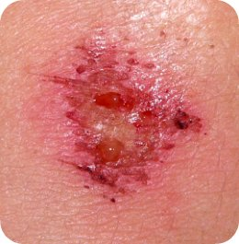
Minor Cuts & Abrasions
Treatment:
Clean with fresh water, ideally running and cold
Do not use cotton wool as this can leave traces in the wound
Use a plaster or bandage depending on size of wound

Slide 8
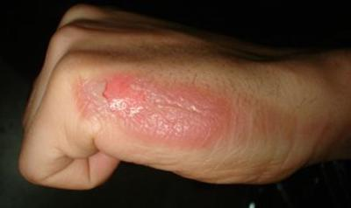
Minor Burns & Scalds
Prevention:
Always take care when cooking
Always place the stove on the ground, never on a picnic table or other elevated surface
Ensure the whole group is aware of hot pans and boiling water
Avoid spillages
Always take burns seriously and report to a supervisor
Treatment:
Immerse in cold, running water for at least 10 mins
Remove any rings from fingers, watches or bracelets from wrists
Cover with a sterile, non-fluffy dressing, clear cling film or small plastic bag
DO NOT apply creams, lotions or fat to the injury

Slide 9
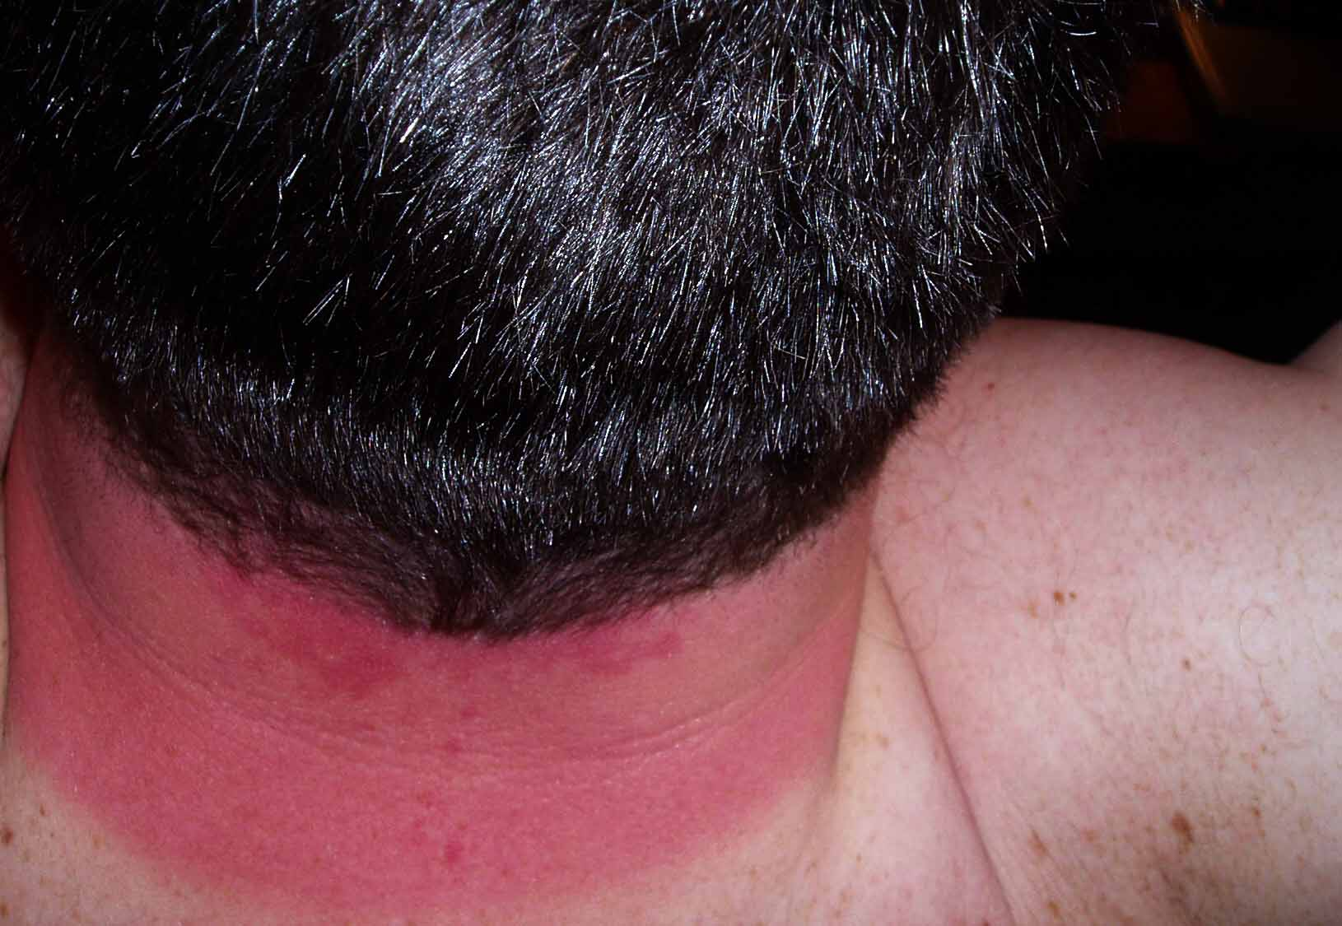
Sunburn
Prevention:
Cover up
Apply water-resistant sun block every few hours
Treatment:
Treat as a minor burn and inform your supervisor

Slide 10
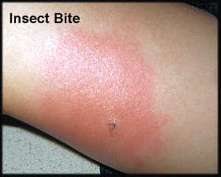
Insect Bites
Prevention:
Use insect repellent
Treatment:
Keep clean and treat as minor abrasion
Some people suffer a reaction to bites – report this to your supervisor
If known to suffer a reaction, keep anti-histamine cream or tablets in your personal first aid kit and use as necessary

Slide 11
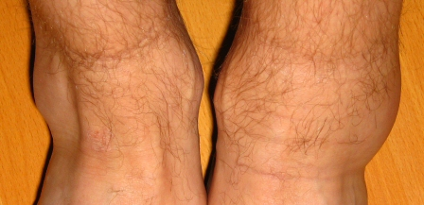
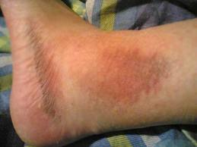
Sprains
Treatment:
R
I
C
E
est
ce
ompression
levation
Stop and rest
Apply a damp towel or t-shirt to help reduce swelling
Elevate injured limb to reduce swelling
If the pain does not ease, treat as a more serious sprain or fracture

Slide 12
Thank you for listening
Any questions?

