Slide 1
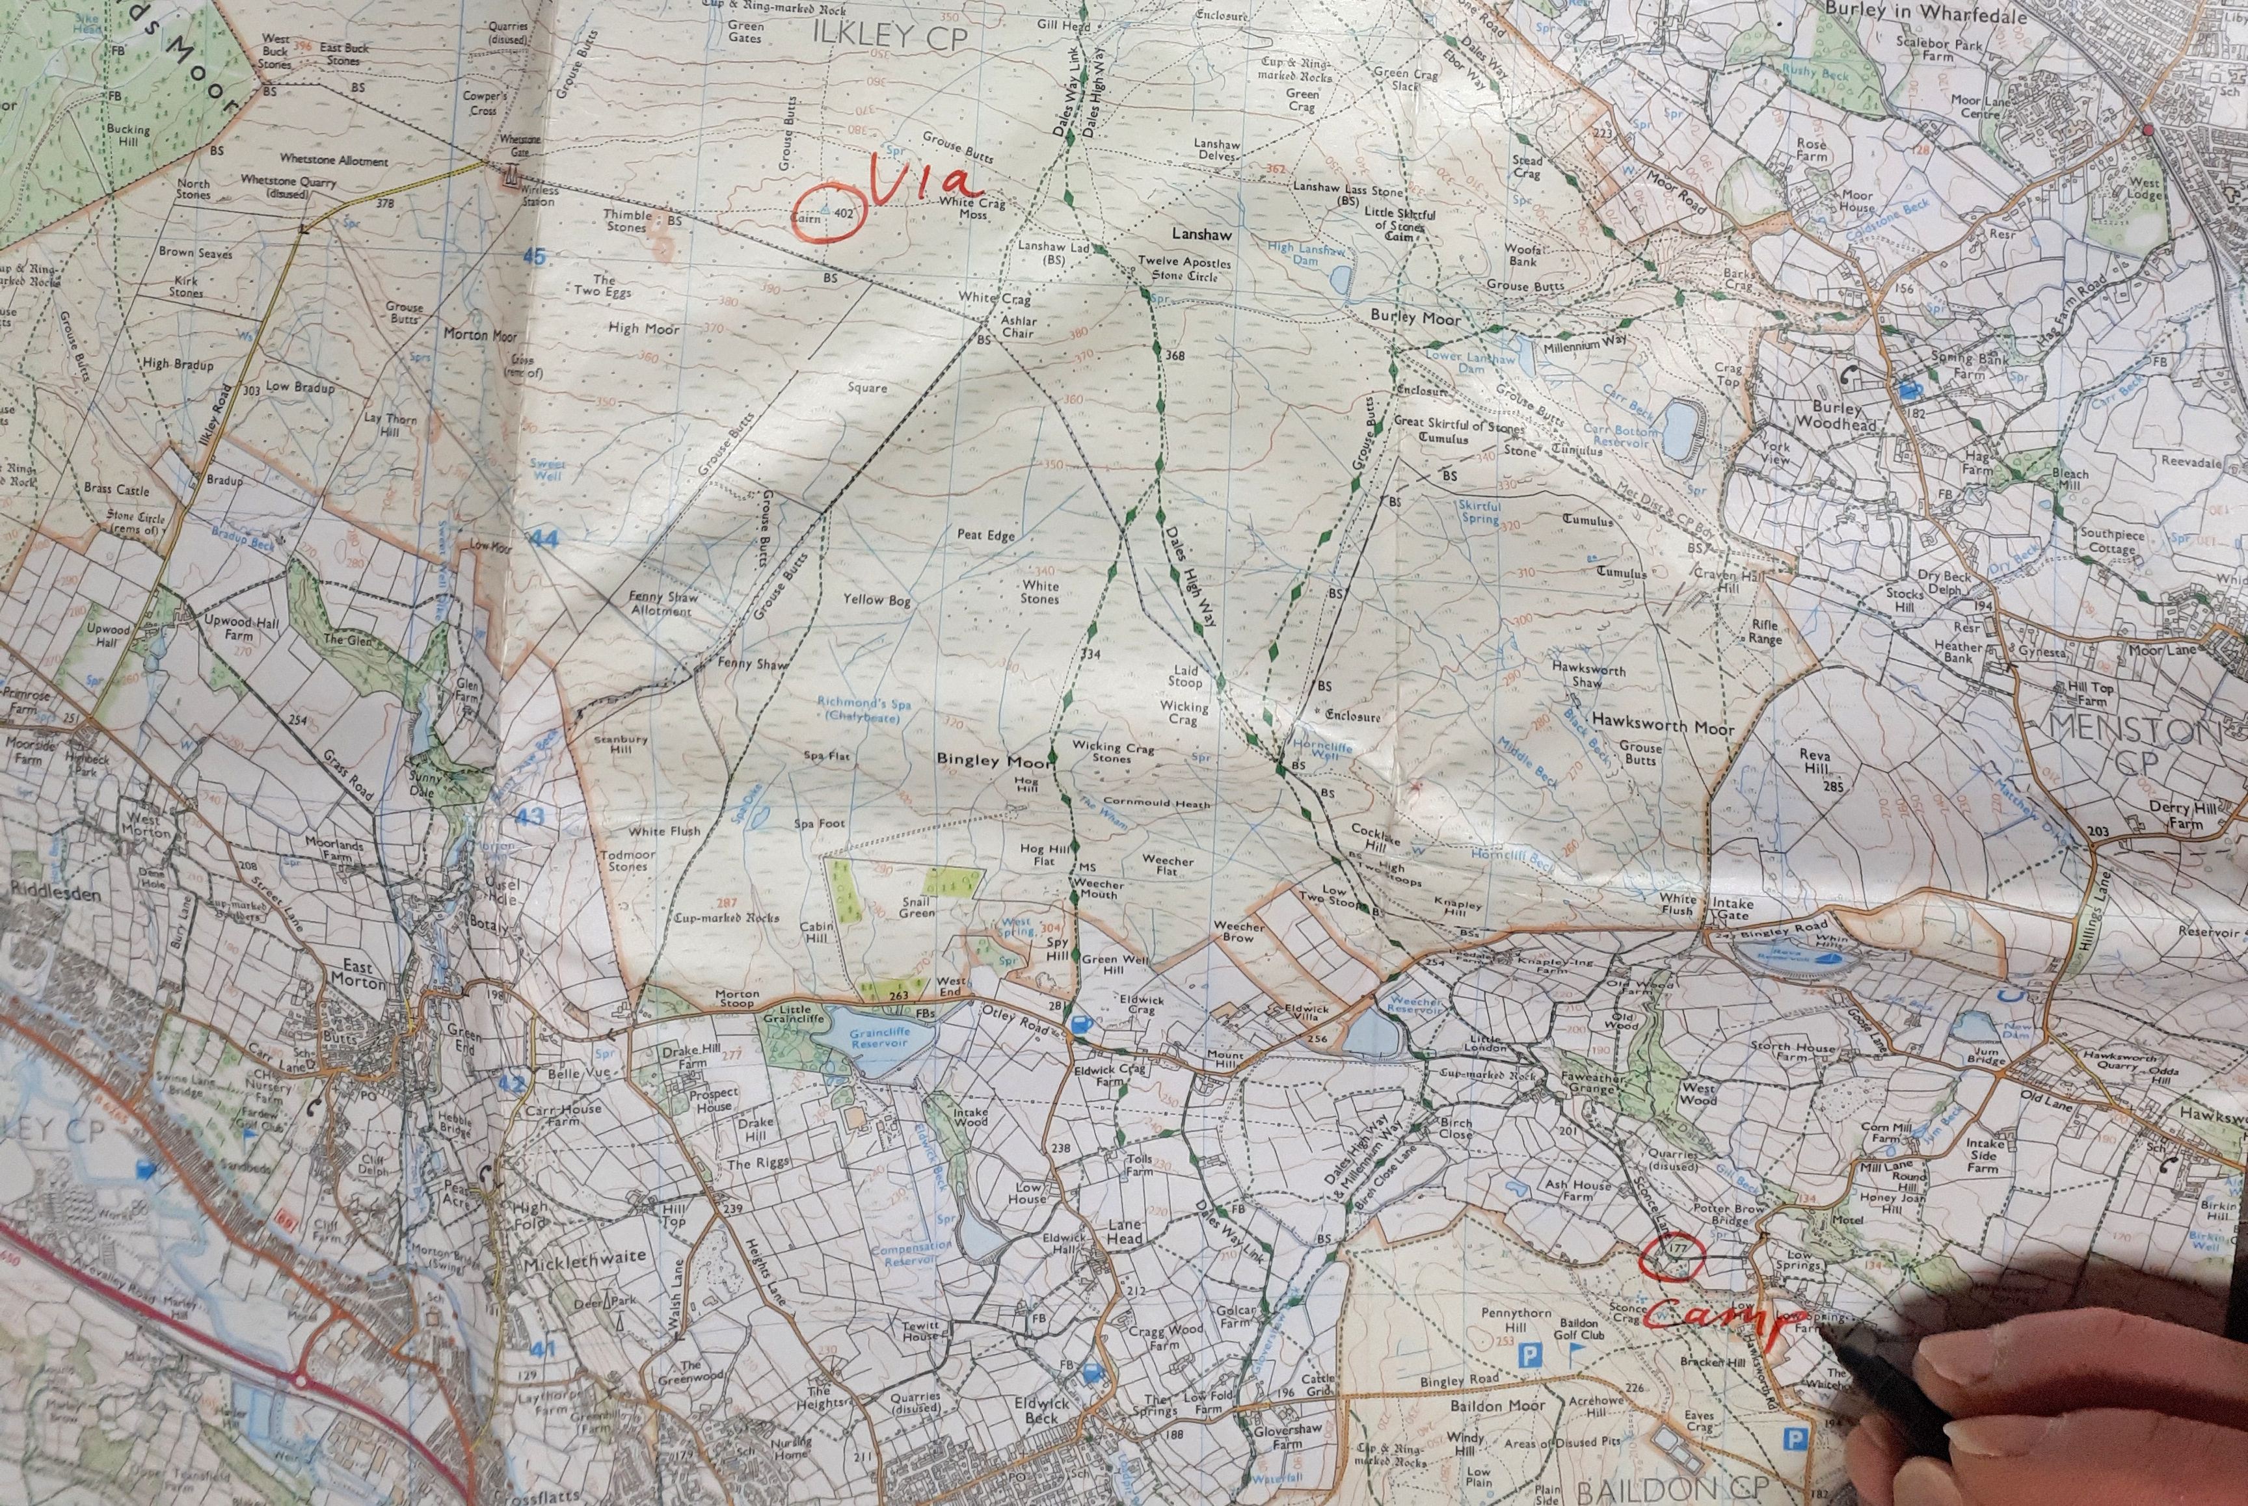
Planning a route using a paper map

Slide 2
Route planning using a paper map
Why route plan?
To ensure that a viable route exists
To ensure that you are out for the required amount of time
To ensure you aren’t out for too long
To make sure you take in places of interest
Why make a route card?
So your supervisor knows roughly where you are
To help you to navigate and keep to time when walking
So that the DofE know who is out and where in case of incidents

Slide 3
Route planning using a paper map
Equipment required
Map
Details of your day’s start, finish and via points
Expected distance to travel
Long piece of string
Whiteboard marker
Permanent marker
Blank route card (ideally on a computer with Excel)
Dates and times of your expedition

Slide 4
Plotting a route
Route planning using a paper map
Mark your map with the day’s start, end and via points

Slide 5
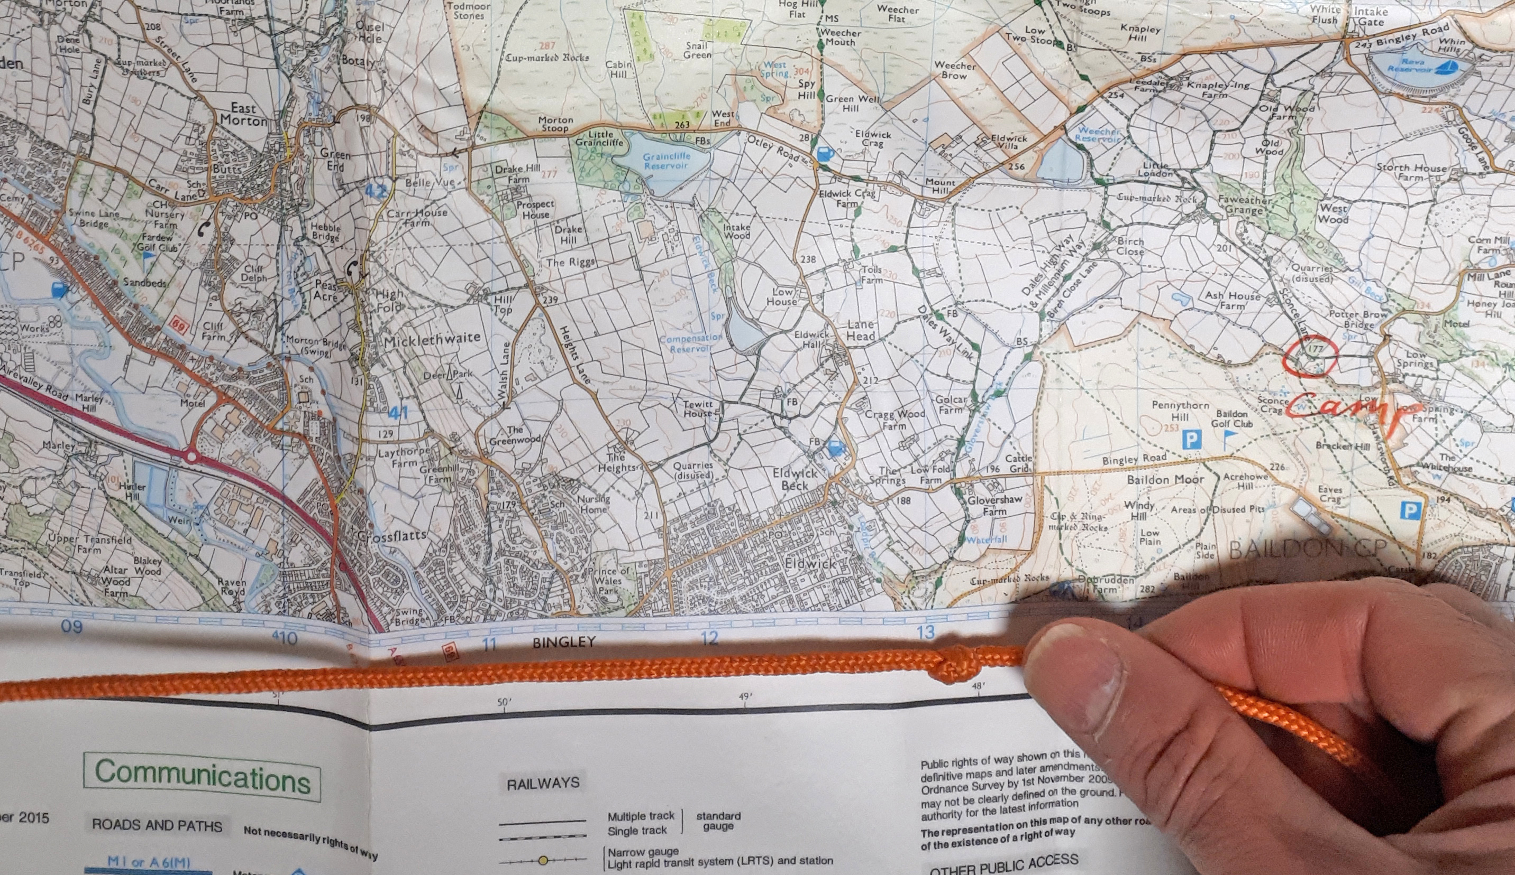
Plotting a route
Route planning using a paper map
Mark your map with the day’s start, end and via points
Knot a piece of string to suitable length for your day
Notes:
Looks like this string is probably knotted at 13km assuming the other end is being held at the 00 grid reference. Don’t stretch the string but hold it so it is slack

Slide 6
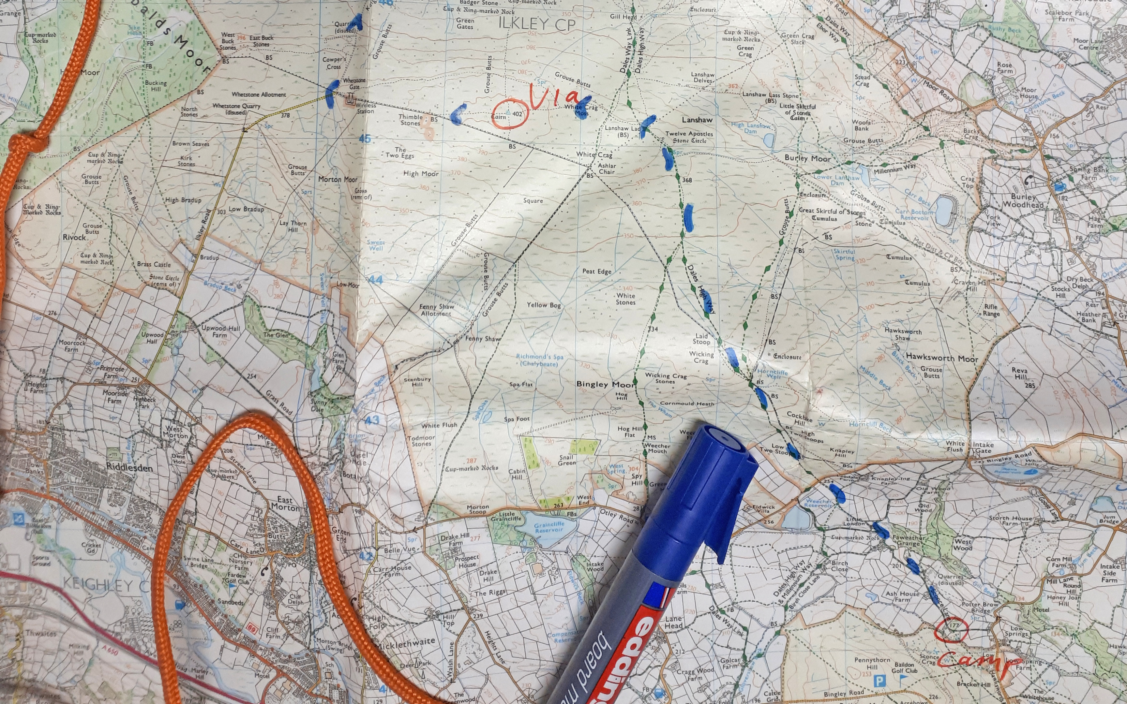
Plotting a route – marking your route
Route planning using a paper map
Mark your map with the day’s start, end and via points
Knot a piece of string to suitable length for your day
Mark your intended route on map with whiteboard marker using your string to ensure it is a suitable length
Notes:
Hold the start of the string at the start point and wiggle it around the route you intend to take marking it with the whiteboard marker as you go. If you need to lengthen or shorten it wipe out the marker and do that bit again. Be careful not to stretch the string

Slide 7
Route planning using a paper map
Plotting a route
Mark your map with the day’s start, end and via points
Knot a piece of string to suitable length for your day
Mark your intended route on map with whiteboard marker
Ask staff to check it
Notes:
If you don’t get it checked now and it is too short or long or not on public rights of way you will have to correct it and the rest of the exercise later

Slide 8
Route planning using a paper map
Plotting a route
Mark your map with the day’s start, end and via points
Knot a piece of string to suitable length for your day
Mark your intended route on map with whiteboard marker
Ask staff to check it
Split into legs
Notes:
You need probably need 4 or 5 legs a per day. If possible choose points where you will definitely know where you are or where you have a decision to make or change direction.

Slide 9
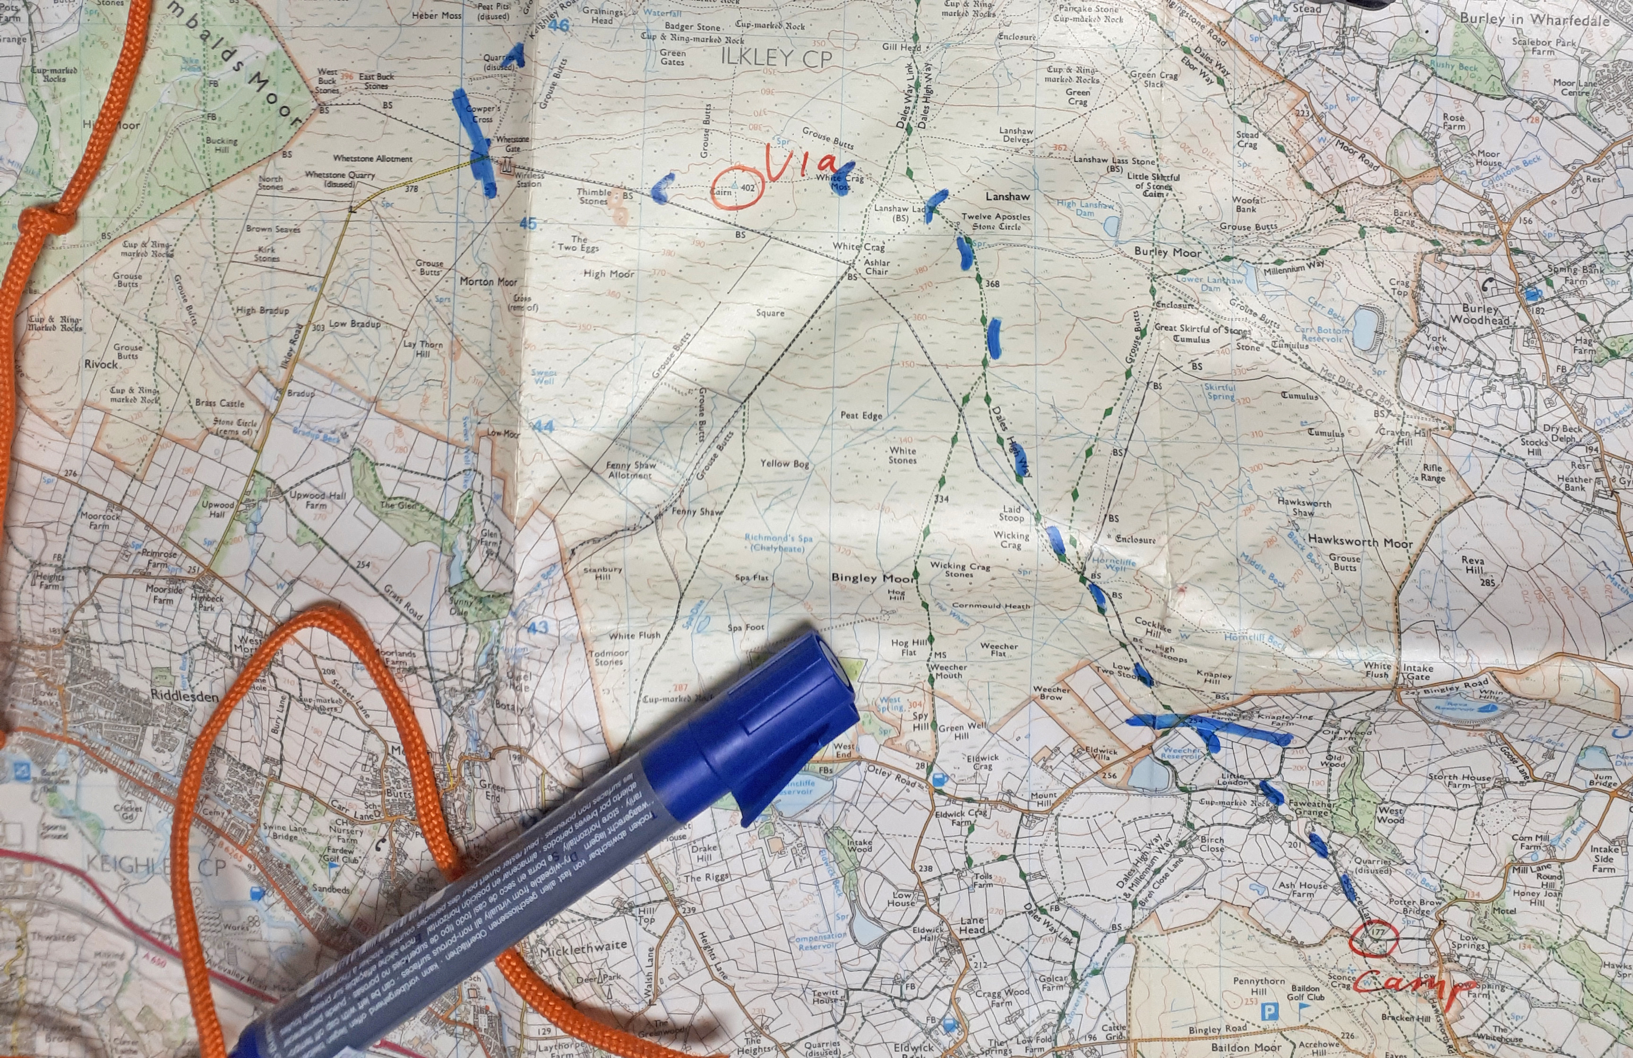
Route planning using a paper map
Plotting a route – Splitting into legs
Mark your map with the day’s start, end and via points
Knot a piece of string to suitable length for your day
Mark your intended route on map with whiteboard marker
Ask staff to check it
Split into legs

Slide 10
Route planning using a paper map
Plotting a route
Mark your map with the day’s start, end and via points
Knot a piece of string to suitable length for your day
Mark your intended route on map with whiteboard marker
Ask staff to check it
Split into legs
Ask staff to check the legs

Slide 11
Route planning using a paper map
Plotting a route
Mark your map with the day’s start, end and via points
Knot a piece of string to suitable length for your day
Mark your intended route on map with whiteboard marker
Ask staff to check it
Split into legs
Ask staff to check the legs
Fill in route card

Slide 12
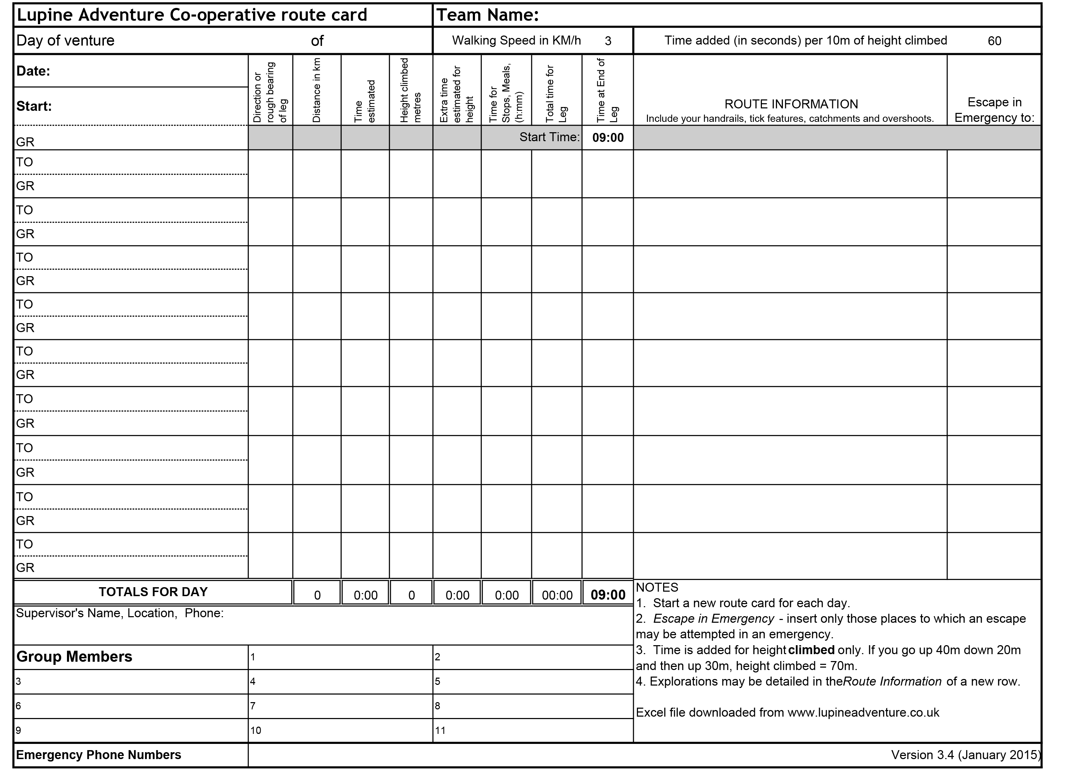
Route planning using a paper map
Fill in a route card
Notes:
This is a route card. This version is an excel file that you can download from our website. It does a lot of the maths for you
You complete one route card per day and one row of the route card per leg.

Slide 13
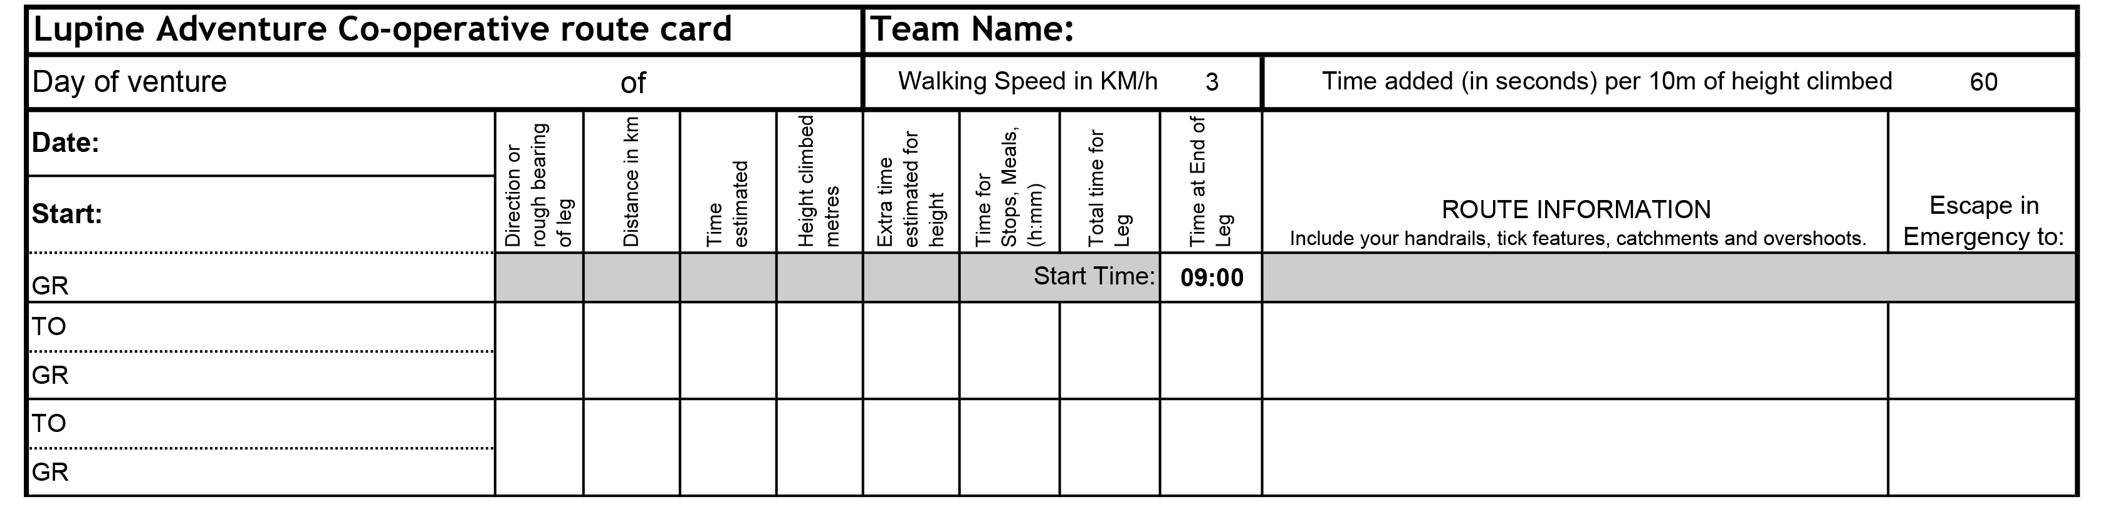
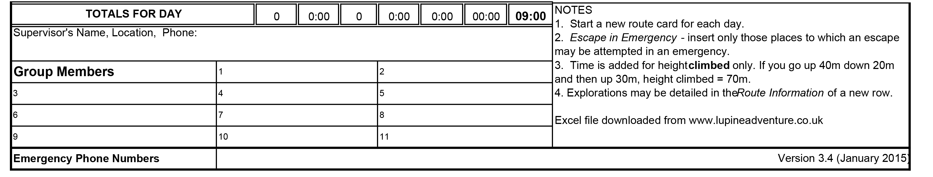
Route planning using a paper map
Fill in a route card
Notes:
Start by giving your team a name and completing the first 3 rows. If you don’t know your walking speed leave it at 3km / hour and 60 seconds per 10 meters climb
Next to ‘start:’ (in the first column 4th row) write a description of the start point (camp site in this instance)
In the GR under it put the grid reference of the start point.
Put in a sensible start time.
For each row point out what to put in each column (next to ‘To:’ put a description and ‘GR’ is the grid reference
For route information they can describe the route or list key features where they will know where they are and in order.
Escape in emergency to: put the name of a farm or village or road that you might go to for help if necessary
At the end adjust the times for stops and meals to ensure that the time requirement is fulfilled
Fill in the bottom rows

Slide 14
Route planning using a paper map
Fill in a route card

Slide 15
Route planning using a paper map
Plotting a route
Mark your map with the day’s start, end and via points
Knot a piece of string to suitable length for your day
Mark your intended route on map with whiteboard marker
Ask staff to check it
Split into legs
Ask staff to check the legs
Fill in route card
Replace whiteboard marker with permanent marker
Notes:
Go along the route rubbing out the whiteboard marker with permanent marker, use little arrows, the less ink you put on the map the better as you’ll be obscuring less detail

Slide 16
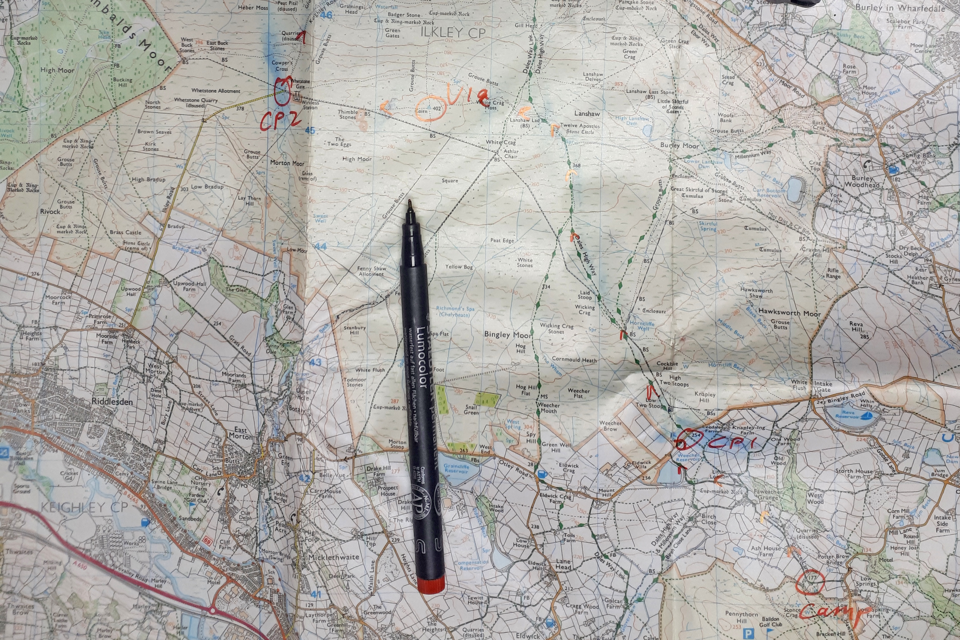
Route planning using a paper map
Plotting a route – Permanent marking
Mark your map with the day’s start, end and via points
Knot a piece of string to suitable length for your day
Mark your intended route on map with whiteboard marker
Ask staff to check it
Split into legs
Ask staff to check the legs
Fill in route card
Replace whiteboard marker with permanent marker
Notes:
Go along the route rubbing out the whiteboard marker with permanent marker, use little arrows, the less ink you put on the map the better as you’ll be obscuring less detail

Slide 17
Route planning using a paper map
Plotting a route
Mark your map with the day’s start, end and via points
Knot a piece of string to suitable length for your day
Mark your intended route on map with whiteboard marker
Ask staff to check it
Split into legs
Ask staff to check the legs
Fill in route card
Replace whiteboard marker with permanent marker
Notes:
Split the group so they can work on multiple days at once.
This slide is to leave up with the process on while they do it

Slide 18
Information for teachers and instructors
This presentation is designed for use alongside our ‘Course notes’ and ‘Workbook’ booklets, and lesson plans all of which are downloadable for free from our website https://www.lupineadventure.co.uk/downloads/dofe-downloads.html
or google ‘Lupine DofE downloads’.
The presentations are designed so that they can be used at all DofE levels simply tailor the depth that you go into each subject and maybe skip some slides accordingly.
The presentations are designed to be used in a classroom or remotely over Zoom / Teams etc. One of the versions of the Workbook is editable so you can ask students to fill this in and email to you, alternatively, on our website there are Google and Microsoft Forms relating to some lessons that you can copy to your accounts and share with students.
You are free to edit the presentation for your organisation however you wish but please don’t distribute further, we would rather you point people to our website.
If you would like to be informed of future releases then subscribe to our mailing list from our website.
If you would like early copies of, and to be involved in shaping, future resources then join our Facebook group for this purpose https://www.facebook.com/groups/859994524494945/
Lupine Adventure Co-op are an approved activity provider for the expedition section of the DofE. Please do get in touch if you would like assistance with running any part, or all of your expedition programme.

